Slide 1

Step into Safely
Image Resources Session 7

Slide 2
Session 7
Staying Safe on the Footpath

Slide 3
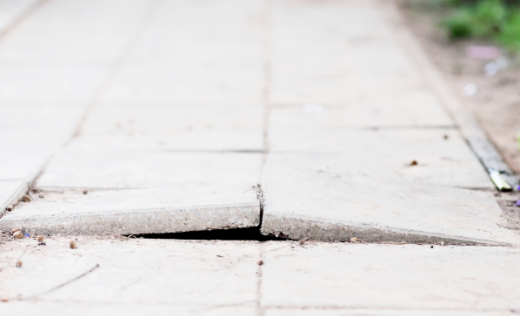

Slide 4
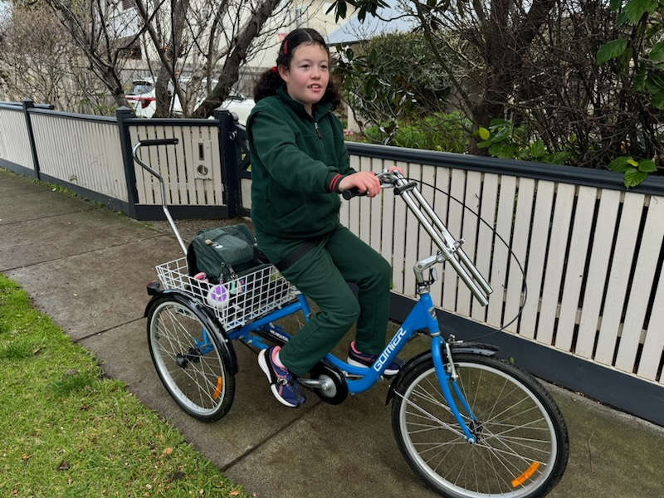

Slide 5
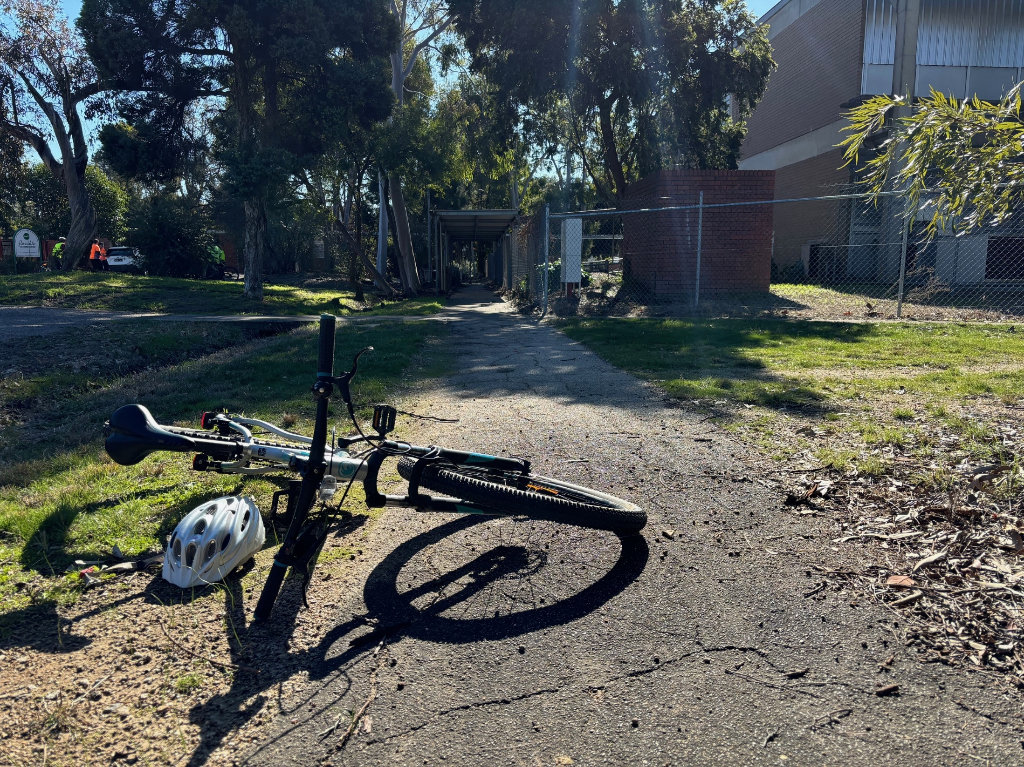

Slide 6
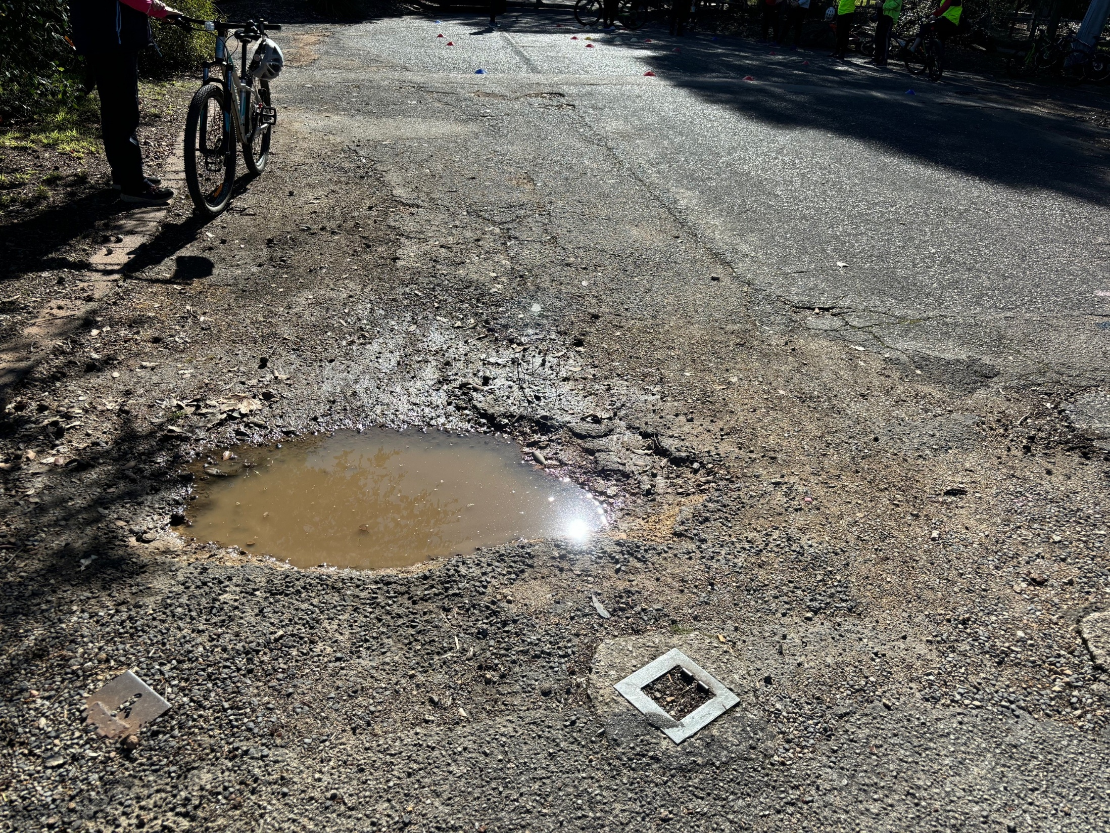

Slide 7
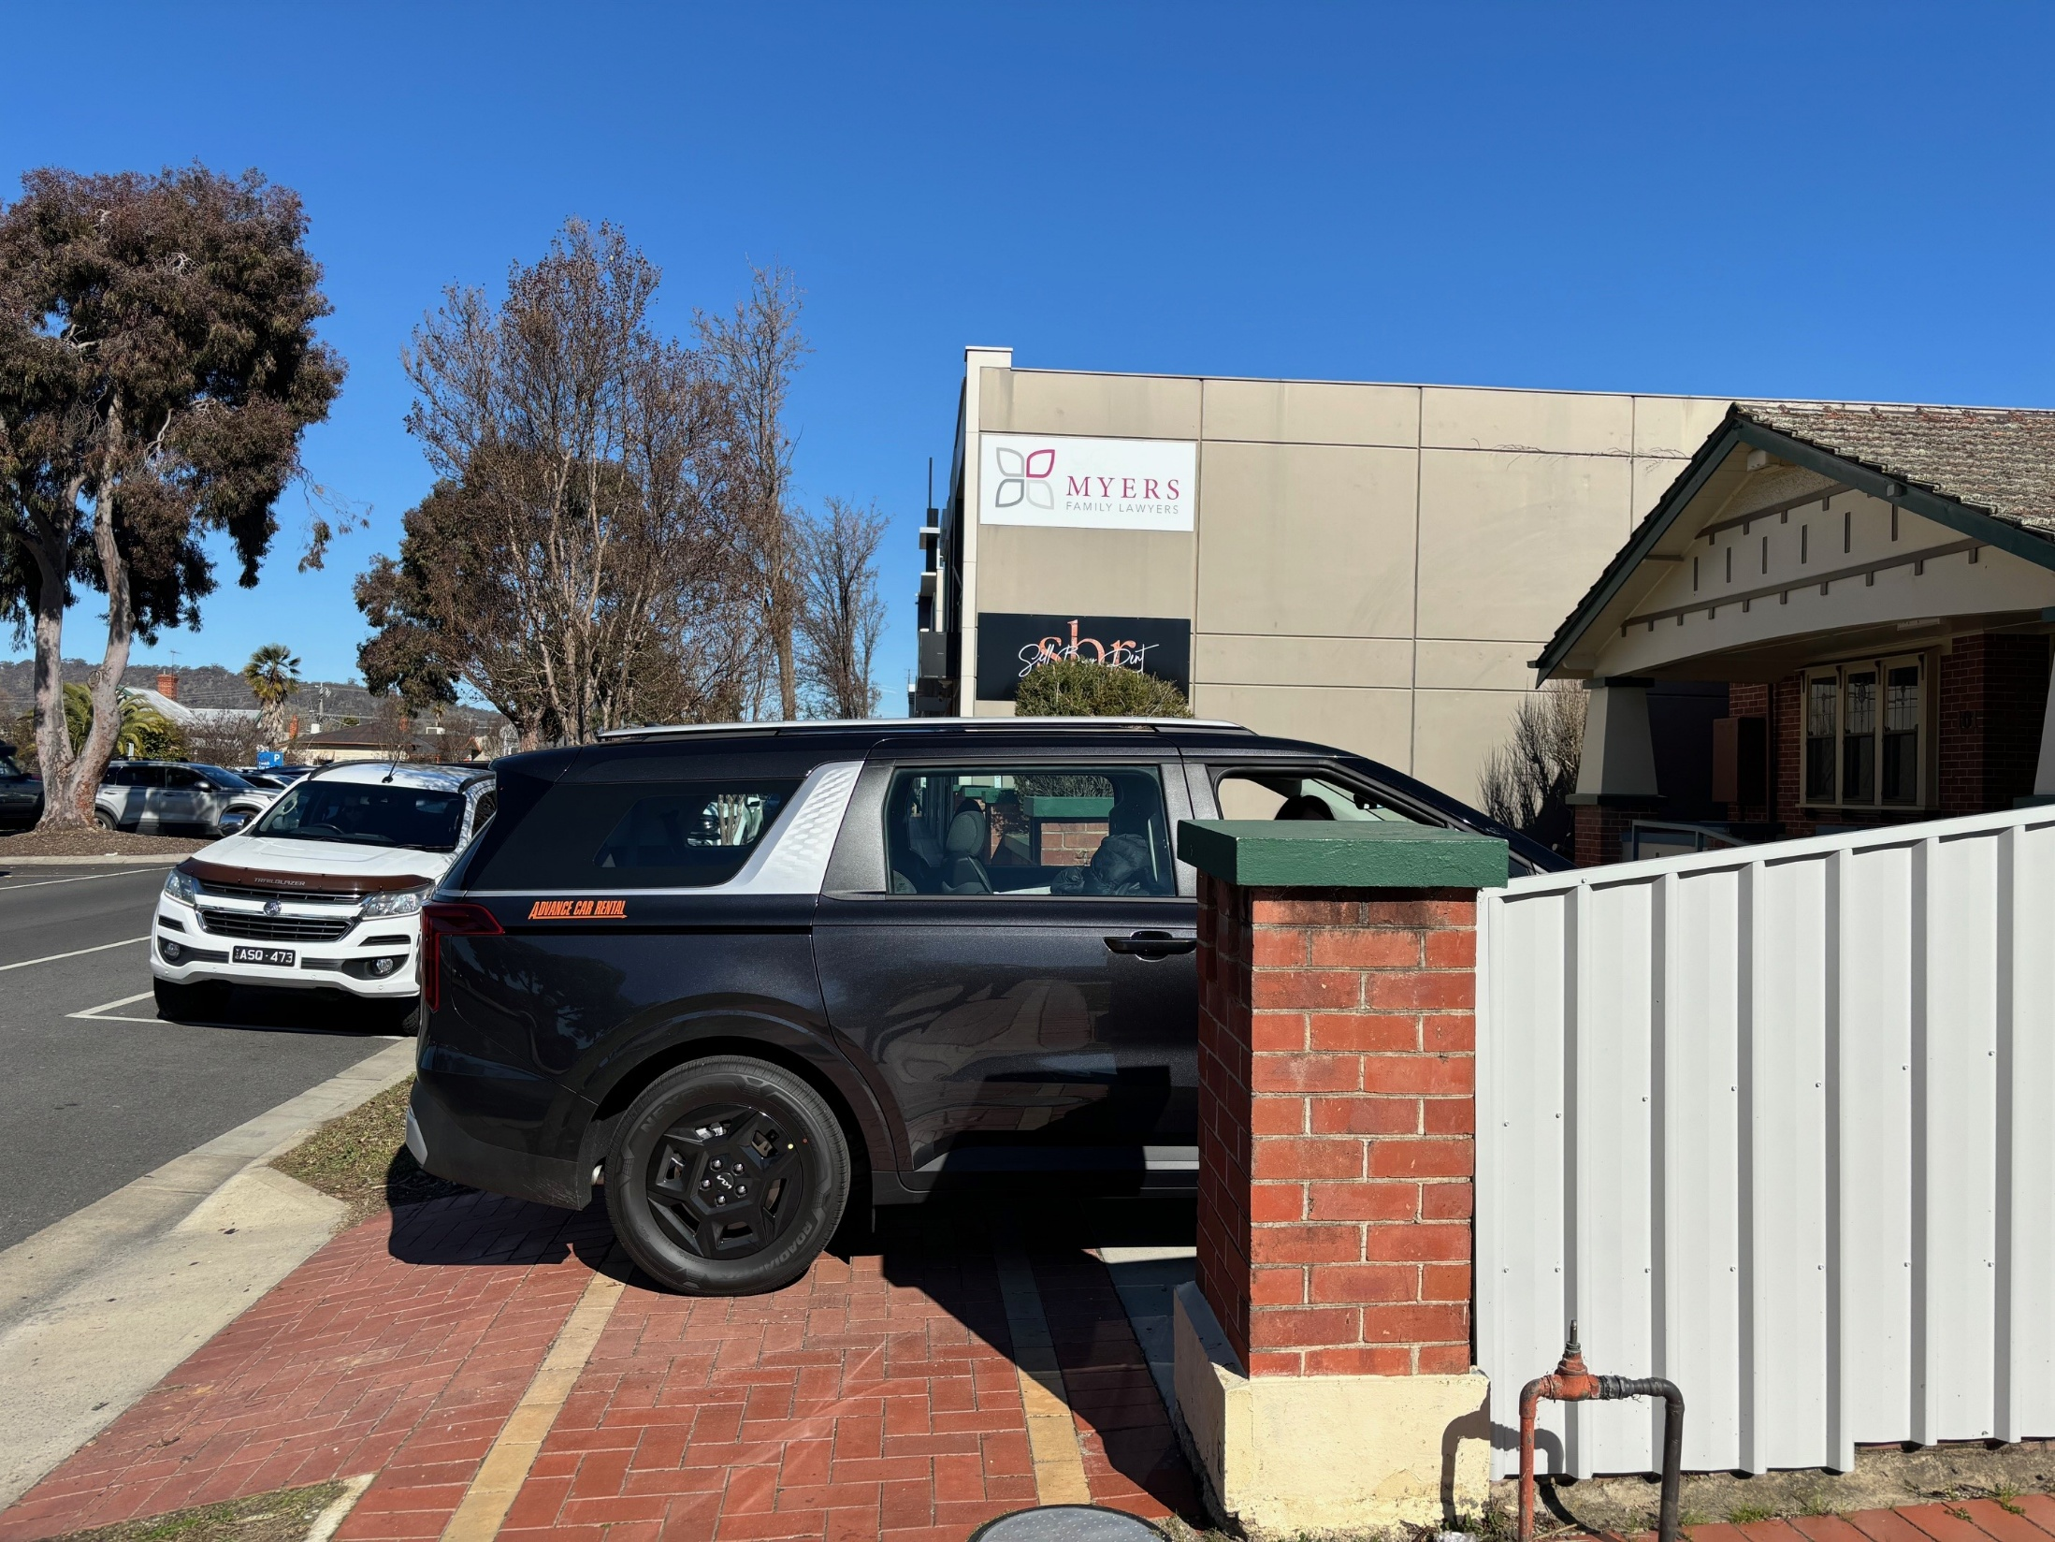

Slide 8
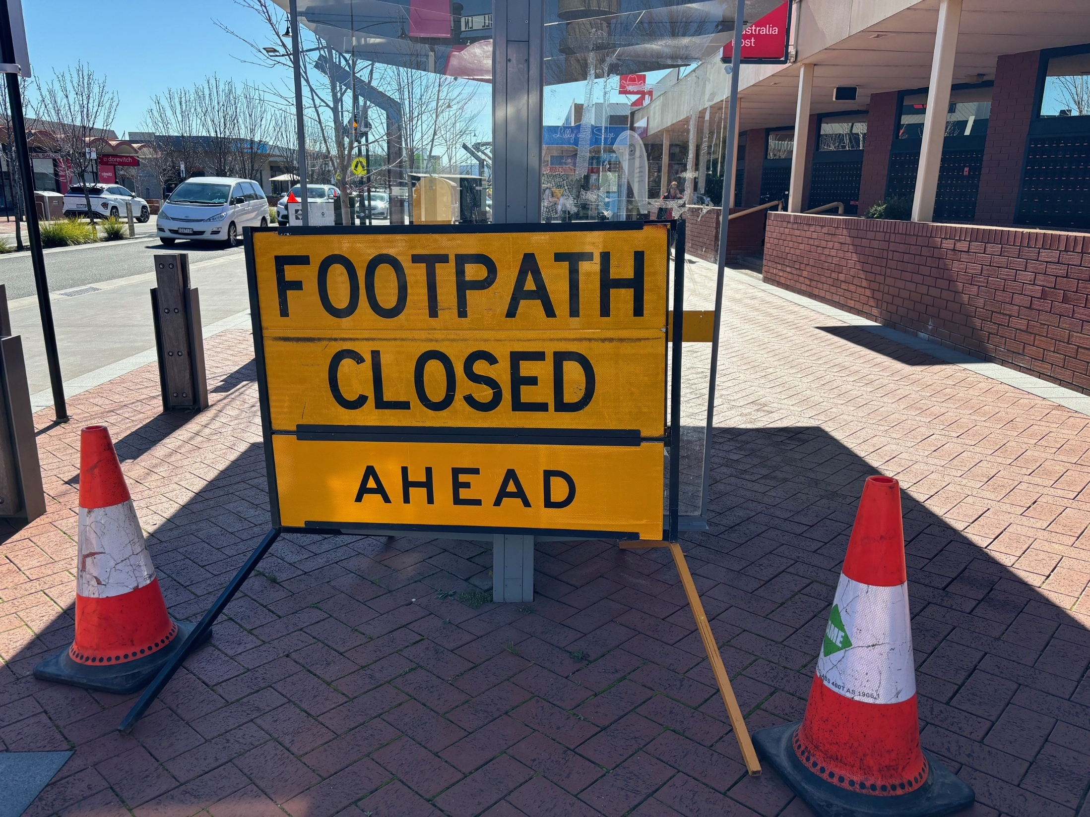

Slide 9
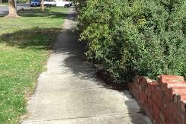

Slide 10
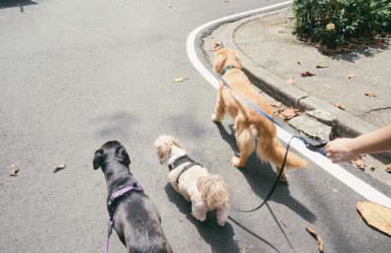
Notes:
Use this image to discuss that whilst it’s perfectly fine and common for people to walk dogs, they can be a hazard for pedestrians on the footpath.

