Slide 1

Step into Safely
Image Resources Session 3

Slide 2
Session 3
Safe and Unsafe and Our Choices in the Local Road Area

Slide 3
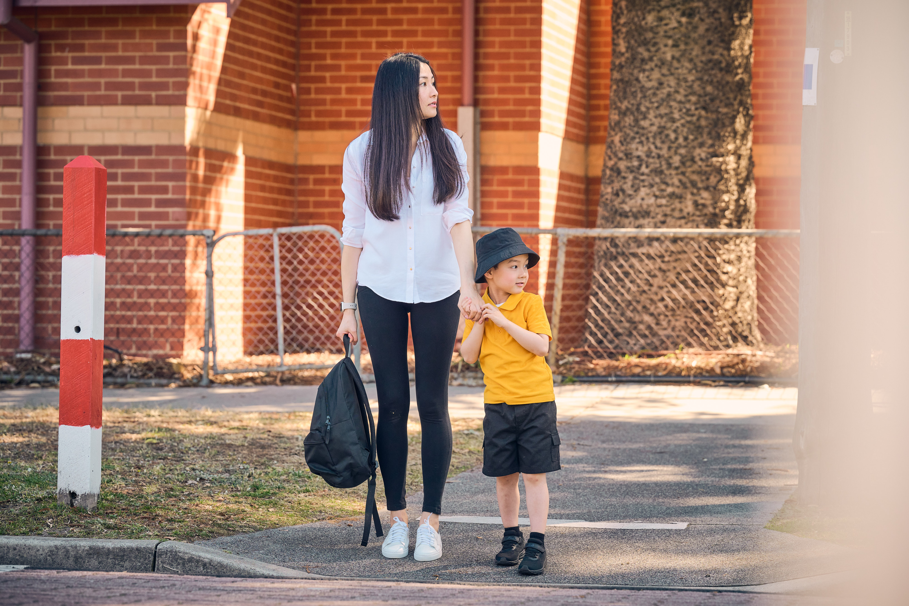
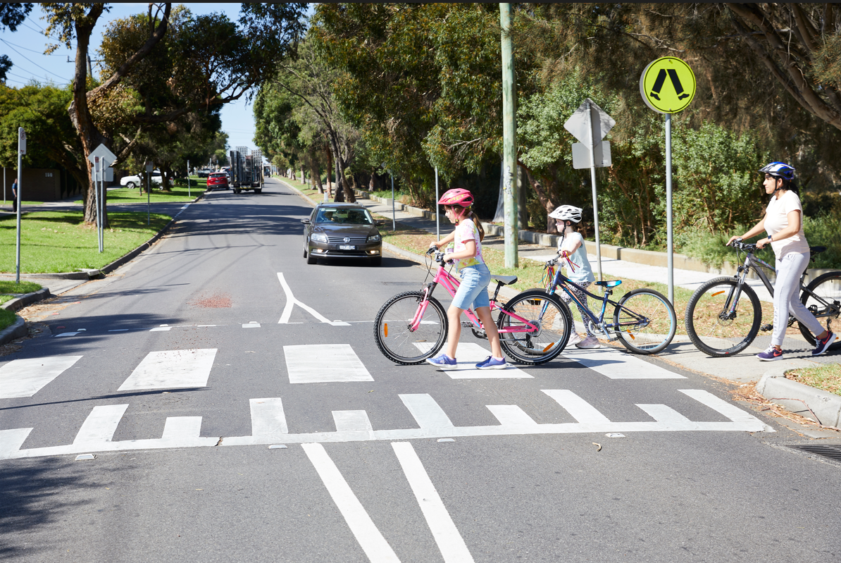
Notes:
SAFE- Use this image to discuss the importance of holding an adult’s hand, and crossing at the safest location

Slide 4
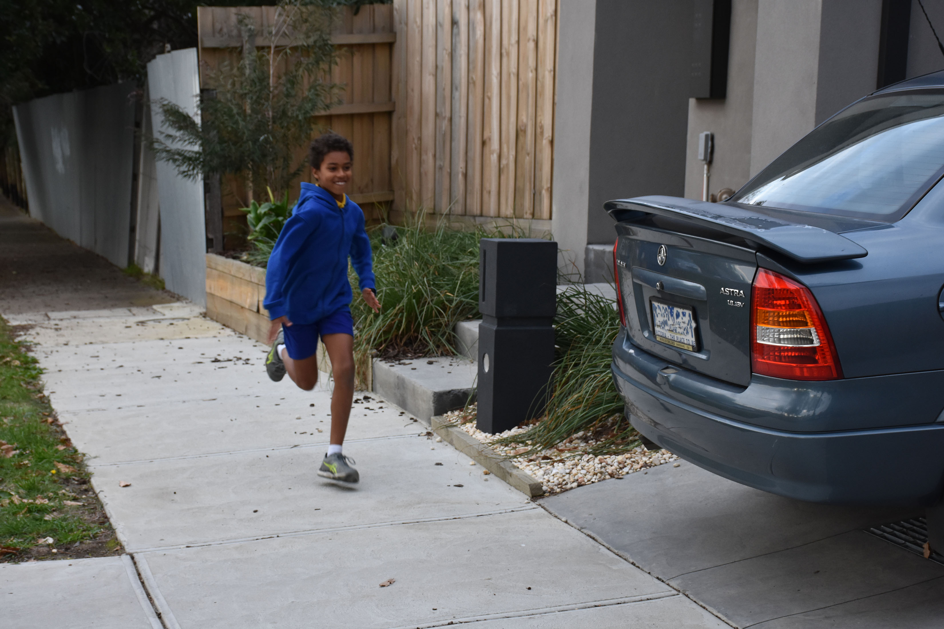
Notes:
UNSAFE- Use this image to discuss the dangers of running on the footpath, particularly past driveways

Slide 5
Notes:
SAFE- Use this image to discuss the importance of wearing a helmet, walking bikes across the road and crossing at the safest location

Slide 6
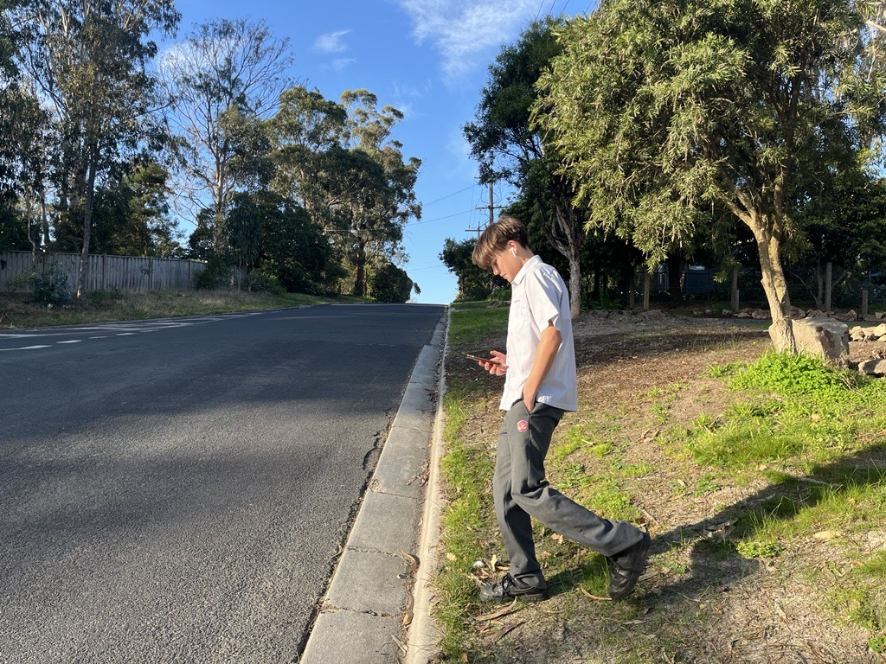
Notes:
UNSAFE- Use this image to discuss the importance of being alert near roads and not being distracted by devices. Note that he is looking at a phone and has earphones in his ears

Slide 7
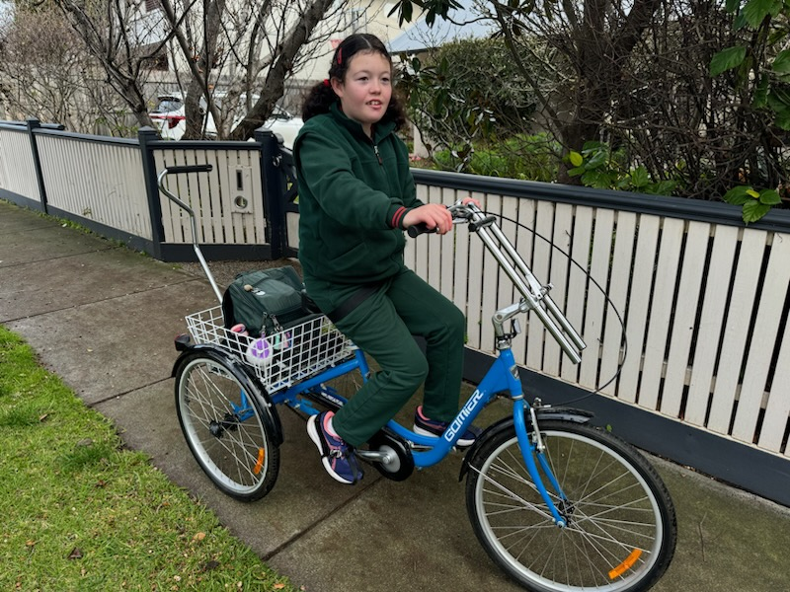
Notes:
UNSAFE- use this image to discuss the fact that whilst riding bikes on the footpath is safe and legal for people below 12 years old, this image is UNSAFE because she is not wearing a helmet.

Slide 8
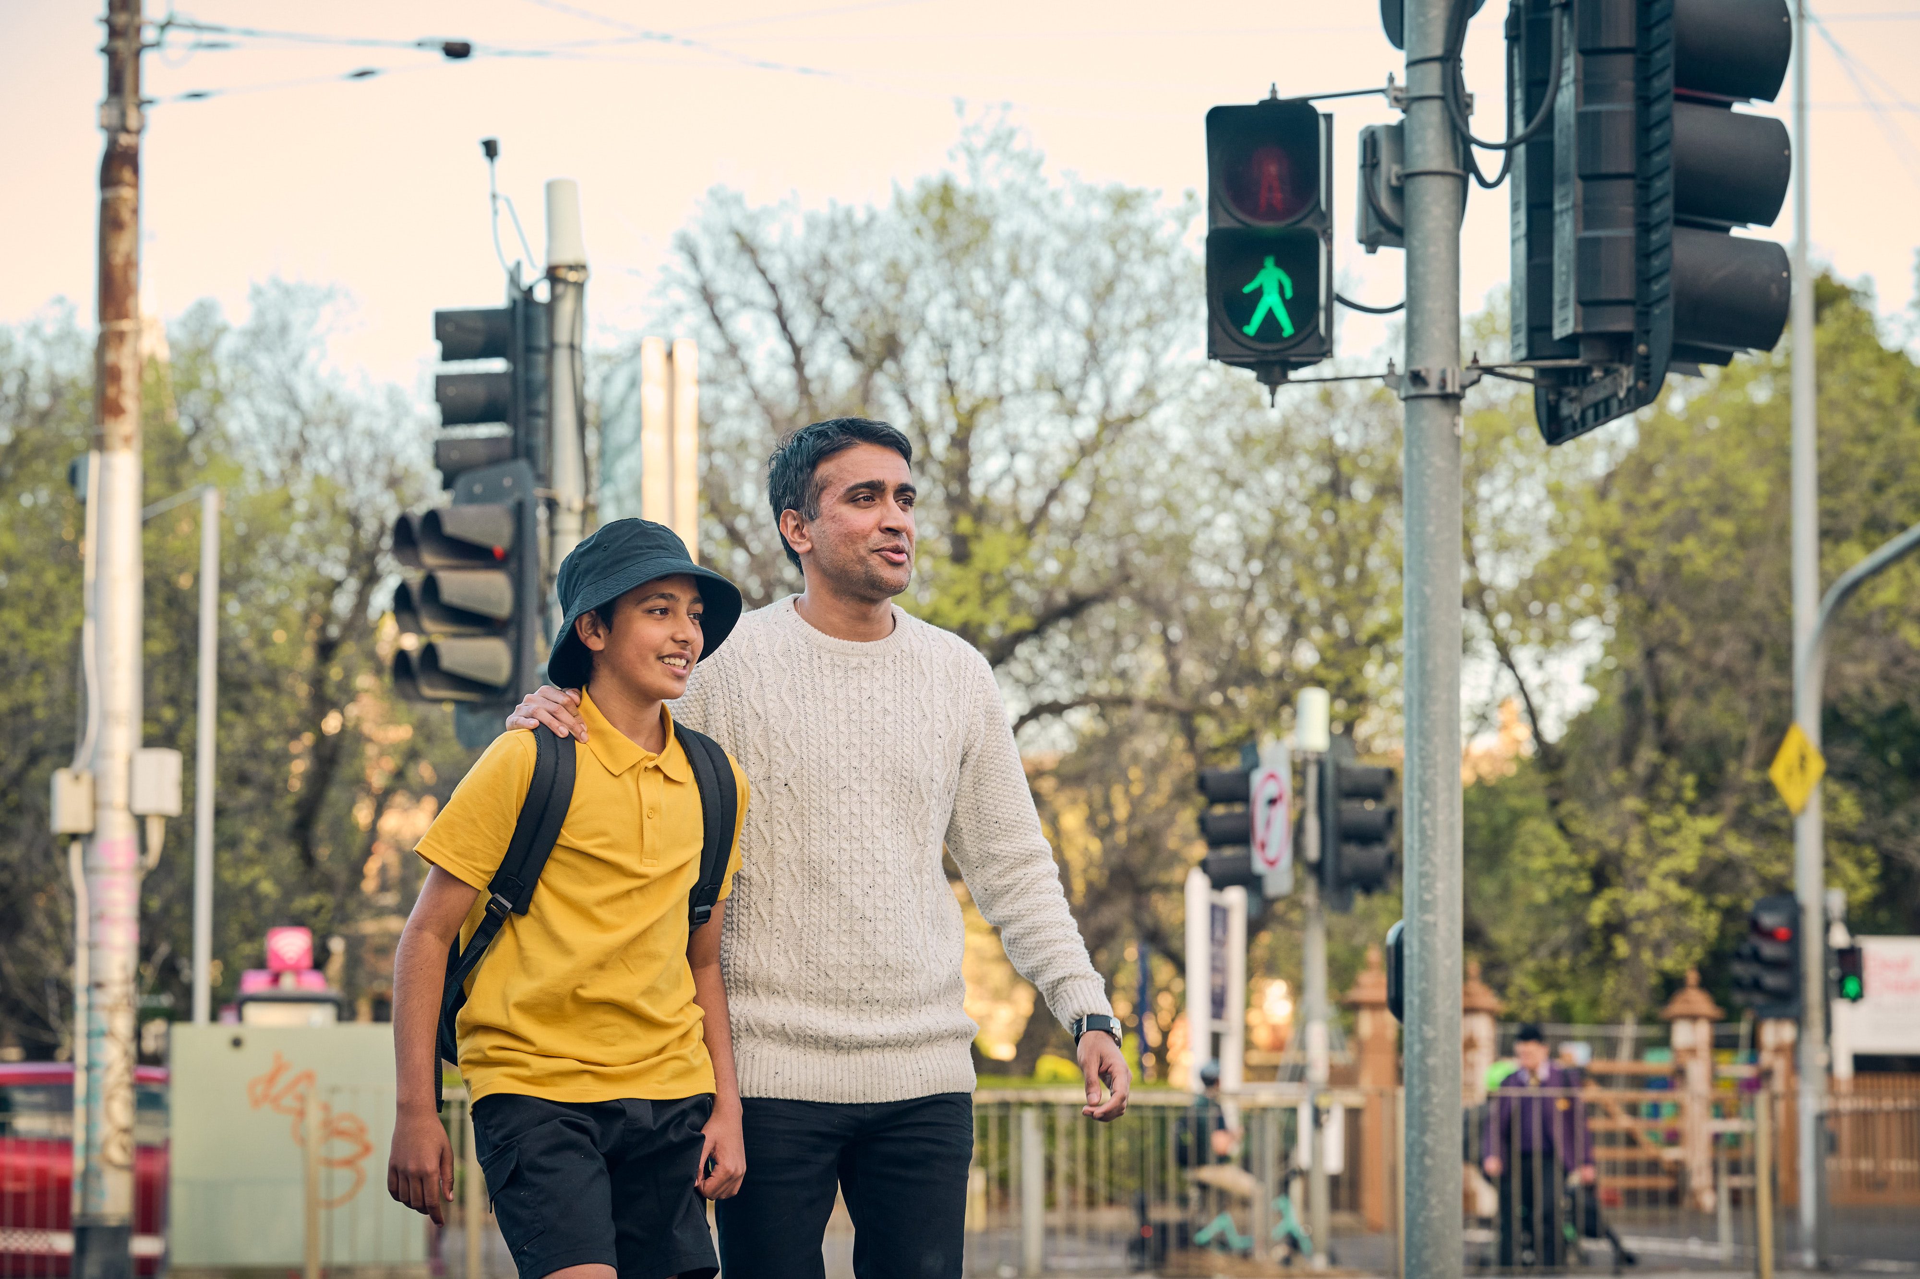
Notes:
SAFE- Use this image to discuss the importance of crossing on the green light and at pedestrian crossings where possible

Slide 9
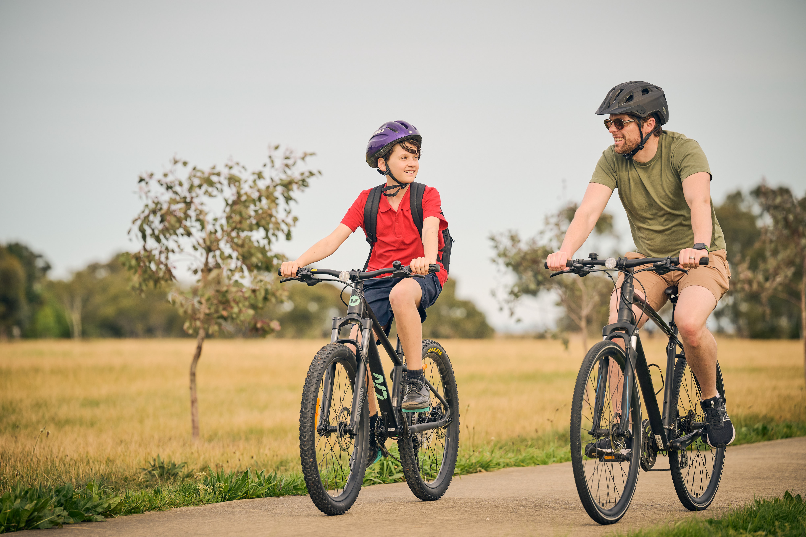
Notes:
SAFE- Use this image to discuss the importance of wearing helmets when ridings bikes and using dedicated bike and shared paths.

Slide 10
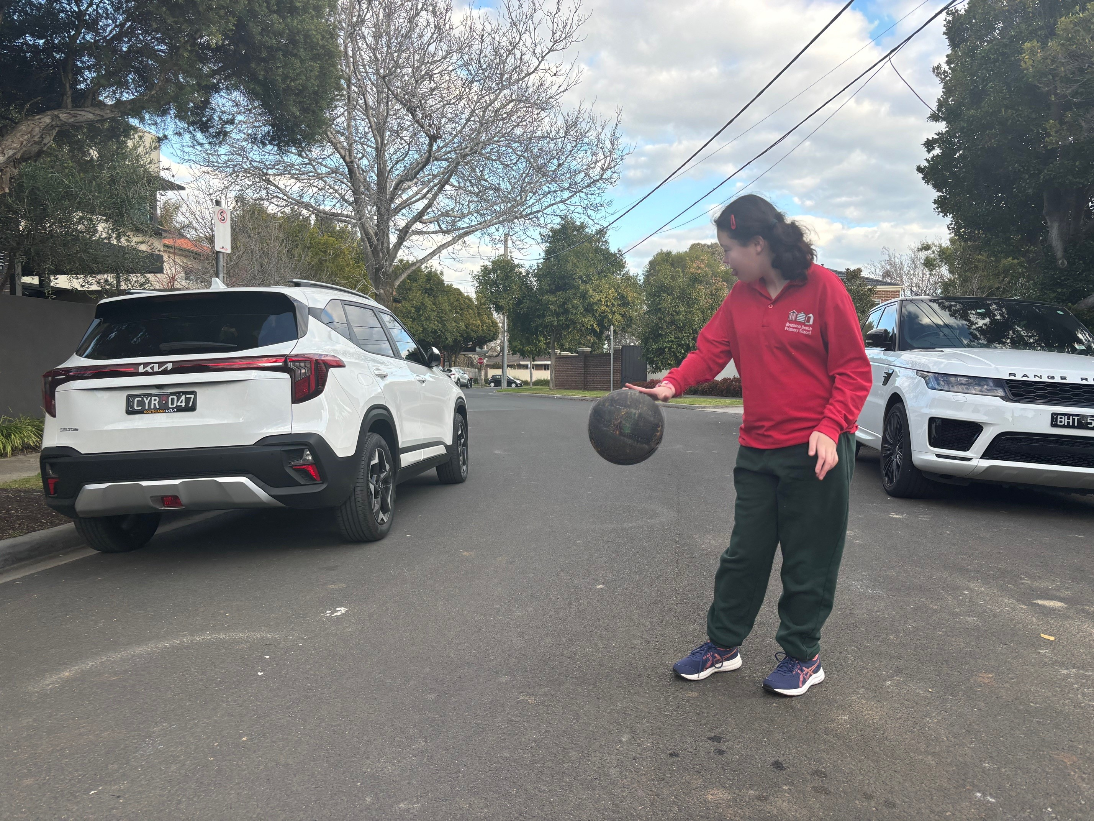
Notes:
UNSAFE-

