Slide 1

Step into Safely
Image Resources Session 7

Slide 2
Session 7 Staying Safe on the Footpath

Slide 3
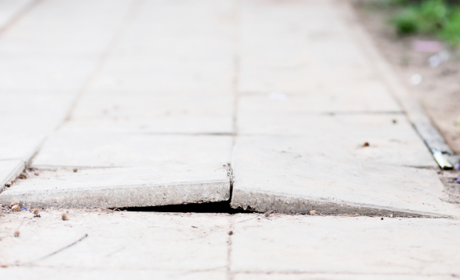

Slide 4
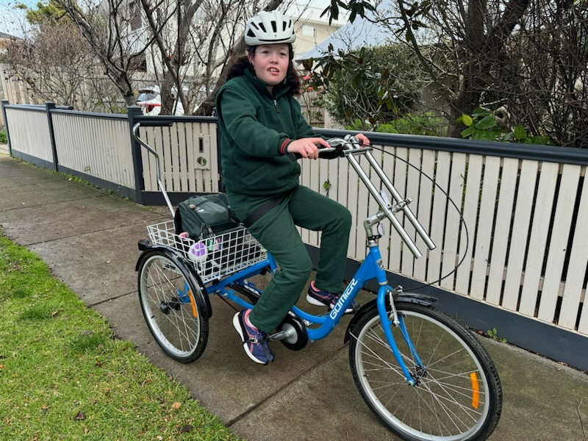
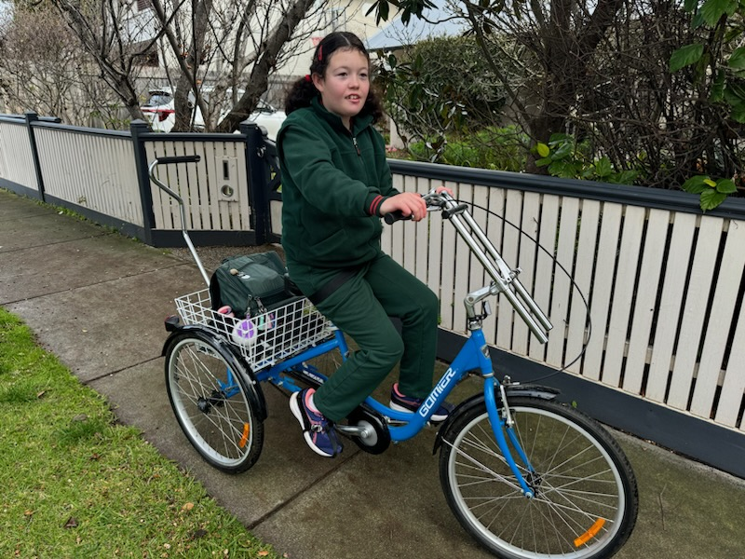
Notes:
Whilst children SHOULD ride on the footpath under 12 years of age, use this image to discuss the hazard a rider on a footpath poses to a pedestrian

Slide 5
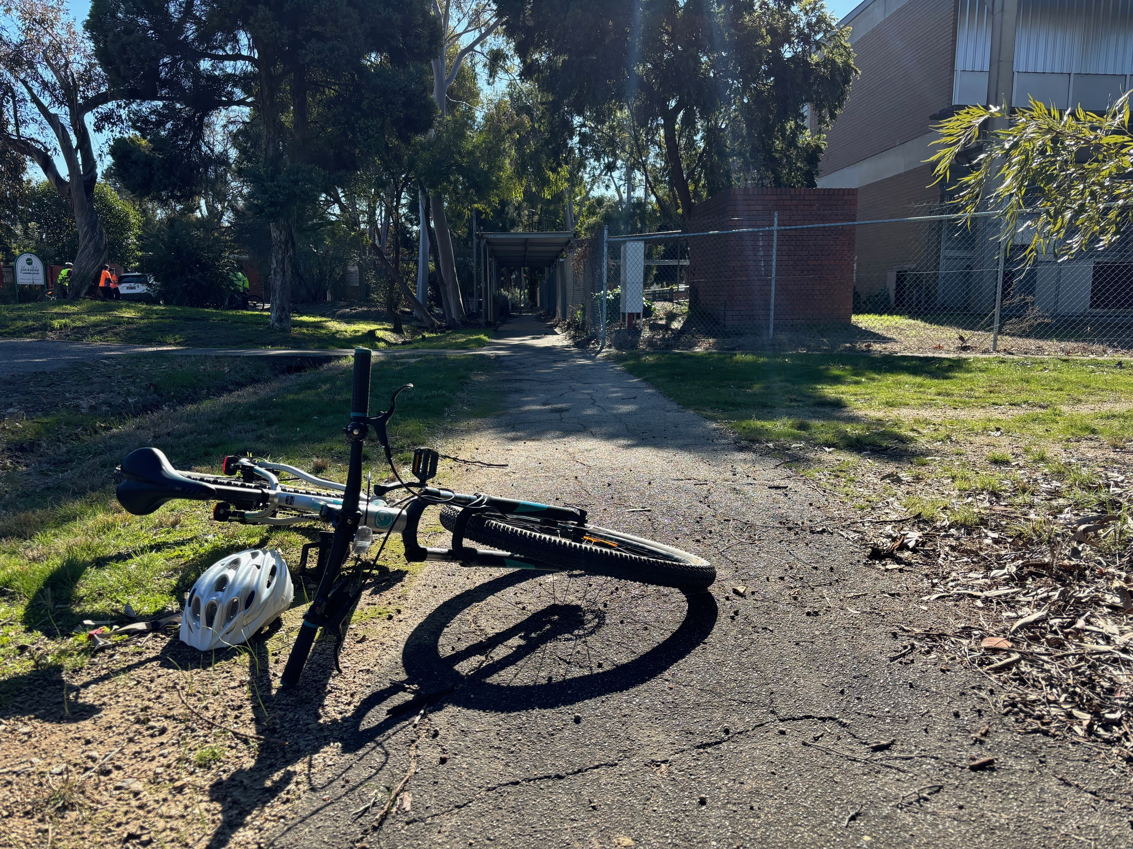

Slide 6
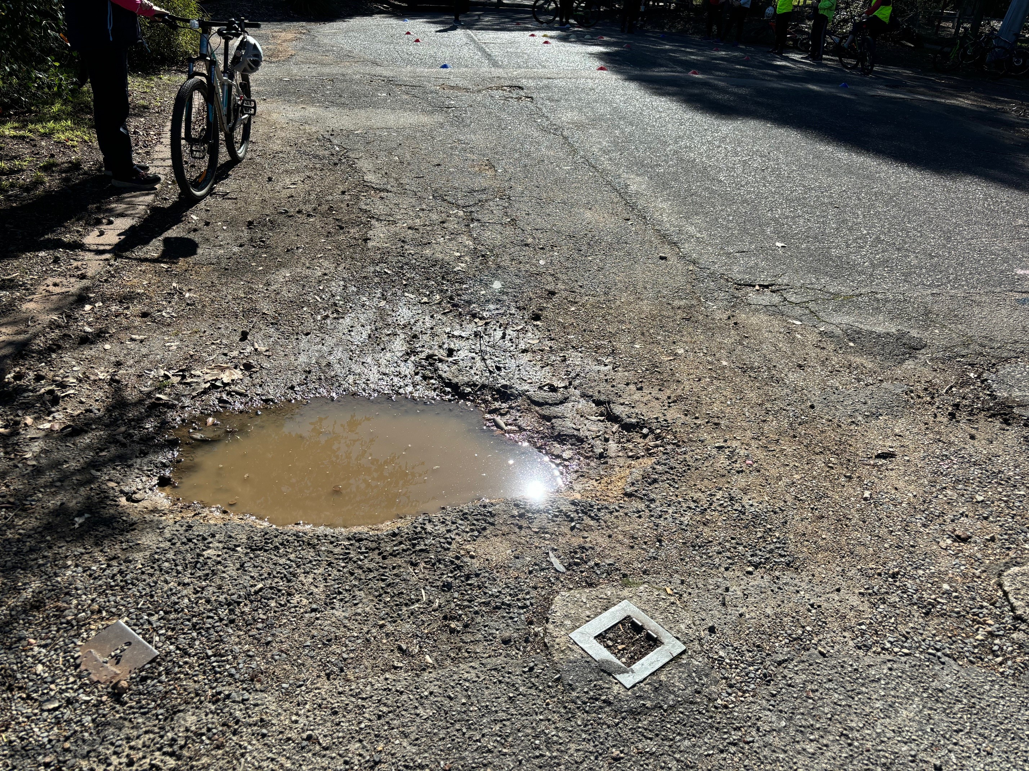

Slide 7
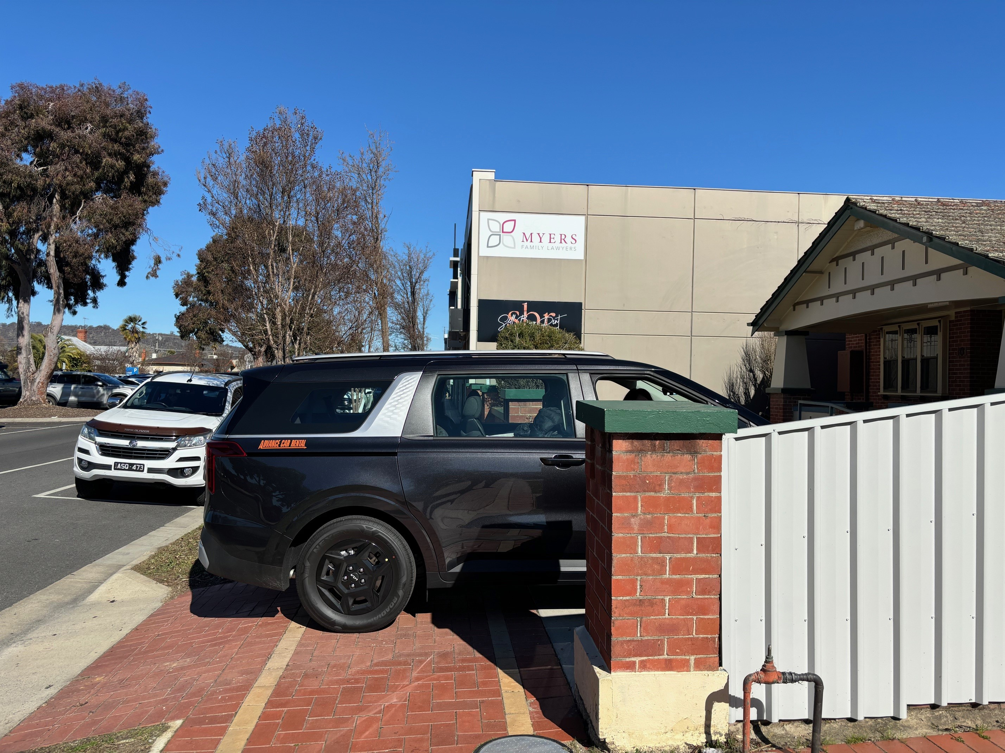

Slide 8
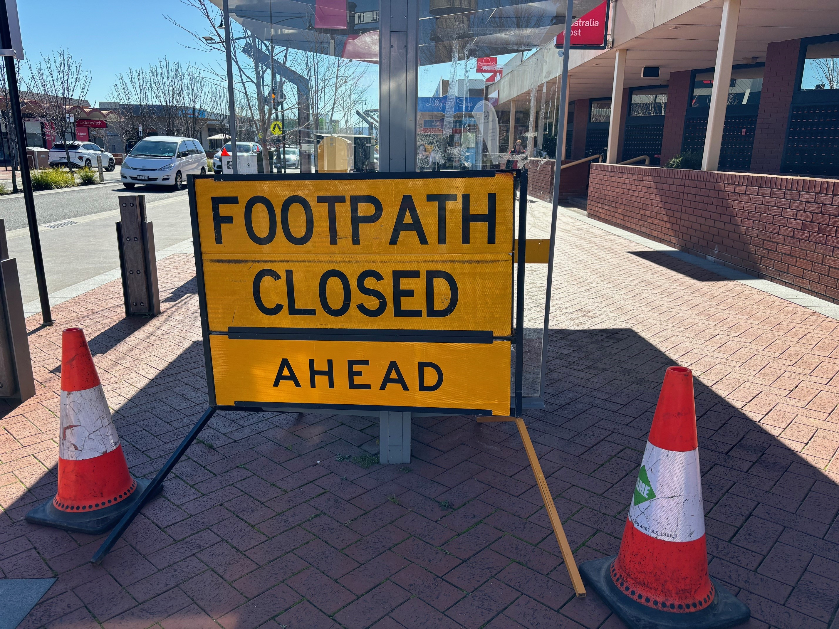

Slide 9
