Slide 1

Step Into Safety Level 1-2
Image Resources

Slide 2
Session 5
Crossing the Road – Stop Look Listen Think

Slide 3
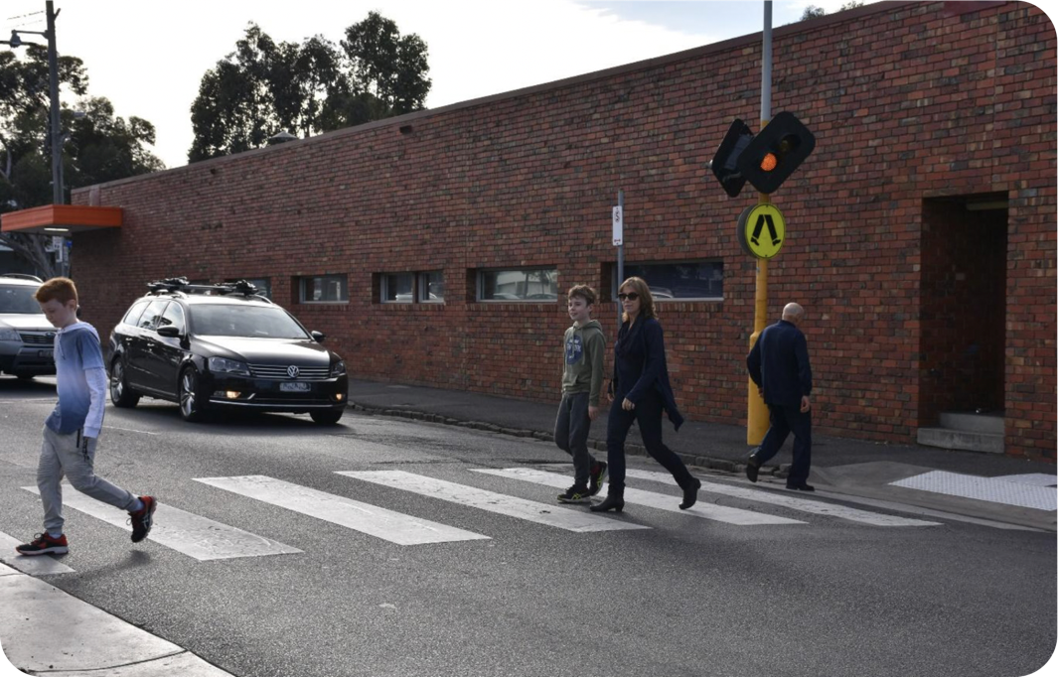
Notes:
MAYBE SAFE- wearing a helmet would make this situation safer

Slide 4
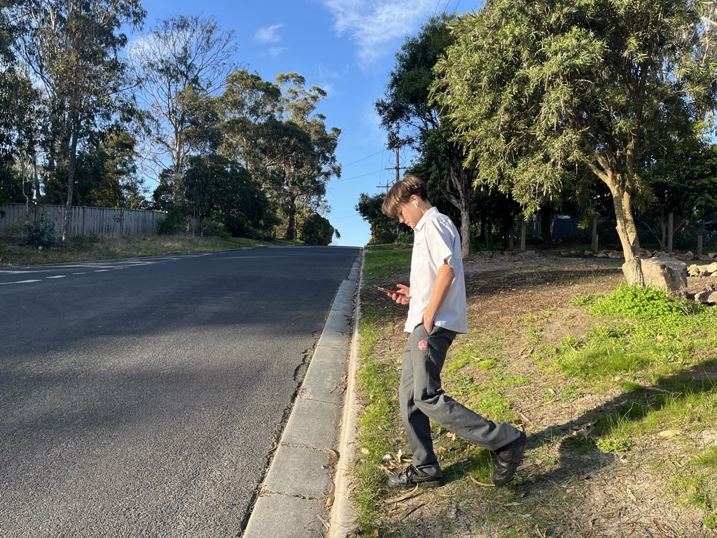

Slide 5
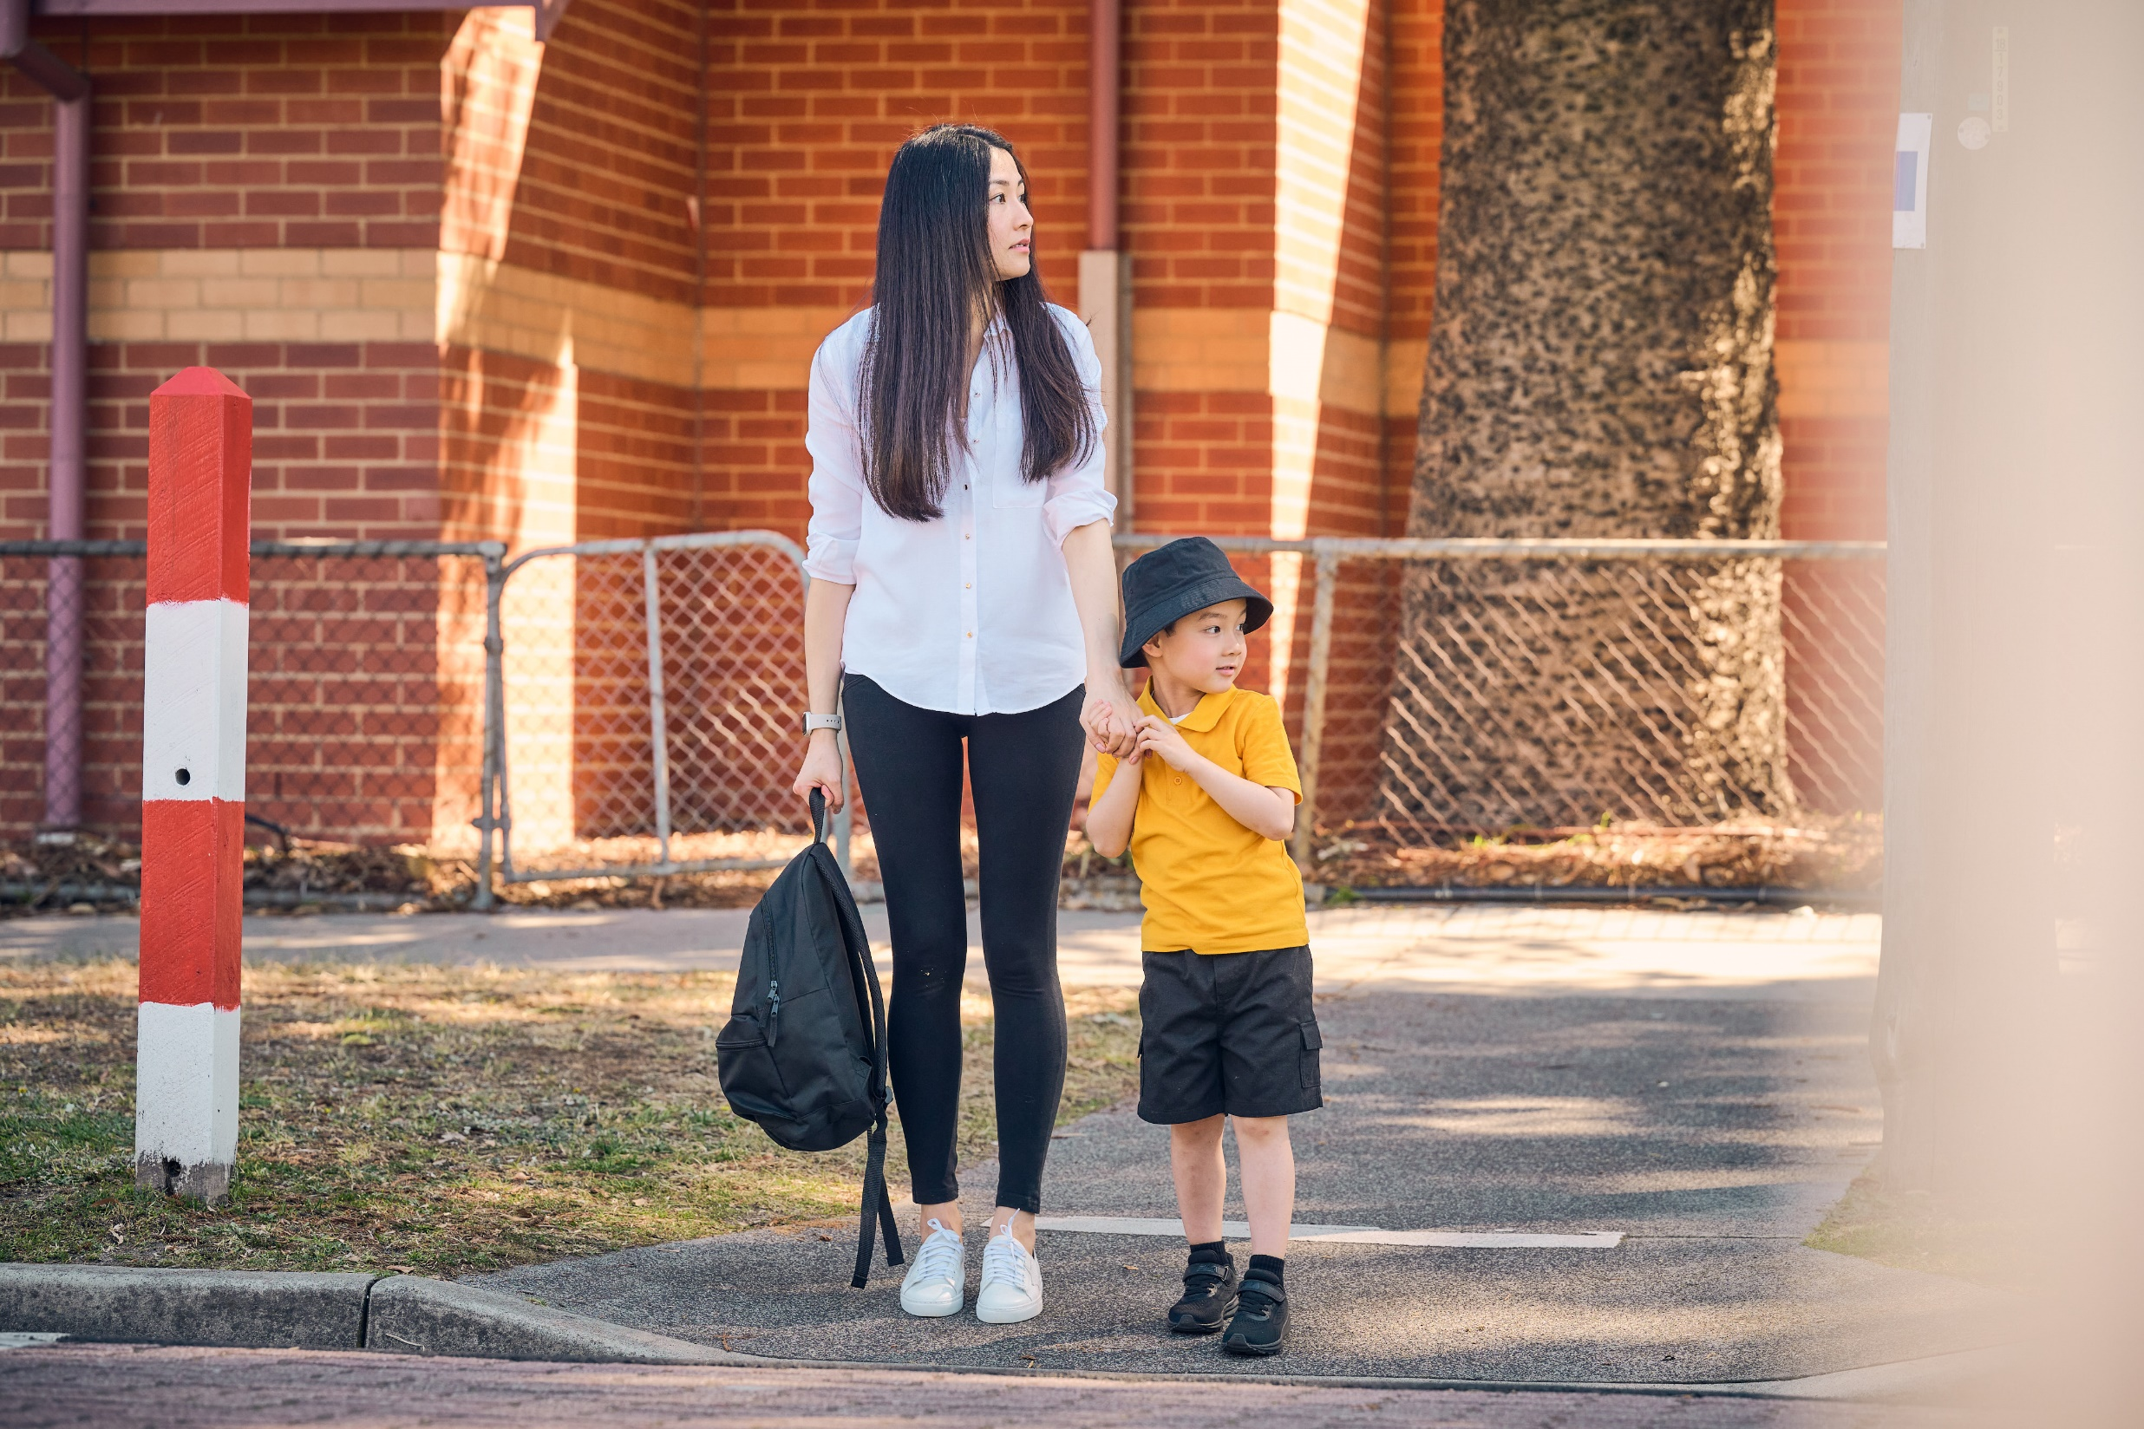

Slide 6
