Slide 1

Step into Safely
Image Resources Session 1

Slide 2
Session 1
Defining Safe and Not Safe

Slide 3
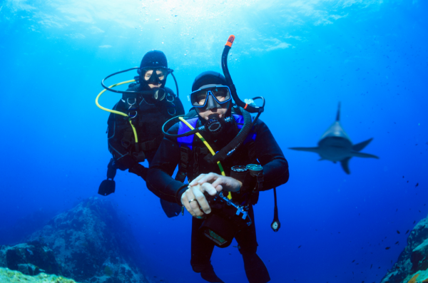

Slide 4


Slide 5
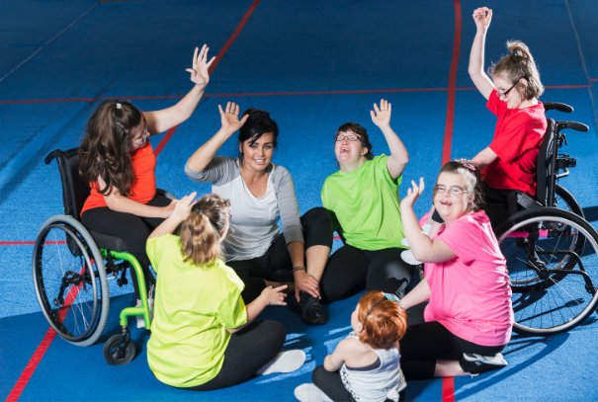

Slide 6
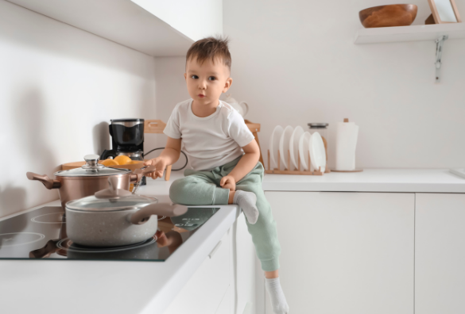

Slide 7
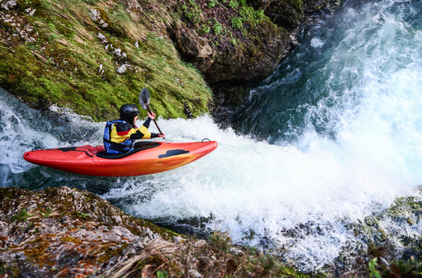

Slide 8


