Slide 1

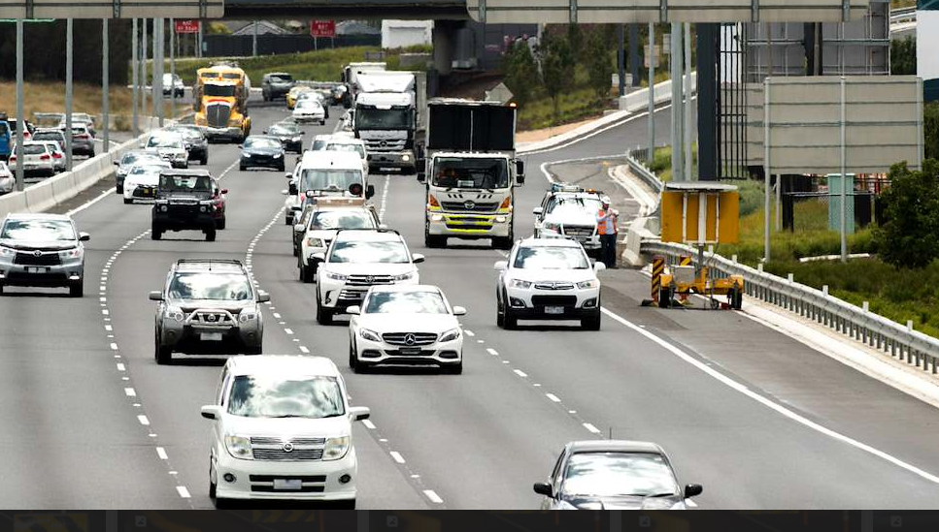

LESSON 1
The Safe System
Learning objective
We will understand important strategies that are used to make roads safer for everyone
Success criteria
I can explain what the safe system is
I can identify ways we make road travel safer and how they fit in safe system
I can interpret road safety data to connect safety risks to safety strategies

Slide 2
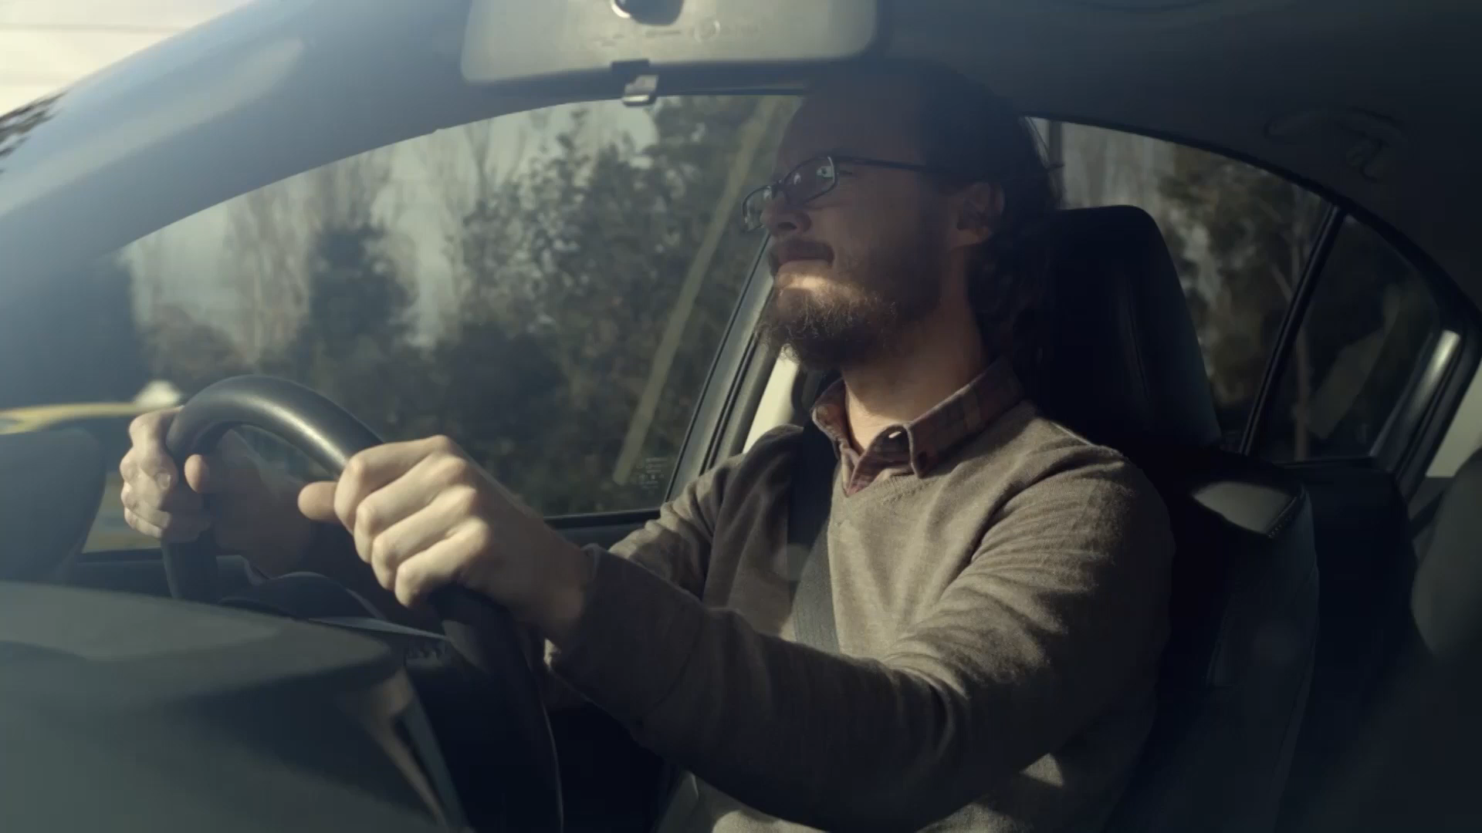

Road Safety
Notes:
YouTube video link (if video not playing): https://www.youtube.com/watch?v=kT8t2p1Ca4E

Slide 3
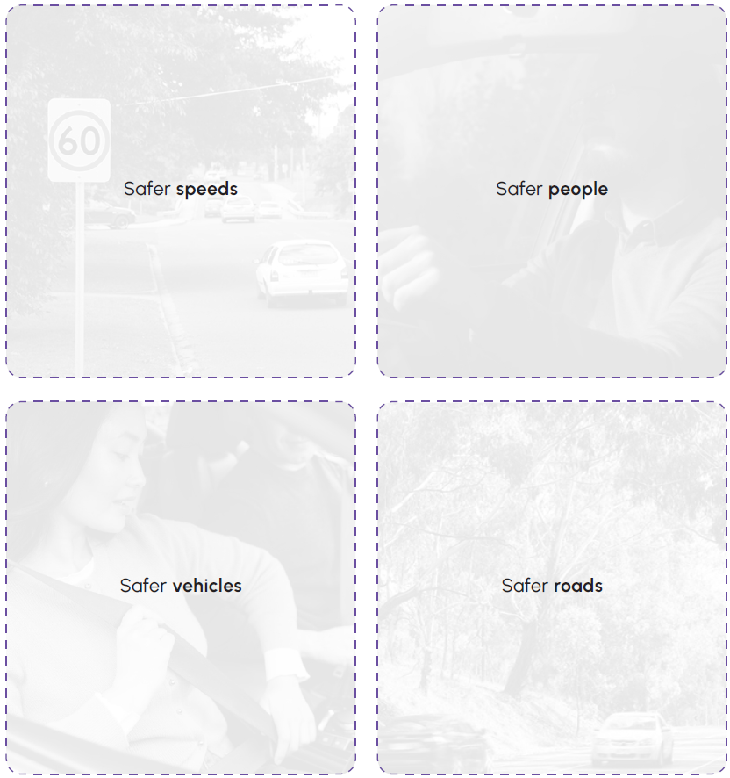
The Safe System

Slide 4
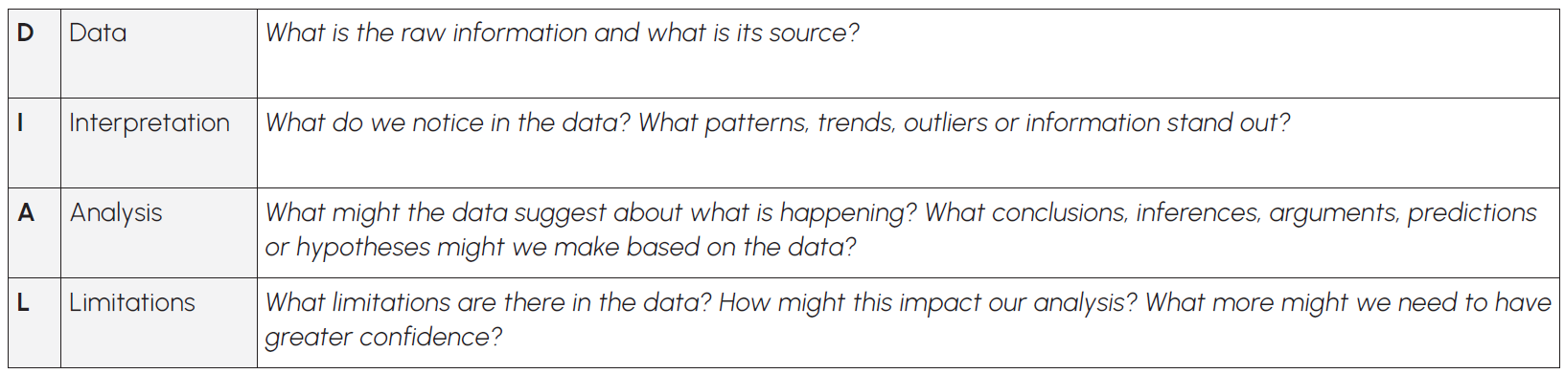
DIAL in to data
Source: Michael Rosenbrock https://michaelrosenbrock.com

Slide 5
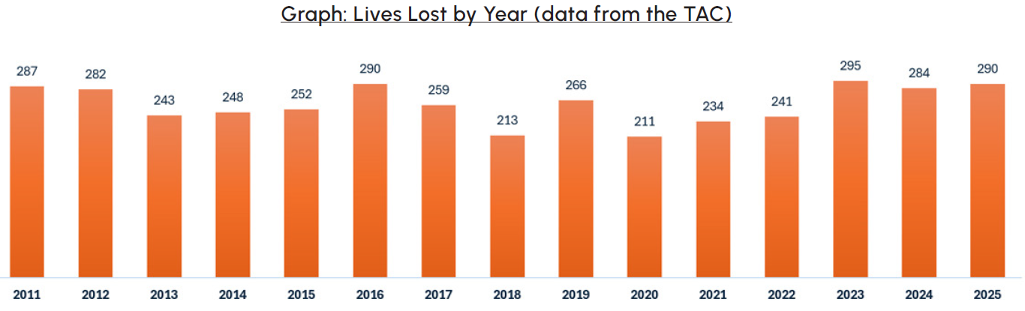
Dataset 1

Slide 6
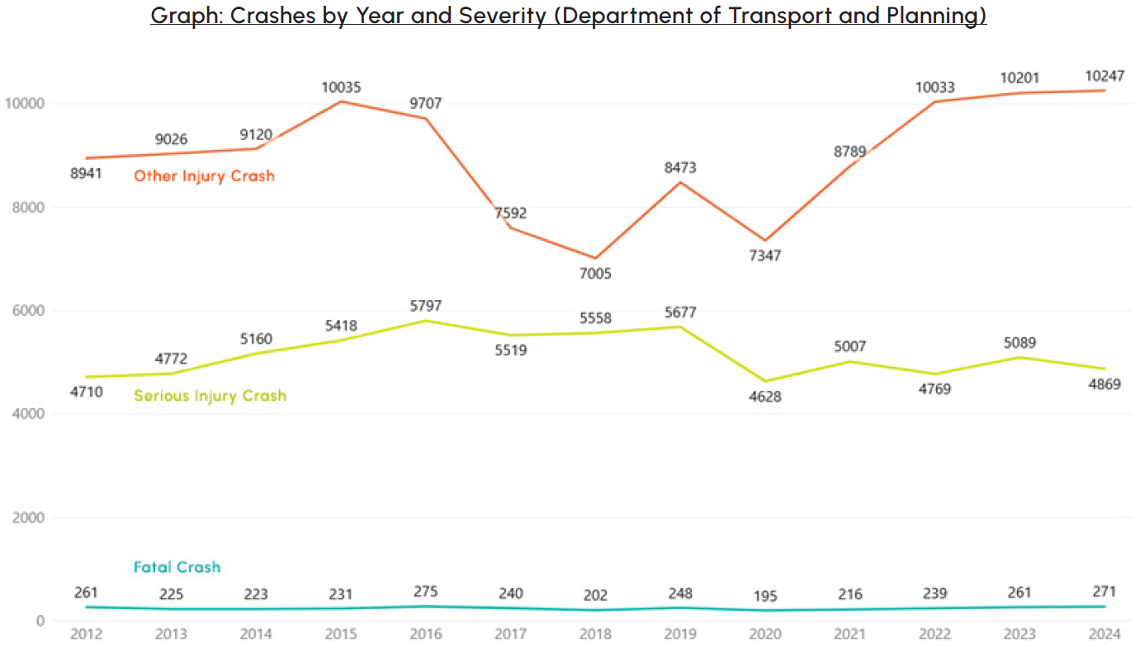
Dataset 2

Slide 7
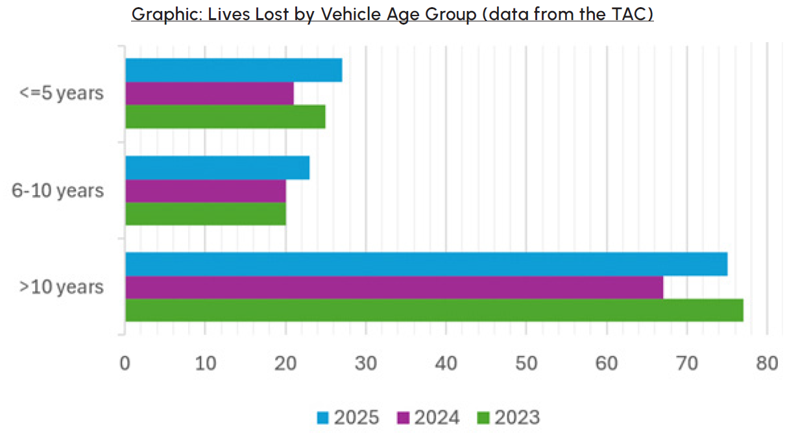
Dataset 3

Slide 8
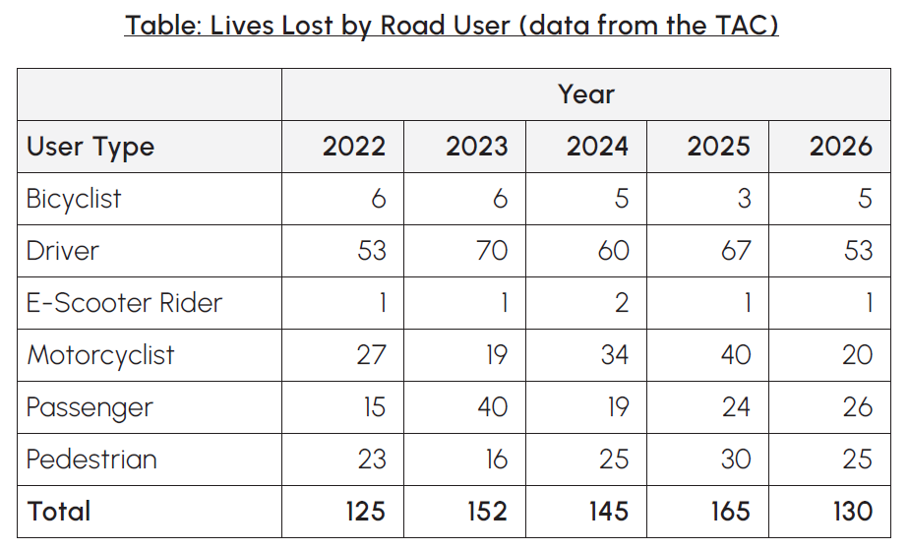
Dataset 4

Slide 9
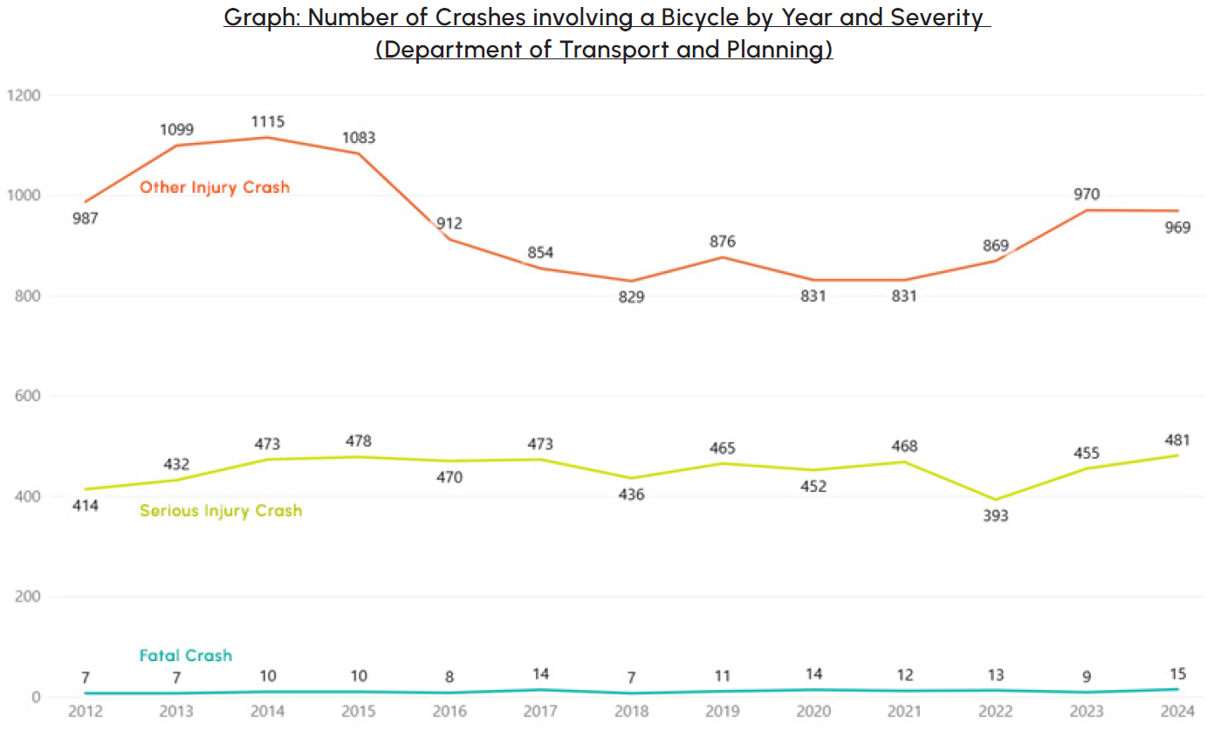
Dataset 5

Slide 10
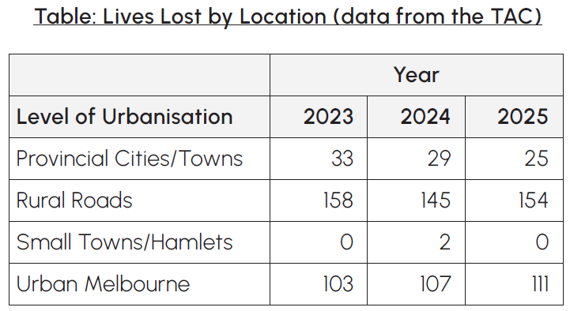
Dataset 6

Slide 11
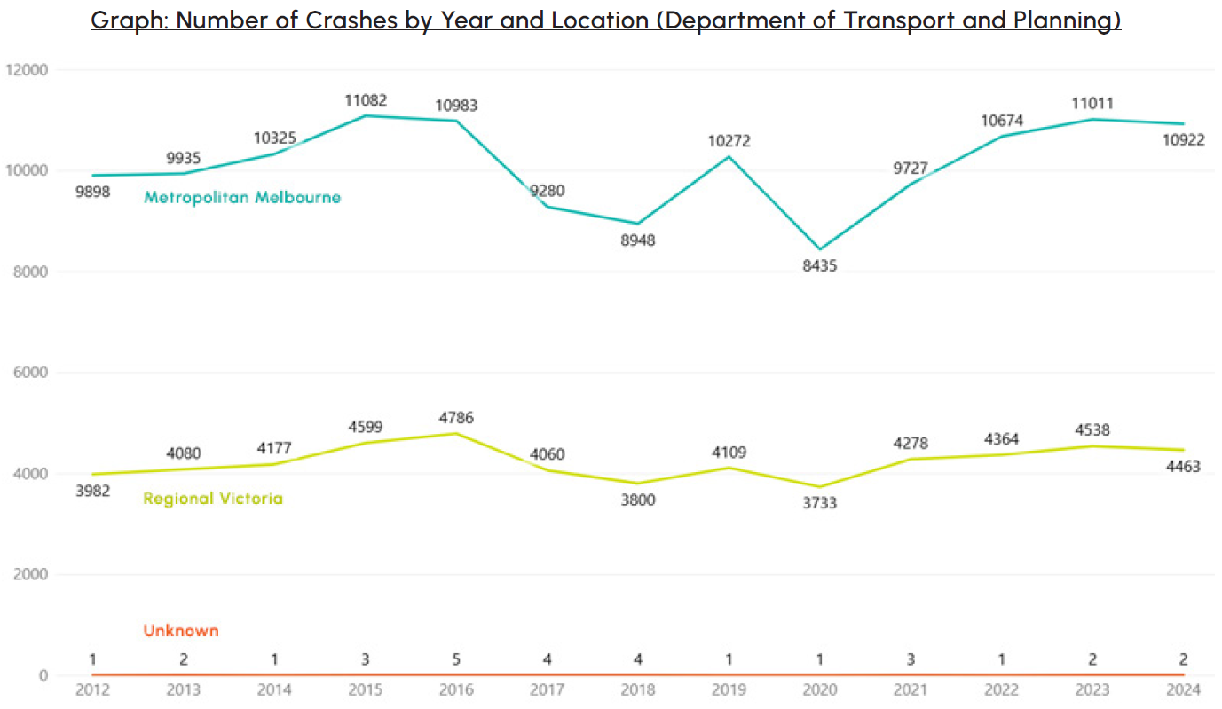
Dataset 7

Slide 12
Exit Ticket
What are the four parts of the safe system?
What were the three most significant things that you found out from analysing and interpreting the road safety data?

Slide 13
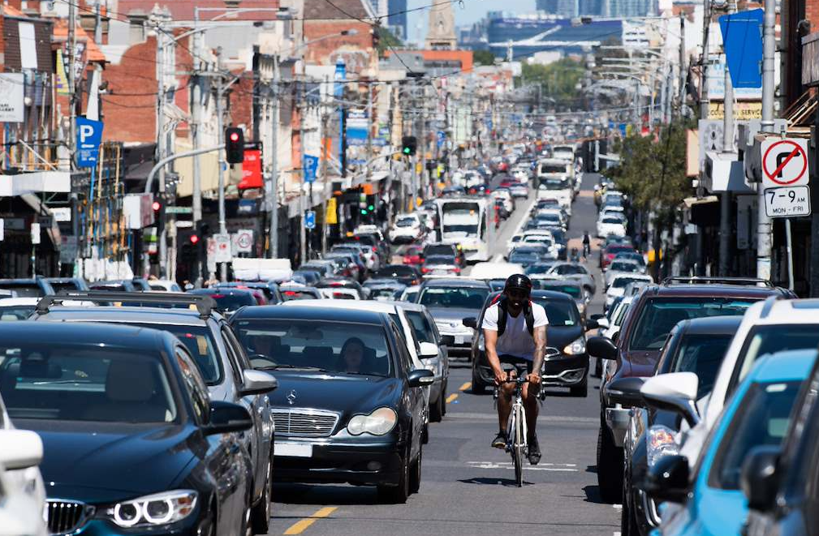
LESSON 2
Safer Speeds
Learning objective
We will understand why speed is an important factor in road safety
Success criteria
I can interpret data on the impact of speed on road safety
I can calculate kinetic energy for objects travelling at different speeds
I can explain how kinetic energy increases with speed and mass

Slide 14
Warm Up – Safer Speeds

Slide 15
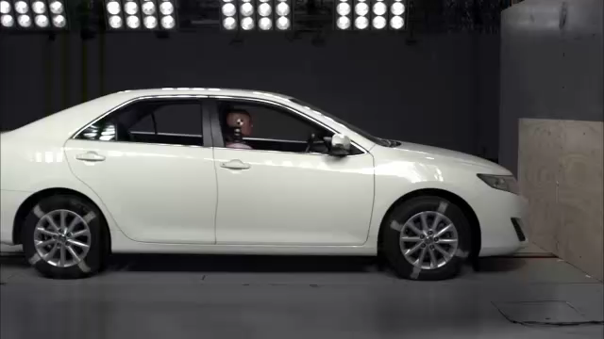
Vehicle Crash Test (1)

Slide 16
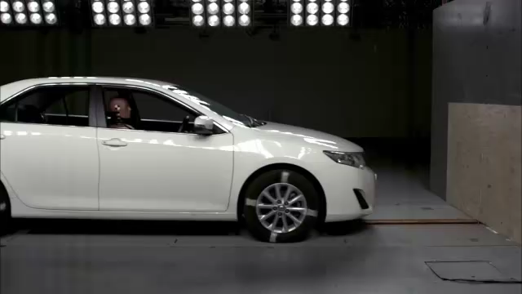
Vehicle Crash Test (2)

Slide 17
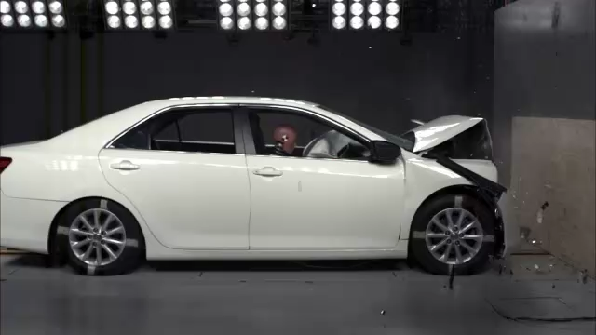
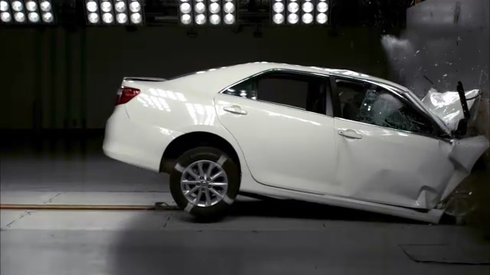
Vehicle Crash Test (1)
Vehicle Crash Test (2)

Slide 18
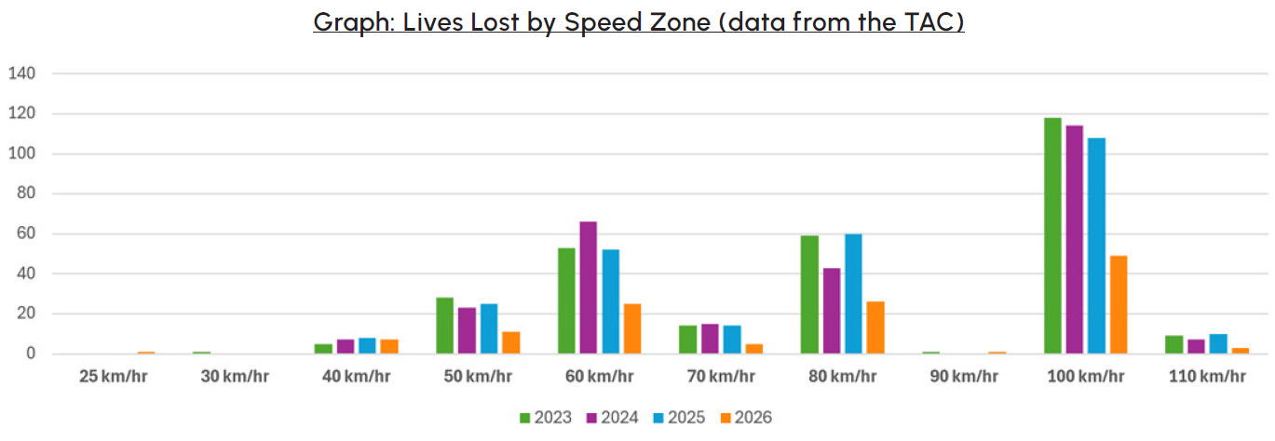
Dataset 8

Slide 19
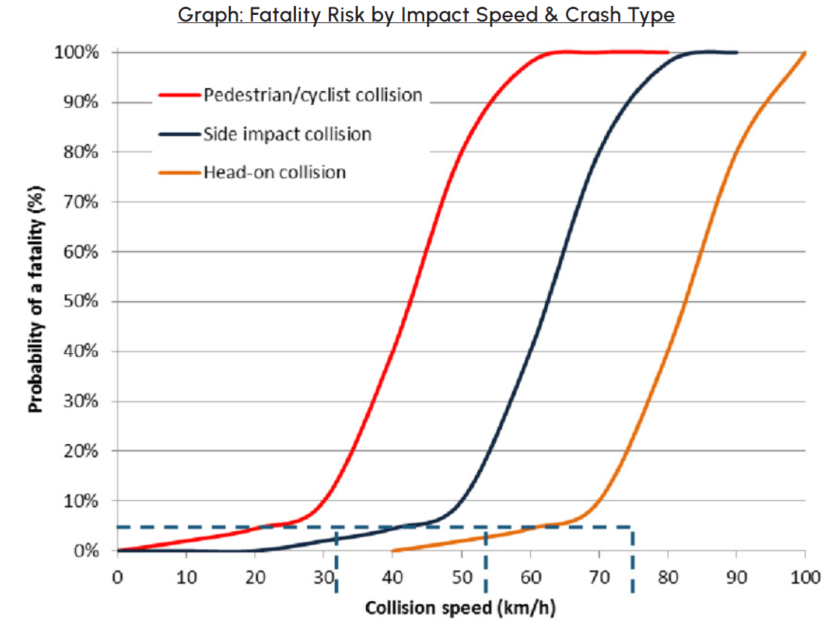
Dataset 9
Source: Jurewicz, Tofler, Makwasha. (2015). https://www.researchgate.net/figure/Wramborgs-model-for-fatality-probability-vs-vehicle-collision-speeds_fig2_295072998

Slide 20
Exit Ticket
Research into vehicle safety has shown that increasing the speed that a vehicle travels at the severity of an accident.
Road safety data from Victoria shows the highest number of lives are lost in the
speed zone.
Kinetic energy of a moving object depends on its and
.
Increasing kinetic energy means that more needs to be done to stop a vehicle in the event of an accident, which can mean that the accident is
severe.

Slide 21
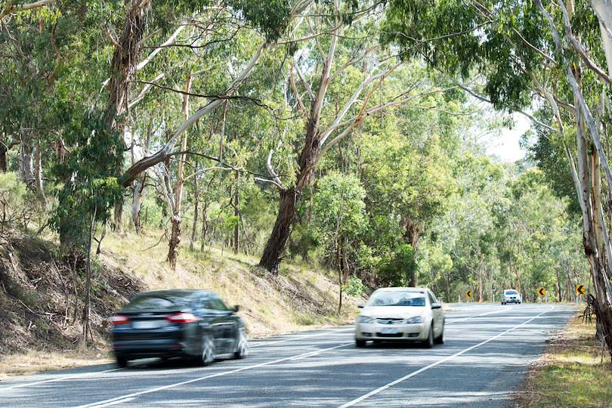
LESSON 3
Stopping Distances
Learning objective
We will analyse vehicle stopping distances in different conditions
Success criteria
I can describe motion using speed, distance, time and acceleration
I can calculate the stopping distance of a vehicle
I can explain the factors that influence stopping distance

Slide 22
Warm Up – kinetic energy and speed
Increasing the speed of a vehicle by 5% will result in its kinetic energy:
Decreasing by approximately 5%
Increasing by approximately 5%
Decreasing by approximately 10%
Increasing by approximately 10%

Slide 23

Warm Up - answers
Increasing the speed of a vehicle by 5% will result in its kinetic energy:
Decreasing by approximately 5%
Increasing by approximately 5%
Decreasing by approximately 10%
Increasing by approximately 10%
$$E_{k}=\frac{1}{2}mv^{2}$$
Speed is squared in the kinetic energy formula.
Increasing speed by 5% will increase kinetic energy by 10.25%

Slide 24
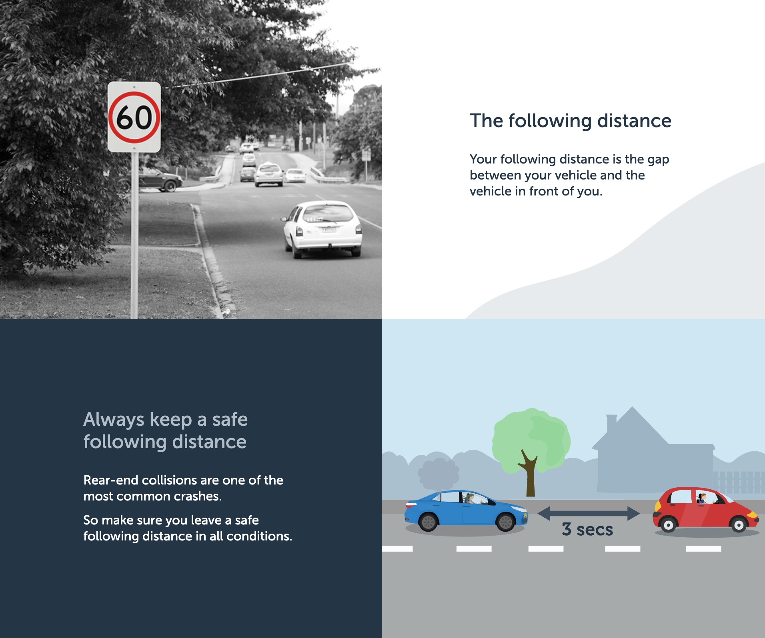
Exit Ticket – three second rule
How does the three second rule connect to what we have just learnt about stopping distances?
When might you need to increase the time to more than 3 seconds (and why)?
Notes:
Source: https://mylearners.vic.gov.au/Stages/Stage2/LD-Safe-distances

Slide 25
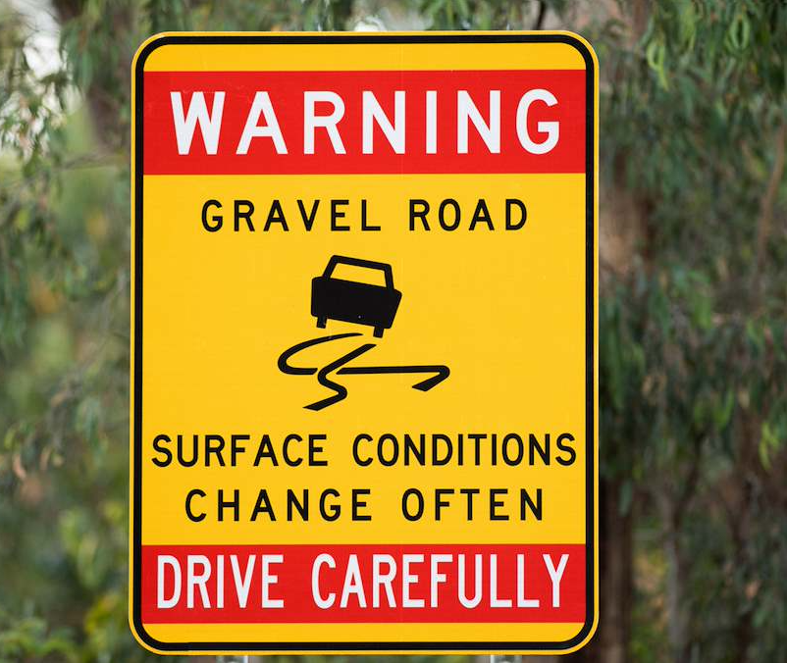
LESSON 4
Reaction Times Experiment
Learning objective
We will conduct a simple experiment to explore factors that affect human reaction times
Success criteria
I can calculate reaction times using the ruler drop distance
I can conduct an experiment following the method provided
I can analyse and reflect on results from the reaction time experiment

Slide 26

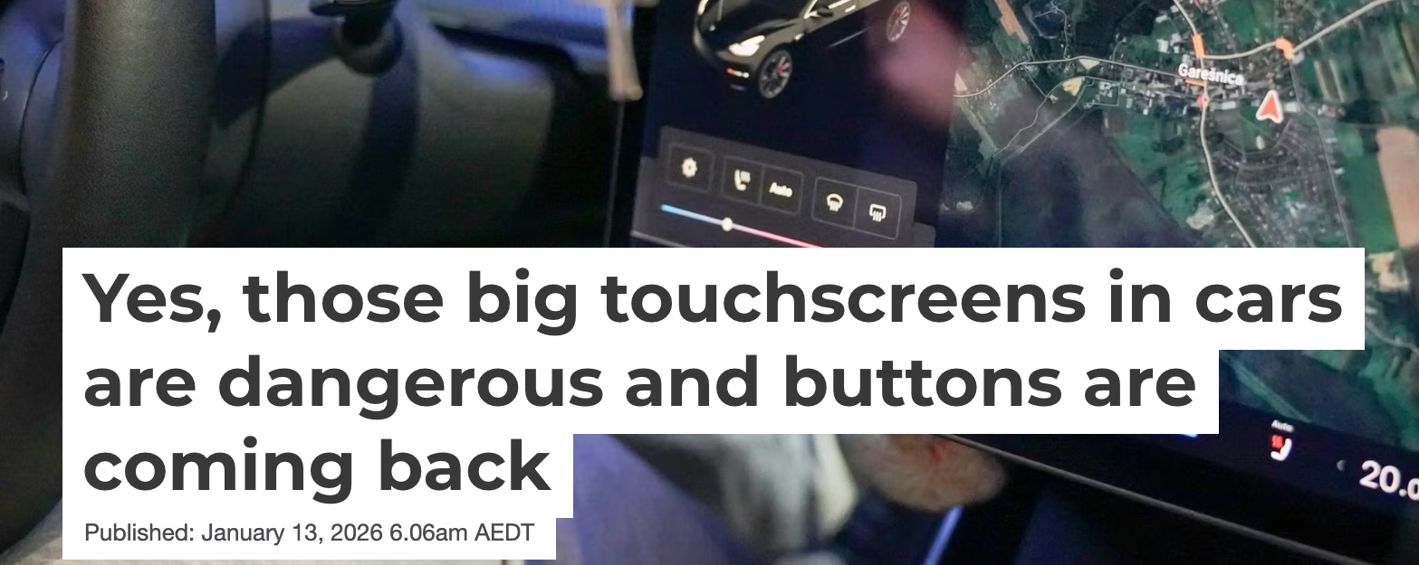
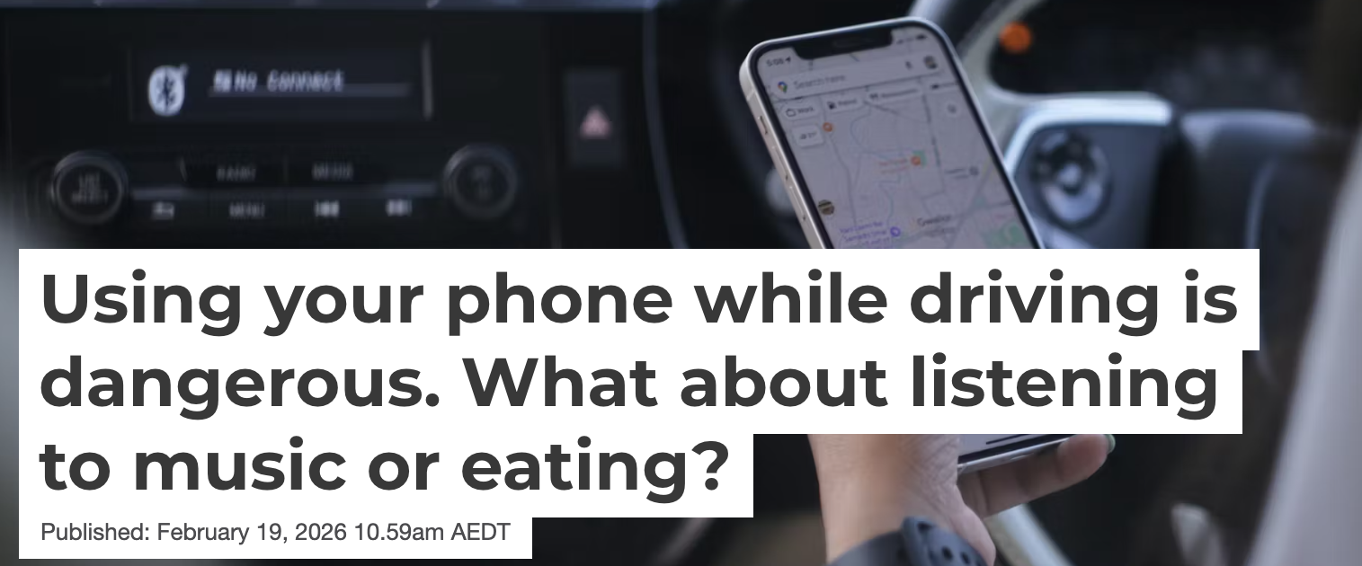
Warm Up – driving distractions
How many different sources of possible driver distraction can you identify?
How does driver distraction (or lack of attention) relate to stopping distance? Why is this a problem for safety?
Notes:
Sources:
https://theconversation.com/yes-those-big-touchscreens-in-cars-are-dangerous-and-buttons-are-coming-back-272704
https://theconversation.com/using-your-phone-while-driving-is-dangerous-what-about-listening-to-music-or-eating-273236

Slide 27
How we react
Eye sees ruler move
Eye sends message to brain
Brain processes message
Brain sends message to hand
Fingers close to stop ruler

Slide 28
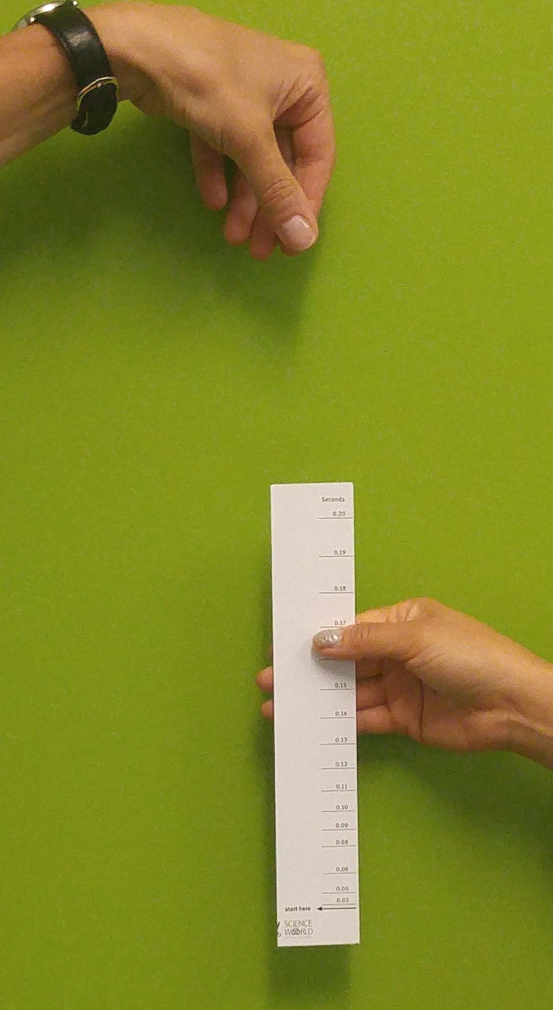
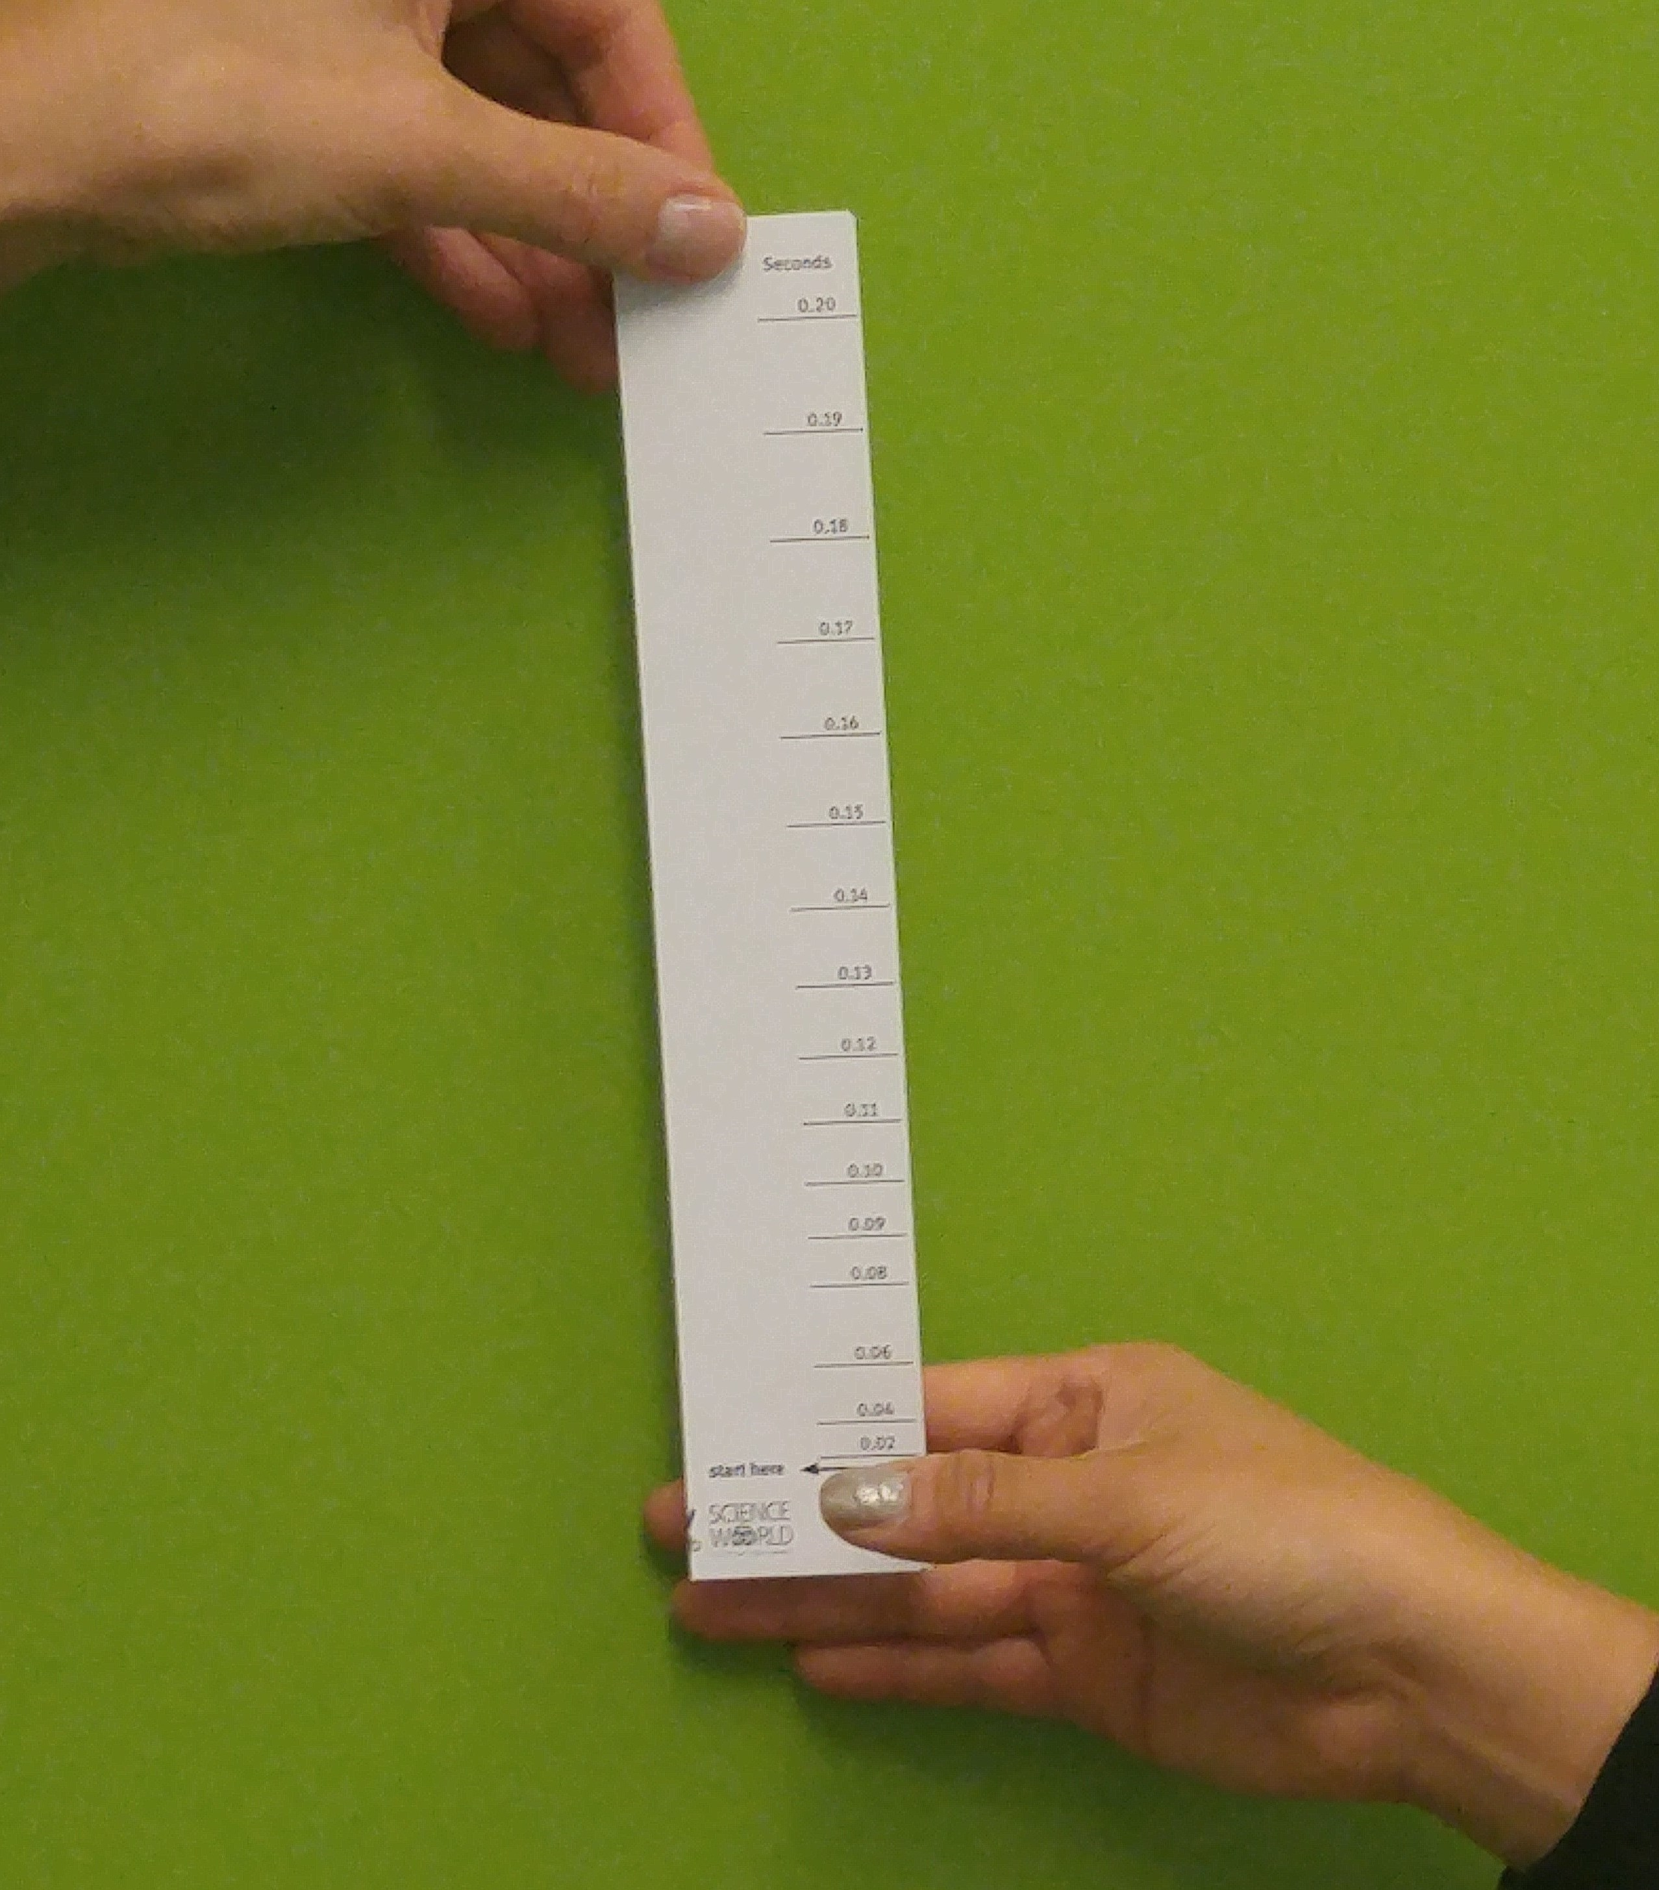
Ruler drop reaction test
Caught and ready to read and record the result (steps 7-8)
Ready to go (step 6)

Slide 29
Exit Ticket – reaction times experiment
Did this experiment produce a fair test of reaction times? Explain your reasons.
How would you improve this experiment if you ran it again?
What did this experiment suggest about the variation in reaction times between different people?
What conclusions can you draw about the effect of distraction and field of view (and another variable if you tested it) on reaction time?

Slide 30
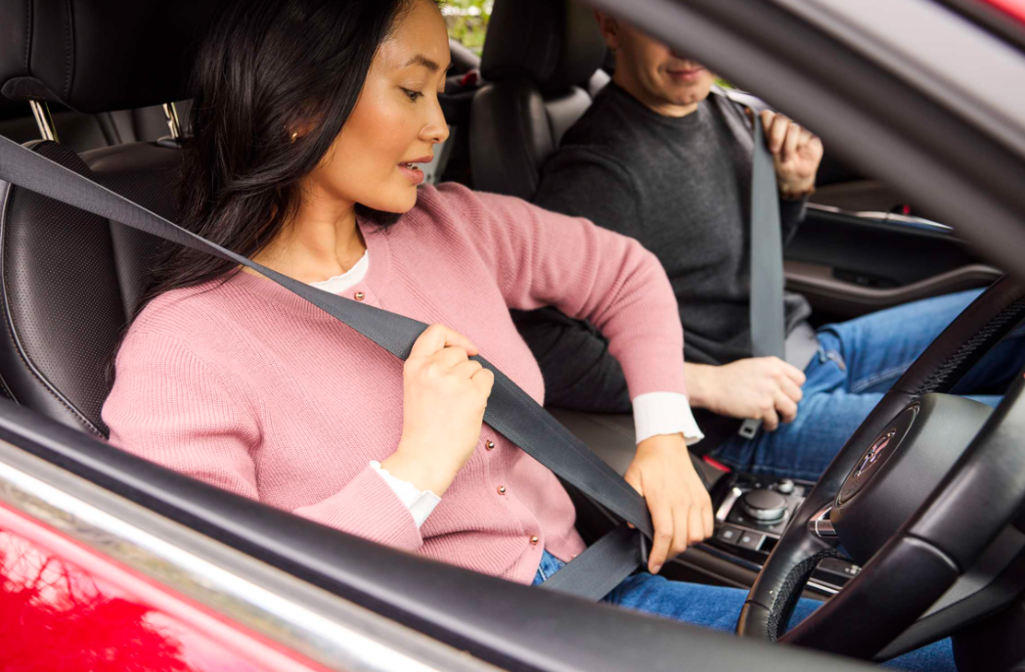
LESSON 5
Vehicle Safety Features
Learning objective
We will understand how active safety features improve vehicle safety
Success criteria
I can explain the difference between active and passive vehicle safety features
I can interpret information on specific active safety features
I can explain how specific active safety features improve safety

Slide 31
Warm Up – distraction
Quick write:
Explain using your scientific understanding how a driver being distracted can make them less safe on the road.

Slide 32
Safer vehicles

Slide 33
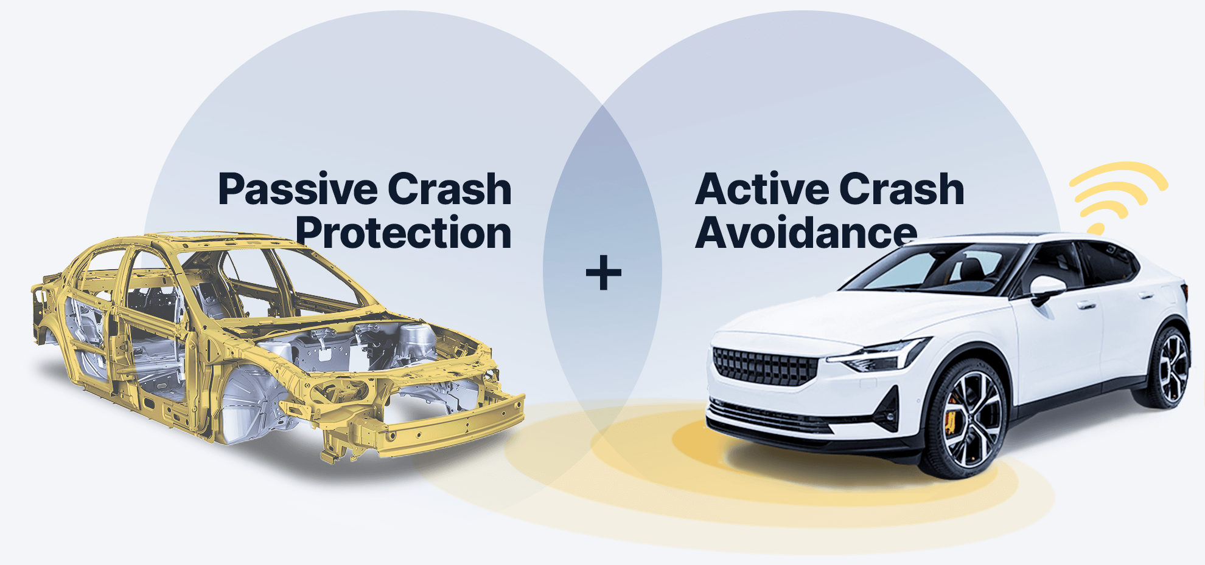
Vehicle Safety Features
https://www.ancap.com.au/what-makes-a-vehicle-safer
Notes:
https://www.ancap.com.au/what-makes-a-vehicle-safer

Slide 34
Exit Ticket - ADAS
What is the difference between active and passive safety systems?
Why are ADAS systems not the same as autonomous systems or self-driving cars?
Explain one way that an ADAS system can ‘assist’ a driver that improves road safety.

Slide 35
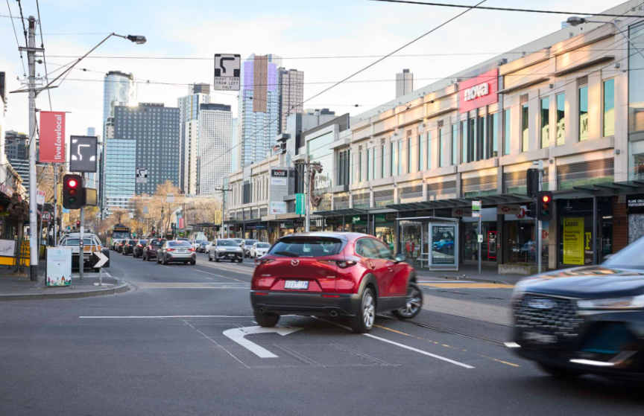
LESSON 6
Forces and Passive Safety
Learning objective
We will understand how passive safety features improve vehicle safety
Success criteria
I can explain safety features using work and energy
I can explain safety features using inertia, forces and acceleration
I can elaborate on how specific safety features improve safety

Slide 36
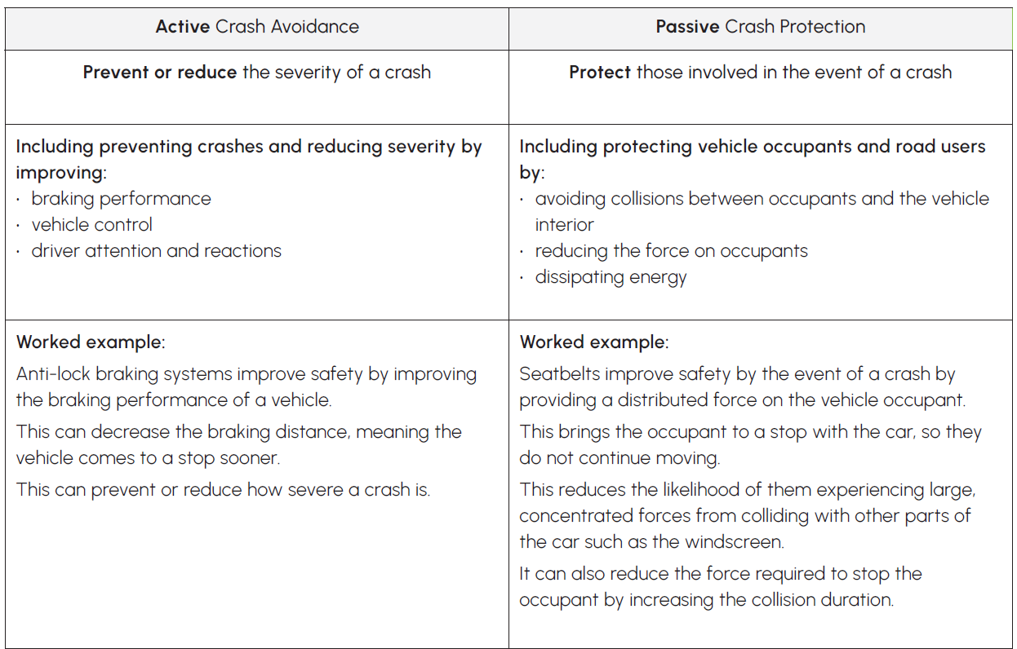
Warm Up – revisiting active safety systems
Active and Passive Safety (Key Resource 4)

Slide 37
Exit Ticket
Increasing the time it takes for a collision to occur will
the force involved.
How do restraints such as seatbelts and airbags relate to inertia?
What effect do crumple zones have on the energy involved in a collision? What is the role of work in this?

Slide 38
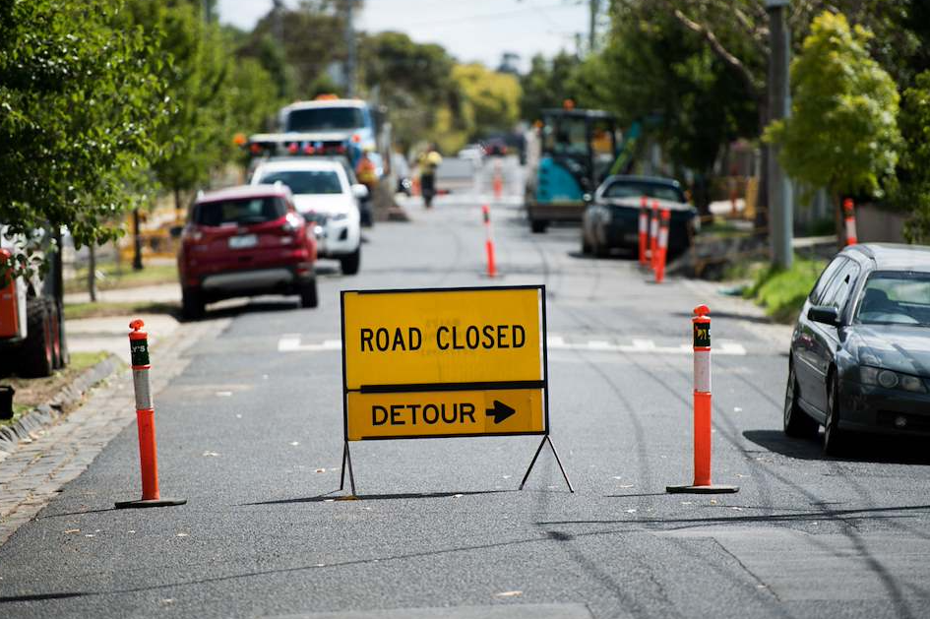
LESSONS 7&8
Egg Crash: Design, Build, Test
Learning objective
We will apply our knowledge of safety features to design, build and test a
‘mini vehicle’
Success criteria
I can create a design that meets all requirements of the brief
I can build and test the design
I can reflect on the process and evaluate the design

Slide 39
Warm up
Why are seatbelts and airbags (restraints) important for protecting vehicle occupants from injury?
How do crumple zones in the vehicle structure help to reduce the severity of a crash?

Slide 40
Exit Ticket
Were the safety features in your ‘mini vehicle’ design active or passive? Explain why.
How might the results have changed if you used an uncooked egg?
The tests did not explore the effect of the vehicle mass in detail, how do you predict having a heavier or lighter vehicle would affect the results? Explain using appropriate physics.

Slide 41
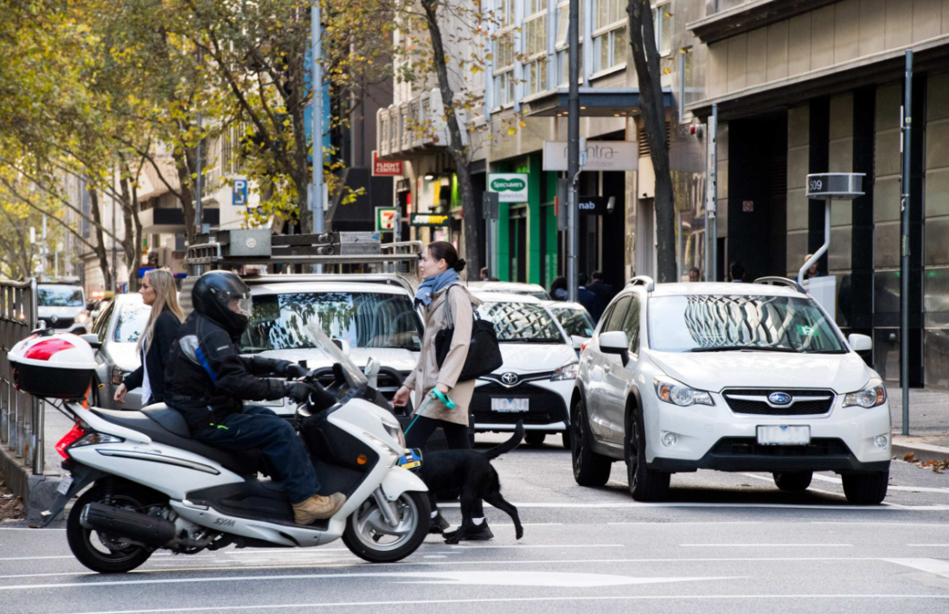
LESSON 9
Road Safety in Action
Learning objective
We will communicate the case for a specific road safety feature to a general audience
Success criteria
I can explain the key details of a chosen safety feature
I can explain how the feature improves safety and connect this to the safe system
I can test the resource and reflect on potential improvements

Slide 42
Warm up
Safer by Design: Investigating Forces, Motion and Road Safety (L 9/10)

Slide 43
Exit Ticket
3 most relevant things that you learnt about road safety in this unit
2 things that effect road safety that you’d like to know more about
1 top tip for being safer that you’d share with people that have not done this unit

