Slide 1
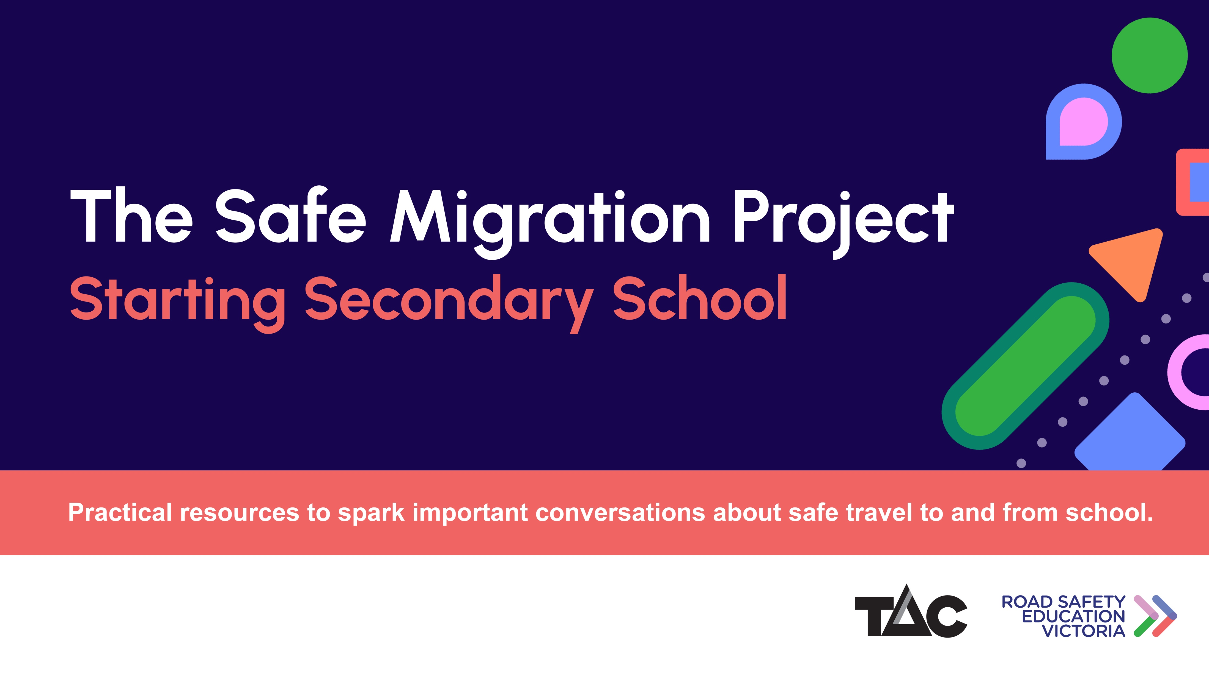
Practical resources to spark important conversations about safe travel to and from school.
Feel free to add extra slides to suit your school community, but please do not alter existing road safety content.

Slide 2



This video is part of the TAC’s Safe Migration Project, designed to help parents and carers establish safe travel habits with their children from the very beginning of secondary school.

Slide 3


Slow down when driving around school neighbourhoods
Help to keep children and teens safe around schools.
Children and teens are still developing awareness of road risks
Slow down and drive with extra care around school neighbourhoods
Driving below speed limits helps keep school communities safe for all

Slide 4

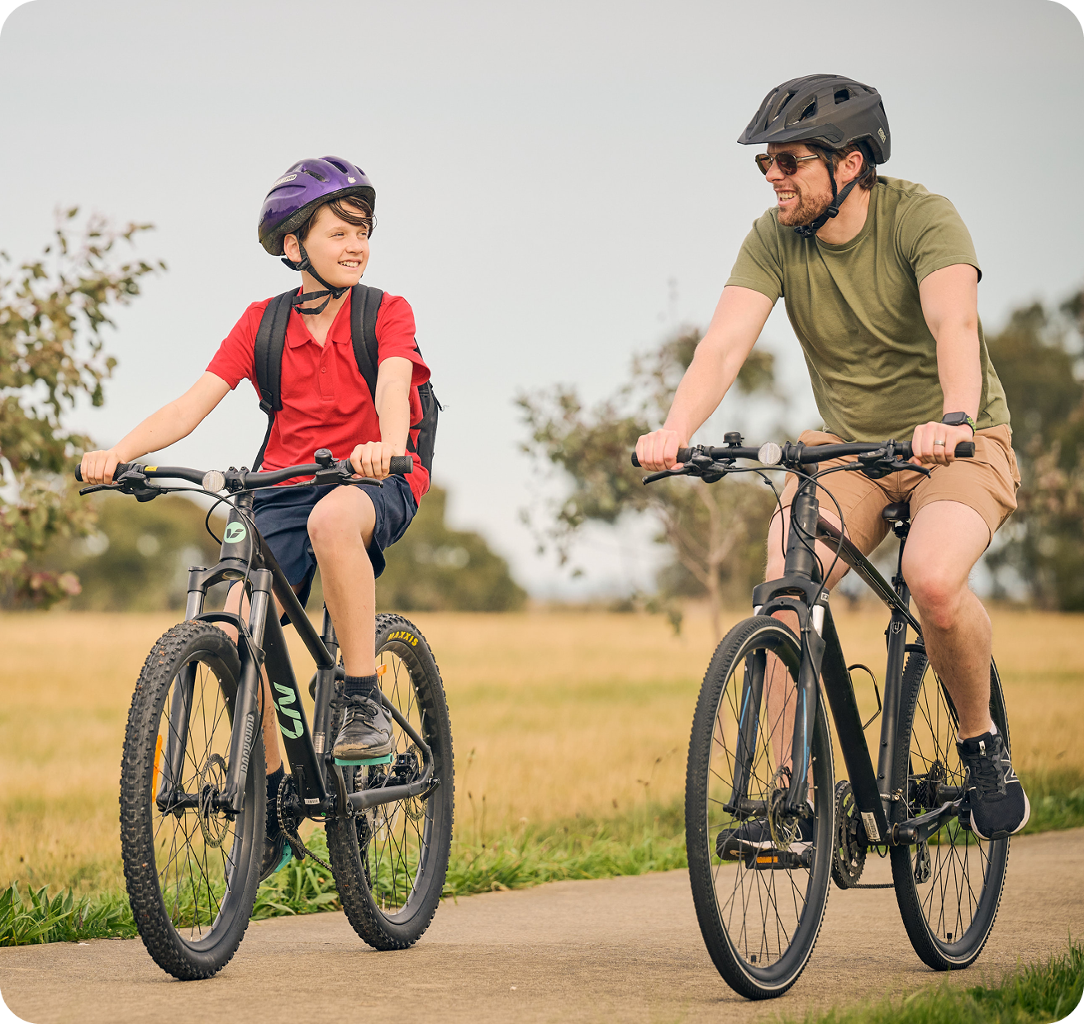
Plan ahead for a safe journey
Support your child in planning and travelling independently and safely.
Choose the safest route – this may not necessarily be the quickest
Travel the route together before the term starts
  Use quiet streets and roads with 40 km/h speed limits or less
  Avoid high-speed roads and complex intersections
Discuss any possible hazards and how to avoid them

Slide 5

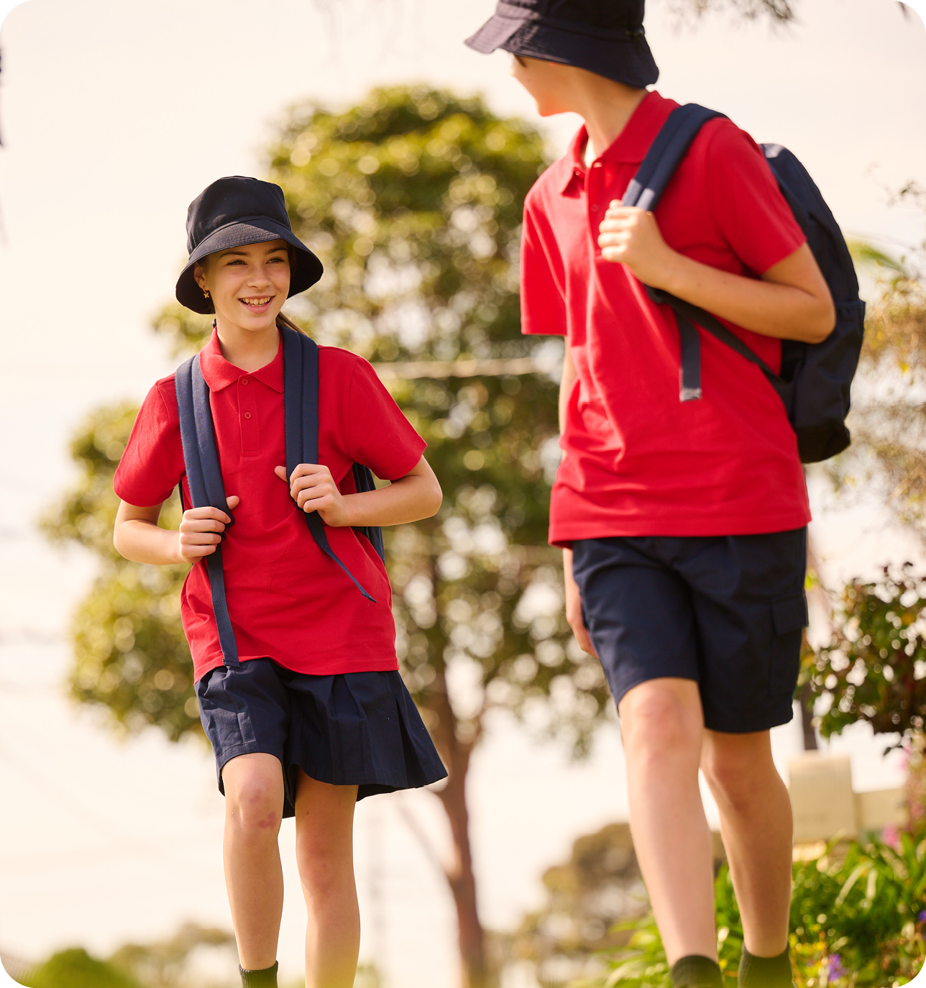
Encourage walking to school
Active forms of travel are great for health, well-being, and the environment.
If walking, remind your child to:
  Avoid distractions like phones when crossing roads
  Cross roads at pedestrian crossings, pedestrian signals and places where drivers can see them

Slide 6

Cycle safely to school
DID YOU KNOW?
Helmets can reduce head injury risk by 74%.¹
Cycling is a great form of active travel.
To ensure your child cycles safely:
Plan the safest route: bike paths, shared-use paths or roads with bike lanes
Bikes must have a bell, working brakes, and a rear reflector
Wear a helmet that meets Australian Standards
It is also important that your child knows:
  Not wearing a helmet incurs a $254 fine
  E-scooters are dangerous and illegal for under 16s in Victoria – fine = $305
1 Bambach, M. R., Mitchell, R. J., Grzebieta, R. H., Olivier, J. The effectiveness of helmets in bicycle collisions with motor vehicles: A case-control study. Accident Analysis and Prevention, Issue 53, 2013.

Slide 7
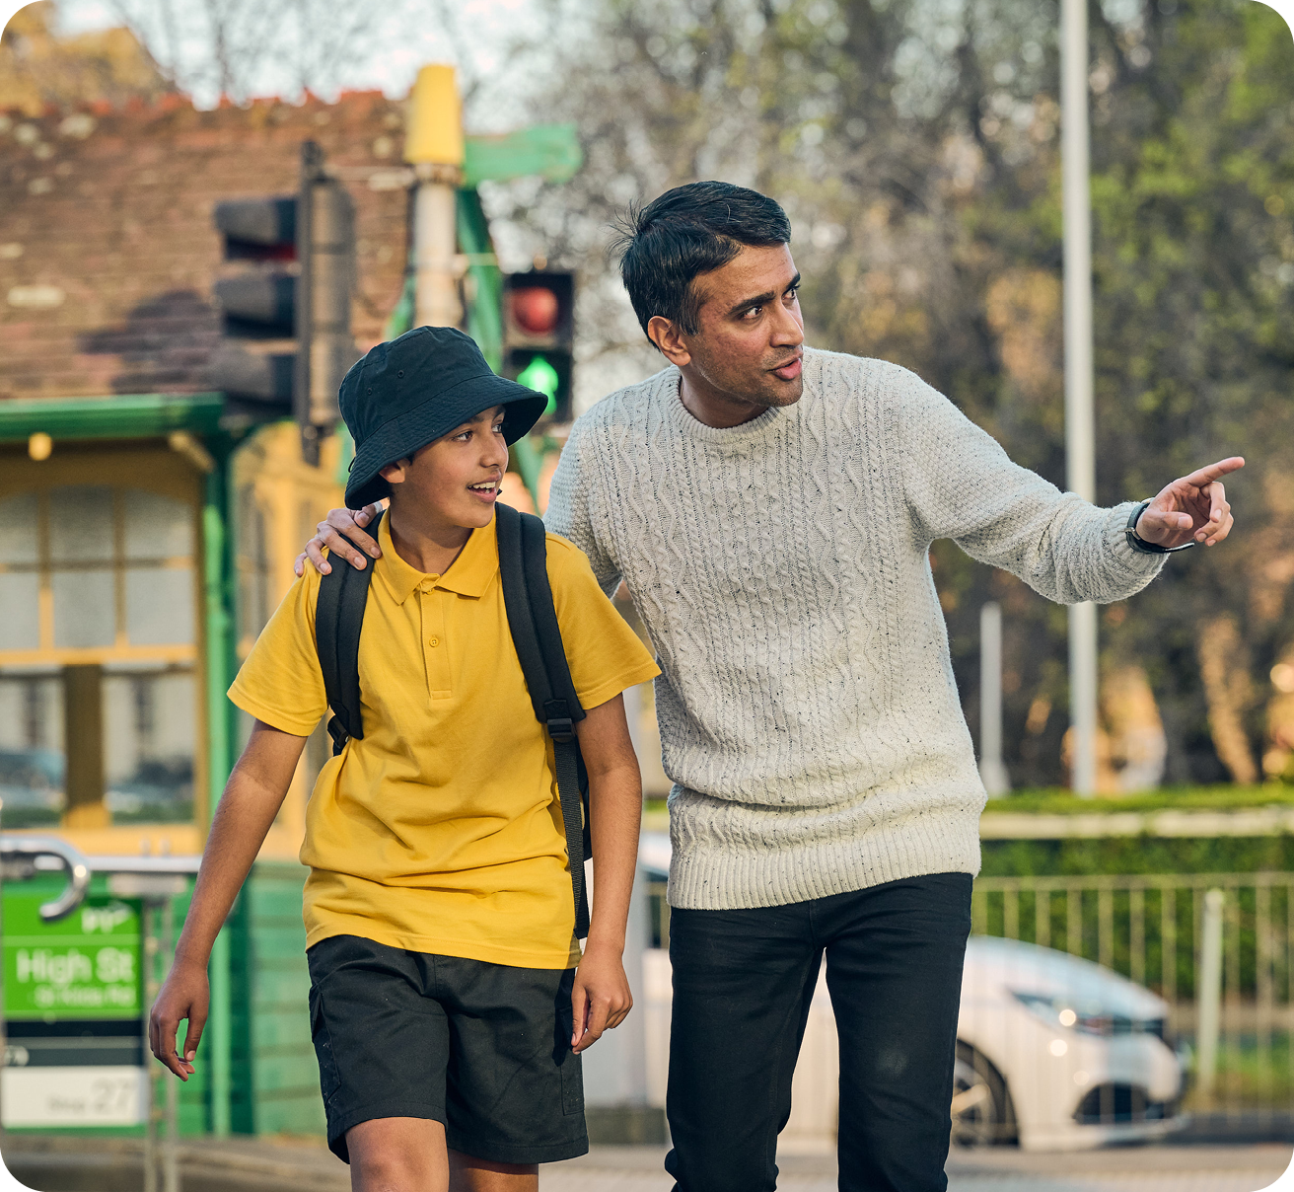
Support safe and smart public transport use
Help your child prepare to use public transport safely.
Practice public transport routes together before school starts
Remind your child:
  Stand behind the yellow line at stations
  Keep away from the road at bus/tram stops
  Never cross in front of or behind a bus or tram – instead, get off onto the nearest footpath

Slide 8

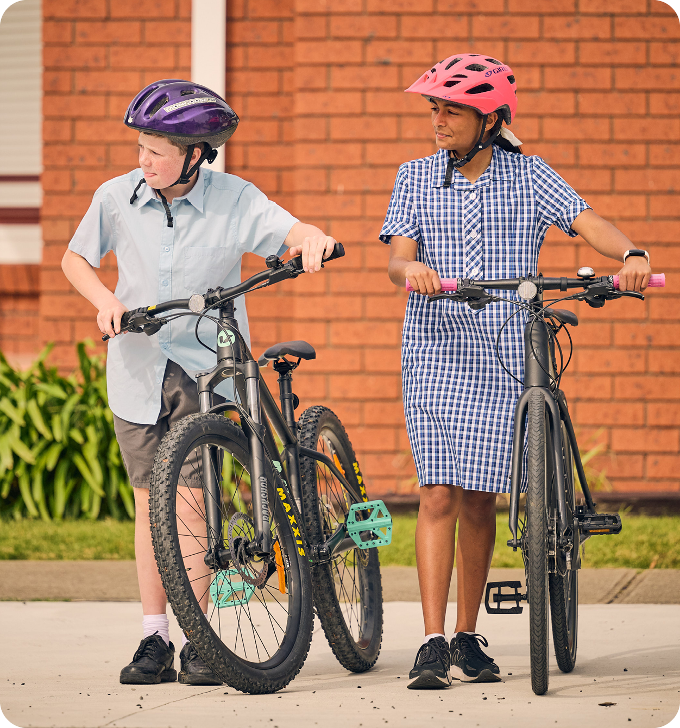
Drive and park safely
If you drive your child to school, prioritise safety.
All passengers must wear seatbelts or use booster seats as required
Use designated drop-off zones and follow all road rules
Consider parking a short distance from school and walking the rest – it eases congestion and improves safety near the gate

Slide 9

Road safety at our school
Tip #1
Tip #2
Tip #3
DID YOU KNOW?
Insert a tip or fact...

Slide 10

Additional resources
Click the below links to learn more.
Public Transport tips
Cyclist safety
E-scooter road rules
Bike Ed Program for schools
Road Safety Education Victoria
If you have any questions about these resources, please contact the TAC Education Team at roadsafetyeducation@tac.vic.gov.au

