Slide 1

Step Into Safety Level 1-2
Image Resources

Slide 2
Session 6
Understanding Common Pedestrian Traffic Signs

Slide 3
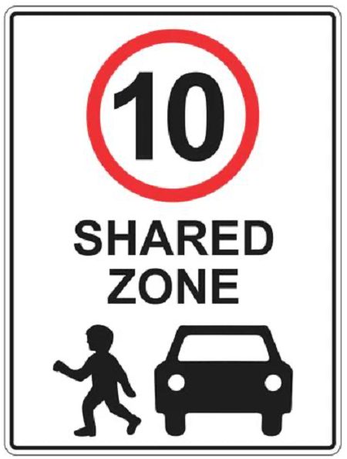

Slide 4


Slide 5


Slide 6


Slide 7
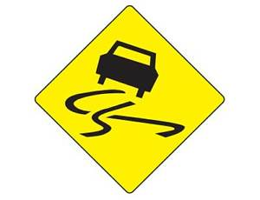

Slide 8


