Slide 1

Step Into Safety Level 1-2
Image Resources

Slide 2
Session 1
Defining Safe, Not Safe, Maybe Safe

Slide 3
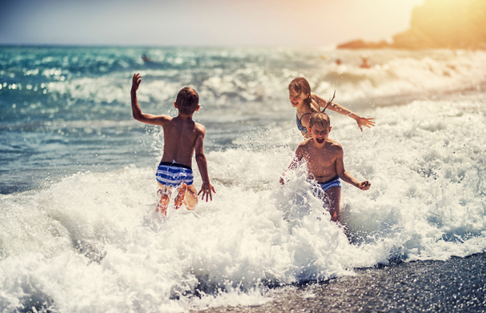
Notes:
MAYBE SAFE- Use this image to discuss the importance of being careful at the beach, wearing sunscreen and sun-safe clothing, not going out too far etc.

Slide 4
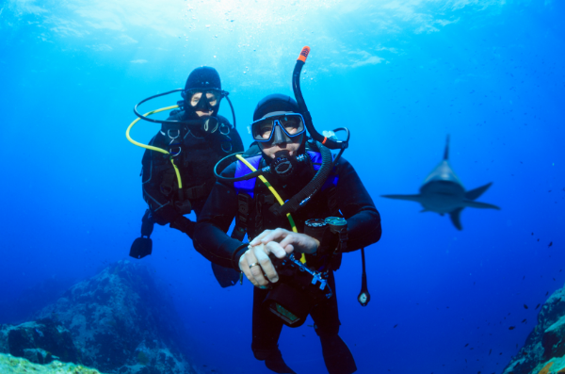
Notes:
UNSAFE

Slide 5
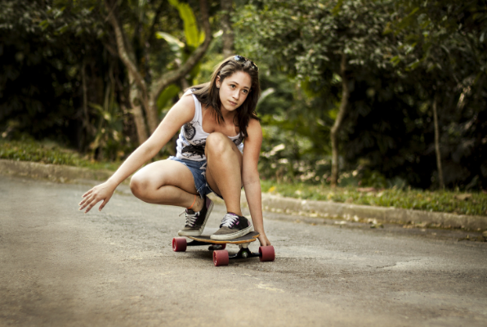
Notes:
MAYBE SAFE- wearing a helmet would make this situation safer

Slide 6
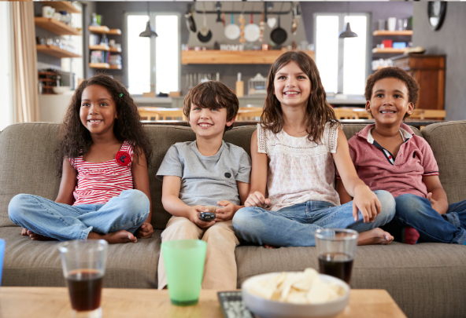

Slide 7
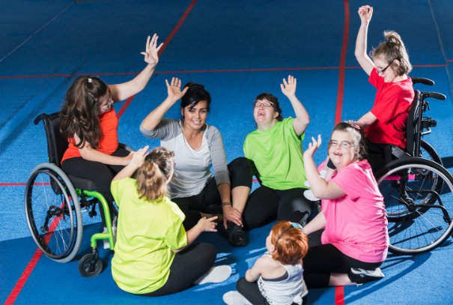

Slide 8
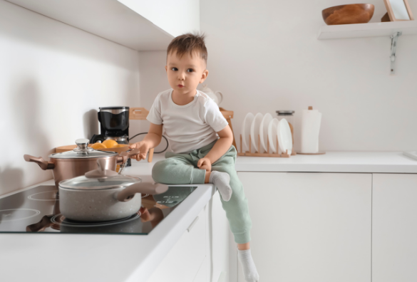

Slide 9
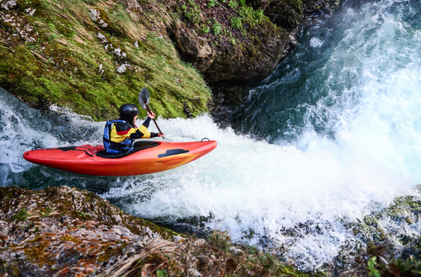

Slide 10
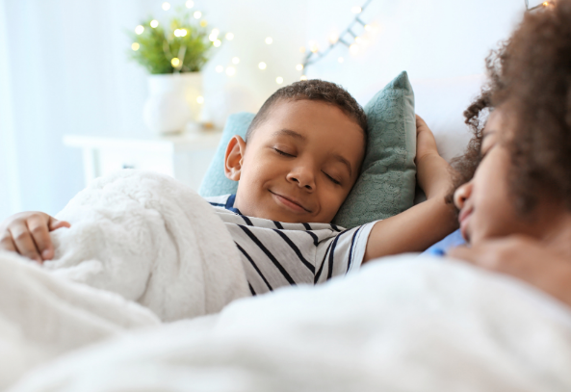

Slide 11
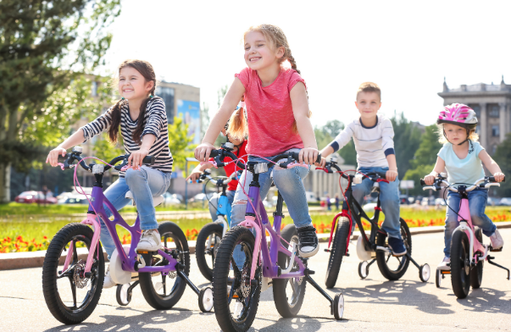
Notes:
MAYBE SAFE- Wearing helmets would make this image safer

