Slide 1

Practical resources to spark important conversations about safe travel to and from school.
Feel free to add extra slides to suit your school community, but please do not alter existing road safety content.

Slide 2



This video is part of the TAC’s Safe Migration Project, designed to help parents and carers establish safe travel habits with their children from the very beginning of primary school.

Slide 3

Try using active forms of travel and plan the safest route
Walking, scootering, and cycling are healthy, fun and environmentally friendly ways to travel to school.
Choose the safest route – this may not always be the quickest
  Choose streets with low-speed roads (40km/h or less)
  Cross at pedestrian crossings, pedestrian signals & places where drivers can see you
Avoid busy roads and complex intersections

Slide 4

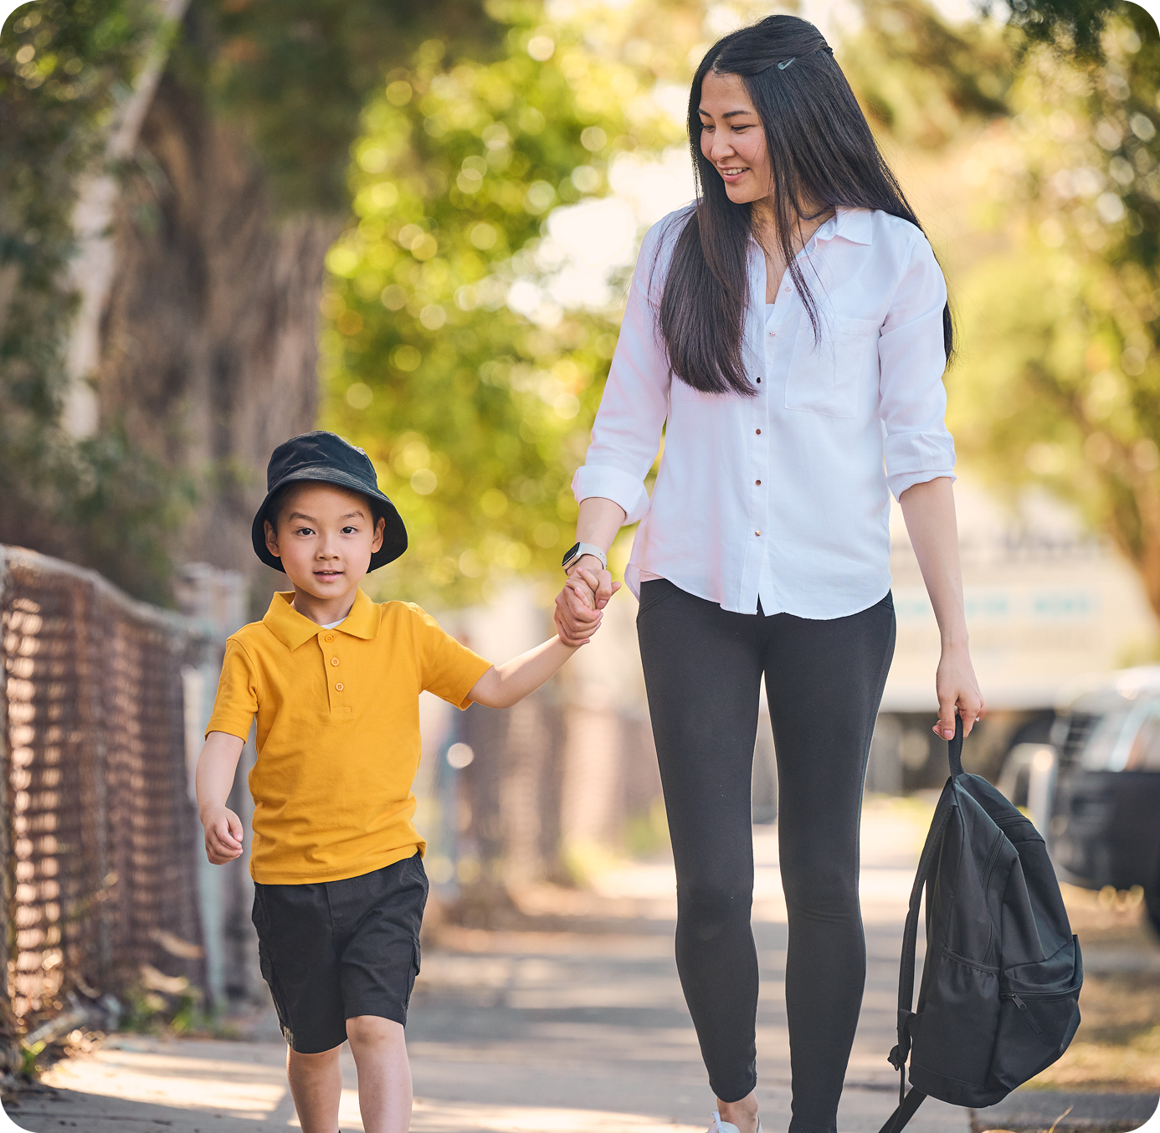
Stay close to children when walking
Young children need close supervision on and around roads.
Always hold their hand when near traffic and crossing roads
Ensure you can always actively supervise
Role model “Stop, Look, Listen, Think” when crossing the road

Slide 5

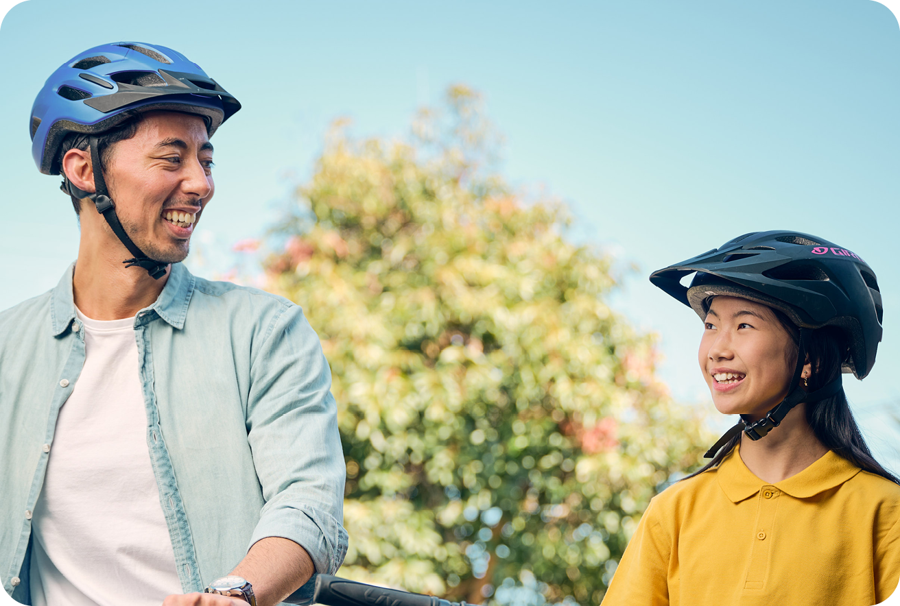
Ride safely on scooters and bikes
Scootering and cycling are great active travel options.
Helmets are a legal requirement for everyone and must meet Australian Standards
Use footpaths on low-speed roads,
shared-use paths and bike paths
Ensure you ride with a bell, an effective brake, and a rear reflector on bikes
You can cycle on the footpath with your
child if they are 12 years or younger
DID YOU KNOW? Helmets can reduce head injury risk by 74%.
1 Bambach, M. R., Mitchell, R. J., Grzebieta, R. H., Olivier, J. The effectiveness of helmets in bicycle collisions with motor vehicles: A case-control study. Accident Analysis and Prevention, Issue 53, 2013.

Slide 6
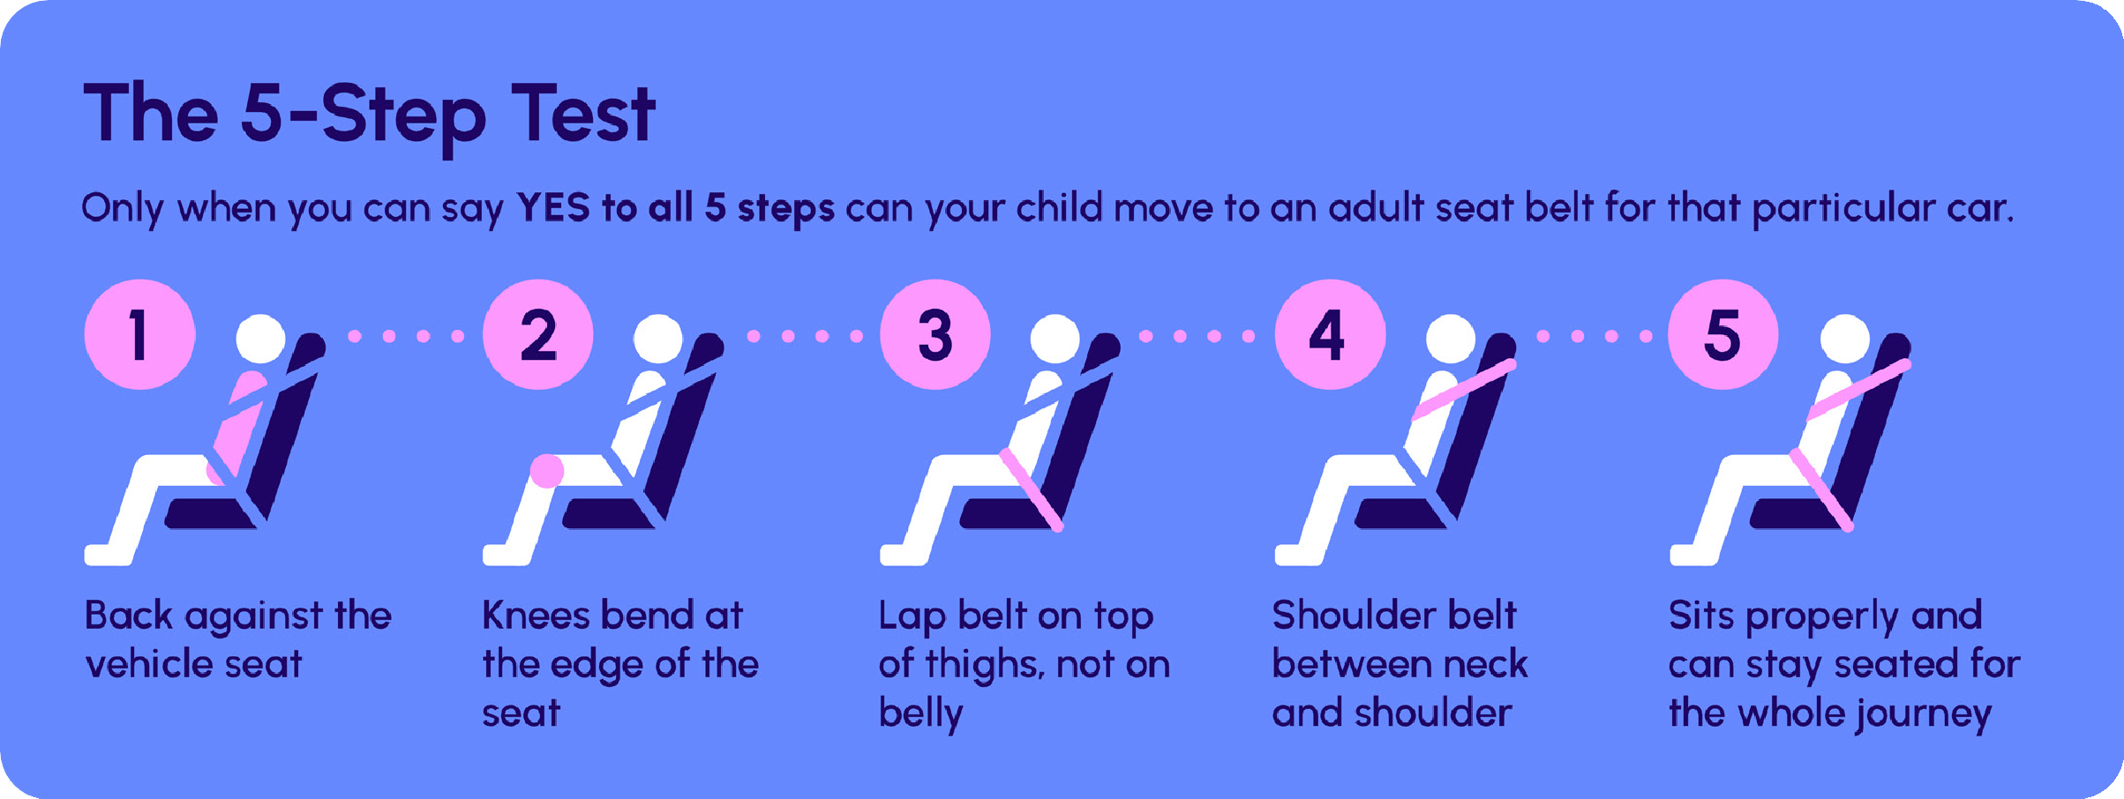
Ensure children are safe as passengers
If driving to school, prioritise safety.
Children should travel in the rear seat with the correct restraint or booster for their size
Booster seats are needed until children can pass the 5-Step Test (typically age 10–12)
Children should use the rear kerbside door (safety door) when entering and exiting the car

Slide 7

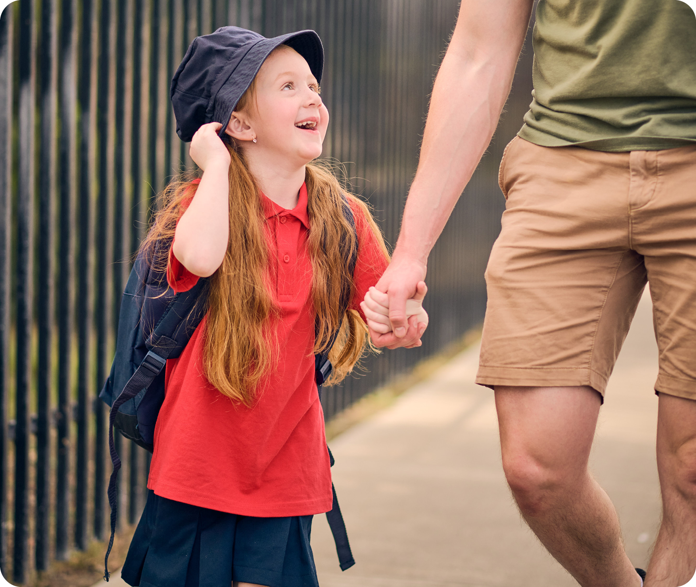
Slow down when driving
Help keep school neighbourhoods safe and calm.
Slow down near schools - children are small, can be unpredictable, and hard to see
Drive below the speed limit – especially during drop-off and pick-up times
Park a short distance away and walk to the gate to reduce congestion

Slide 8

Road safety at our school
Tip #1
Tip #2
Tip #3
DID YOU KNOW?
Insert a tip or fact...

Slide 9

Additional resources
Click the below links to learn more.
Child car seats
Cycling with children
Bicycle helmets
Road Safety Education Victoria
If you have any questions about these resources, please contact the TAC Education Team at roadsafetyeducation@tac.vic.gov.au

