Slide 1

Introduction of the Safe System in Australia and New Zealand
Notes:
Welcome to Module 2, Snippet 4 of Safe System for Universities. In this snippet, we will take a look at Australia’s and New Zealand’s Safe System journey, what has been achieved so far, and what needs to be done as we navigate the path to zero harm.

Slide 2
Press enter to continue
1.0
01 Jul 2020

Slide 3
About this snippet
This snippet is made up of a number of sections. Click on the below links to go through each section. To advance a slide, press enter on your keyboard or click the slide.
Start here
Go to
What is still required
Go to
Introduction of the Safe System
Go to
What we have achieved
Notes:
This snippet is made up of a number of sections. Click on the below links to go through each section. To advance a slide, press enter on your keyboard or click the slide. If you miss anything that has been said, you can replay the narration to each slide. A printed version of the narrative is also provided in the curriculum guideline.

Slide 4
Introduction of the Safe System
Notes:
The Safe System has been integrated into Australian and New Zealand road safety practices since the early 2000s. Firstly, let’s take a look at our journey since we adopted this road safety philosophy.

Slide 5
Press enter to continue
Introduction of the Safe System
Swedish Parliament’s adoption of Vision Zero
“It can never be ethically acceptable that people are killed or seriously injured when moving with the road transport system”
Safe System is endorsed by
the Australian Transport Council
2000
2006
1997
2003
Safe System underpins Australia’s
National Road Safety Strategy 2001-2010
Safe System underpins Austroads’ first
Guide to Road Safety
Notes:
The Safe System can ultimately be traced back to the pioneering work undertaken by Sweden in the 1990s. In 1997, the Swedish Parliament adopted Vision Zero as their ethical mandate to pursue a new direction in road safety. Headlining Vision Zero was the call for no people to be killed or seriously injured when using the road transportation system. While Sweden still suffers from fatal and serious injury outcomes from road crashes, it has seen a dramatic downturn in the number of people harmed on it’s roads and today it represents a as a leading example in the pursuit of zero harm.
Australia’s initial moves towards the Safe System occurred in the early 2000s. In the year 2000, Safe System principles were used to underpin Australia’s national road safety strategy for the years 2001 to 2010. This was followed by endorsement of the Safe System in 2003 by the Australian Transport Council. Though these initial steps where symbolic, more tangible steps were to be taken in the successive years.
In 2006, the first edition of Austroads’ guide to road safety was released as Australia’s and New Zealand’s leading source of road safety guidance. These guides were headlined by the acknowledgement that the Australian and New Zealand road transportation systems must progressively move towards the Safe System. Since this time, acknowledgement of the Safe System has been included in several Austroads guides. However, as we will later discuss, introduction of the Safe System into Australasian road design and operational guidance has arguably been limited to acknowledgement of the guiding principles of harm elimination, with limited resources for implementing its practical considerations.

Slide 6
Press enter to continue
The Safe System in strategy
Northern Territory
Road safety action plan
2018-22
Queensland
Road safety strategy
2012-2021
New South Wales
Road safety strategy
2012-2021
New Zealand
Road safety strategy
2020-2030
Western Australia
Road safety strategy
2008-2020
Australian Capital Territory
Road safety strategy
2011-2020
South Australia
Road safety strategy
2020
Victoria
Road safety strategy & action plan
2016//2020
Tasmania
Road safety strategy
2017-2026
Notes:
Following suit from the federal level, the road safety strategies and action plans for each Australian state and New Zealand place the Safe System and a strategic goal of harm elimination at the top of their agenda. With most of these strategies and action plans due for renewal now or in the near future, each successive strategy and action plan is set to provide a renewed push towards this target. Crucially, each strategy and action plan will now need to clearly state how a sustained, long-term plan towards a target of zero fatal and serious injuries will be managed.

Slide 7
Press enter to continue
Failing the Safe System
National inquiry:
Implementation failure
Safety is often assumed
Opportunities missed when “safer” rather than “safe” is accepted
INQUIRY INTO THE
NATIONAL ROAD
SAFETY STRATEGY
2011-2020
SEPTEMBER 2018
2010
2018
National Road Safety Strategy 2011-2020
Notes:
In 2010, Australia’s new national road safety strategy for 2011 to 2020 was released. This new strategy renewed the national vision that no person should be killed or seriously injured on Australia’s roads. As with New Zealand’s latest road safety strategy, which was released in 2019, it is expected that the next Australian national road safety strategy will continue with this vision of attaining a road system where no person is killed or seriously injured.
Despite these bold visions and equally bold target setting, a national inquiry into Australia’s national road safety strategy was announced following a halt to the downward trend in fatal and serious injuries. This inquiry, released in September 2018, detailed some of the failings within the management of our road transportation system. Despite the demonstrated strategic importance of the Safe System, we have failed to implement the Safe System at a practical level. Additionally, safety is often assumed as implicit with every new road project or redevelopment of the existing network. Opportunities are missed when making things safer, rather than outright safe, is accepted as a reasonable outcome. In other words, safety is improved but not optimised.

Slide 8
What we have achieved
Notes:
Despite so far falling short of Safe System ideals, we have nonetheless attained some considerable achievements in road safety over the past two decades. Now, let’s take a look at some of our achievements.

Slide 9
Current achievements
Press enter to continue
Strategy
E.g. National Road Safety Strategy, state-based strategies
Notes:
In both Australia and New Zealand, the Safe System has been firmly cemented as the future of road safety. Strategic targets have been underpinned by the goal of attaining zero fatal and serious injuries on our road network. However, as highlighted in Australia’s current national road safety strategy, it is not an implementation plan. Detailed planning, an informed system management and the right tools will be required to enact such strategy.

Slide 10
Current achievements
Press enter to continue
Strategy
High level guidance
E.g. New Zealand High-risk Rural Roads and High-risk Intersections guides, Austroads Guide to Road Safety
Notes:
High-level guidance is available across Australia and New Zealand. Safe System principles have been implemented to varying degrees. Austroads, which forms the peak organisation of Australian and New Zealand road transport agencies, has recently released its third edition of its guide to road safety. Additional guidance is distributed by individual road agencies, such as supplemental guidelines and New Zealand’s high-risk guides.

Slide 11
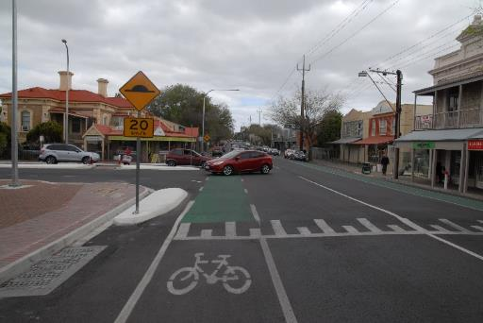
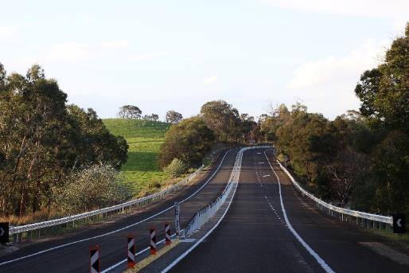
Current achievements
Press enter to continue
Strategy
Showcase projects
E.g. Kent Town raised plateau intersection (South Australia) (below left),
Melba Highway overtaking lane (Victoria) (below right)
High level guidance
Source: Centre for Automotive Safety Research
Source: Safe System Solutions
Notes:
An increasing number of showcase and demonstration projects have been completed across Australia and New Zealand. Many of these projects highlight design and operational solutions that can achieve near Safe System levels of performance. Further to these projects, some works have been implemented on a scale that has made a perceivable impact. Such examples include the Princes Highway through the eastern region of Victoria, the Bruce Highway in Queensland and the Waikato Expressway in New Zealand.

Slide 12
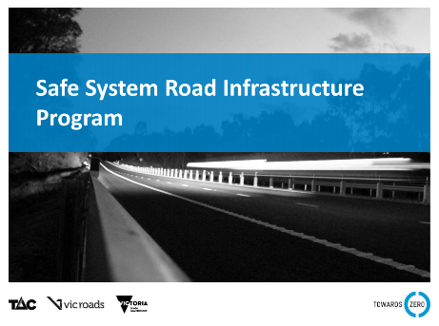
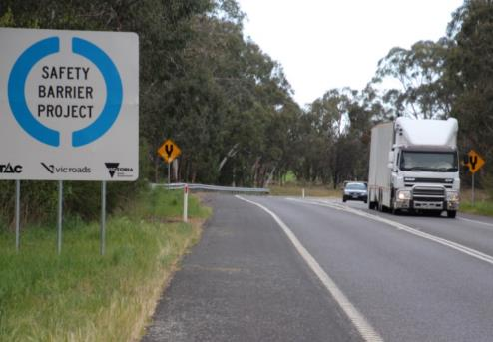
Current achievements
Press enter to continue
Strategy
Showcase projects
High level guidance
Program alignment
E.g. Towards Zero Safe System Road Infrastructure Program (Victoria)
Source: Regional Roads Victoria
Notes:
A number of road safety programs have sought alignment to the Safe System. A key example is the Towards Zero safe system road infrastructure program in Victoria, which has a dedicated one point four billion dollar funding over ten years to implement wide-scale road safety improvements, including Safe System aligned demonstration and targeted projects.

Slide 13
Current achievements
Press enter to continue
Strategy
Showcase projects
Science-based research
E.g. University-based research centres:
CASR (South Australia)
MUARC (Victoria)
CARRS-Q (Queensland)
TARS (New South Wales)
TRG (New Zealand)
Other organisations:
ARRB (Victoria)
ACRS (Australia and New Zealand)
High level guidance
Program alignment
Notes:
Australia and New Zealand contain a number of university-based road safety research centres. These centres, along with other road safety organisations, have contributed a sizeable amount of literature to the road safety field. Key outcomes of this research include demonstrating the clear link between speed and the risk of fatal and serious injuries, identifying the superior performance of road safety barriers over clear zones, and the creation of Safe System tools aimed towards enabling road safety practitioners.

Slide 14
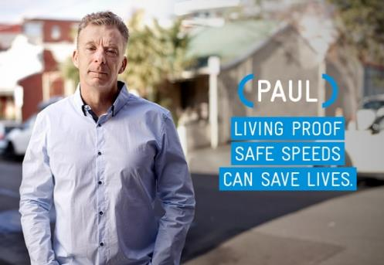

Current achievements
Press enter to continue
Strategy
Showcase projects
Science-based research
Public campaigns
E.g. Road safety advertisements, awareness campaigns
High level guidance
Program alignment
Source: Traffic Accident Commission of Victoria
Notes:
Australia has arguably led the way in terms of public road safety campaigns. Historically, these have targeted the traditional road user-oriented problem areas such the fatal-five of speeding, drink-driving, seatbelt use, distraction and fatigue. More recently, such public campaigns have started to educate the public on the goal of attaining zero harm and the need for a system-based response to the road safety problem.

Slide 15
What is still required
Notes:
Moving forward into the future, there is still a sizable amount of work that needs to be done if we are to realise the Safe System ideal of zero harm. We will finish this snippet by discussing some work that will be required going forward.

Slide 16
Future needs
Press enter to continue
Strategy
Showcase projects
Science-based research
Public campaigns
High level guidance
Program alignment
Practical guidance
E.g. Austroads Towards Safe System infrastructure: a compendium of current knowledge
Notes:
Recently, a number of practical guidance publications and tools have been released for use by road safety practitioners. These include the likes of the Austroads’ compendium of current knowledge and safe system assessment framework, and New Zealand’s infrastructure risk rating tool. This guidance is aimed as supplementing the current Austroads’ and other guides and provides Safe System-aligned information at a level that is still largely missing in the traditional guidelines.

Slide 17
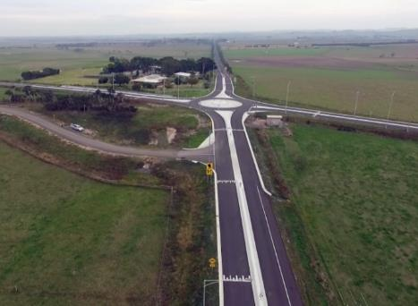
Future needs
Press enter to continue
Strategy
Showcase projects
Science-based research
Public campaigns
High level guidance
Program alignment
Practical guidance
Innovation
Source: Regional Roads Victoria
Notes:
While showcase and demonstration projects have highlighted a need for innovation in the way we approach the design and operation of our road network, such innovation is largely missing in mainstream works. Both road safety specific and more general road projects will need to incorporate innovative solutions, backed by suitable guidance and tools that enable innovation to be used.

Slide 18
Future needs
Press enter to continue
Strategy
Showcase projects
Science-based research
Public campaigns
High level guidance
Program alignment
Professional education
Practical guidance
Innovation
E.g. Industry education, emerging education at tertiary institutions
Notes:
Professional education is a key enabler of road safety as without knowledge of the Safe System and how to implement its principles as practical solutions, achieving Safe System-alignment will be all but impossible. Some tertiary and professional education is currently available but its availability is sporadic and the quality of content is arguably inconsistent.

Slide 19
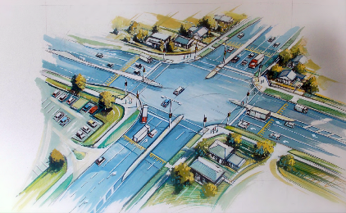
Future needs
Press enter to continue
Strategy
Showcase projects
Science-based research
Public campaigns
High level guidance
Program alignment
Professional education
Practical guidance
Innovation
Science-based practice
Source: Regional Roads Victoria
Notes:
Science-based practice is largely missing from the practical implementation of road safety solutions. While a large body of evidence is available, much value is placed on empirical evidence and waiting until practices become mainstream before engaging in them. Unfortunately, this is incompatible with the scale and pace of change that is required. To overcome this, more weighting will need to be placed on theoretical evidence to compensate for where empirical evidence is lacking.

Slide 20
Future needs
Press enter to continue
Strategy
Showcase projects
Science-based research
Public campaigns
High level guidance
Program alignment
Professional education
Practical guidance
Innovation
Science-based practice
Widespread implementation
Notes:
Widespread implementation of Safe System practices will need to be undertaken if harm elimination is to be achieved. At this time, widespread implementation remains unachievable with a lack of knowledge on how this is to be achieved, lack of tools to enable practitioners to prioritise safety, and a lack funding made available and conditional on meeting specific road safety targets.

