Slide 1

Eliminating harm to vulnerable road users
Notes:
Welcome to Module 3, Snippet 4 of Safe System for Universities. In the last two snippets, we have discussed ways in which harm can be eliminated for motor vehicle users. Now, we will look at how to eliminate harm for vulnerable road users.

Slide 2
Press enter to continue
1.0
01 Jul 2020

Slide 3
About this snippet
This snippet is made up of a number of sections. Click on the below links to go through each section. To advance a slide, press enter on your keyboard or click the slide.
Start here
Go to
How does harm occur?
Go to
Supporting treatments
Go to
Primary treatments
Notes:
This snippet is made up of a number of sections. Click on the below links to go through each section. To advance a slide, press enter on your keyboard or click the slide. If you miss anything that has been said, you can replay the narration to each slide. A printed version of the narrative is also provided in the curriculum guideline.

Slide 4
How does harm occur?
Notes:
Firstly, let’s take a look at what a vulnerable road user is and how they can be harmed.

Slide 5
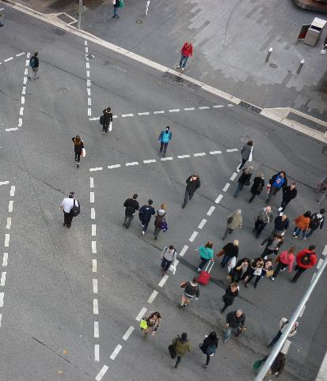
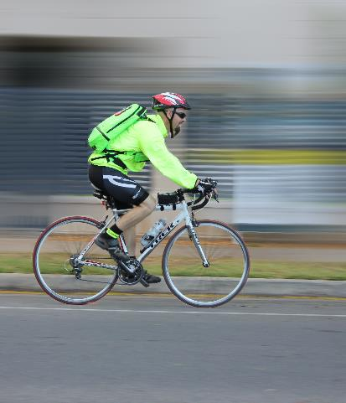
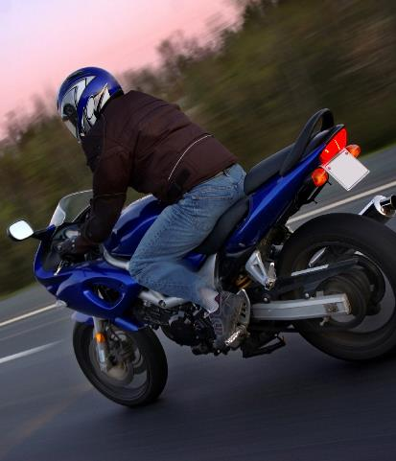
What is a vulnerable road user (VRU)?
Press enter to continue
Pedestrians
Bicyclists
Motorcyclists
Source: Centre for Automotive Safety Research
Source: Centre for Automotive Safety Research
Source: iStock.com (shaunI)
Notes:
A vulnerable road user, or VRU for short, is any road user mode that is especially susceptible to harm. This is generally because of a lack of protection normally afforded by being an occupant of a motor vehicle. Pedestrians, bicyclists and motorcyclists are the most common forms of vulnerable road users, although this category also includes the likes of skateboarders, mobility scooter users and others.
While pedestrians and bicyclists are often talked about in the same conversation, motorcyclists are generally discussed separately due to their individual problems and needs. In this snippet, we will focus on pedestrians and bicyclists. Motorcyclists will be discussed in next Snippet.

Slide 6
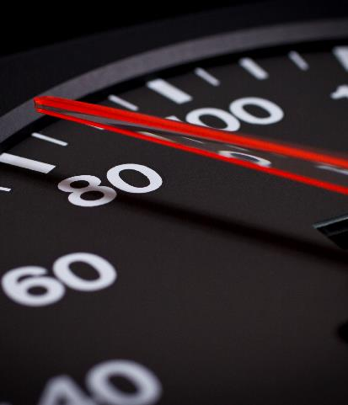
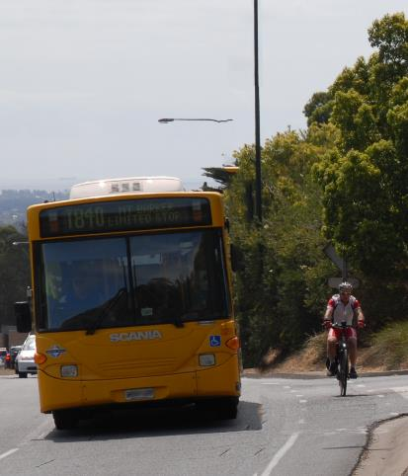
Mechanisms of harm
Press enter to continue
Fragility
Speed
Mass inequality
Source: Centre for Automotive Safety Research
Source: iStock.com (sndr)
Source: Centre for Automotive Safety Research
Notes:
Vulnerable road users are particularly susceptible to harm. This is due to a combination of fragility, speed and mass.
The human body is fragile. Compared to the structure of a motor vehicle, it is particularly susceptible to damage. Occupants of most modern motor vehicles are protected from harm by the surrounding structure of the vehicle. When a crash occurs, the vehicle’s protective structure absorbs most of the crash energy, reducing the potential for harm to occur to its occupants. Vulnerable road users are generally afforded no protection by their particular mode. When a crash occurs, all of the crash energy is absorbed by the human body.
Speed is also a major contributor to harm. The human body evolved to survive low speed impacts, such as running into a solid object or falling from a low height. The human body was never designed to cope with the forces of a crash with a high speed motor vehicle.
Mass is the other contributor to the harm endured by vulnerable road users. When two objects of equal mass collide, they both undergo the same acceleration. As one of the objects decreases in mass relative to the other, its acceleration becomes greater. This is Newton’s three laws of motion in practice. Vulnerable road users tend to be much less massive than the objects they collide with. It results that in a crash, most of the acceleration is undergone by the vulnerable road user and not the other object with which the vulnerable road users collides.

Slide 7
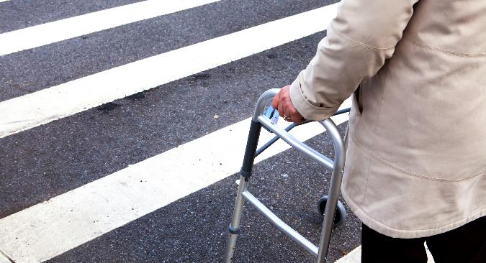
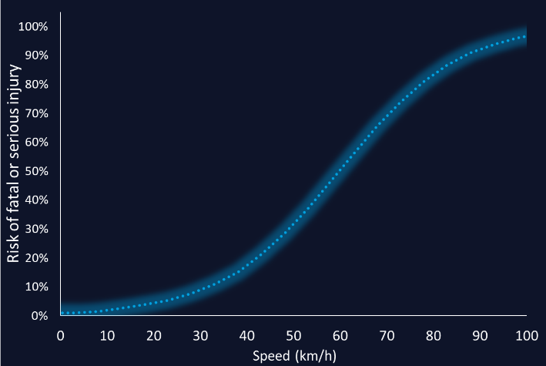
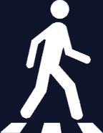
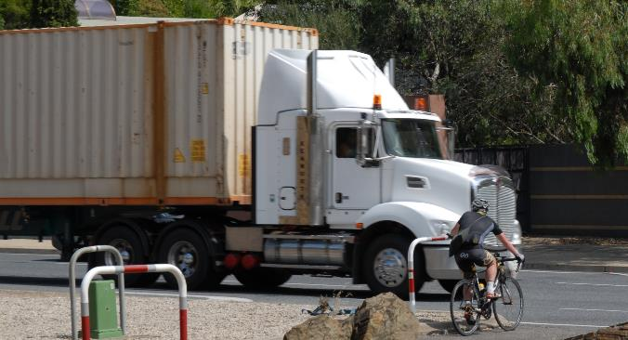
The safe interaction speed
Press enter to continue
Source: iStock.com (ericsphotography)
Source: adapted from Jurewicz et al (2015)
Source: Centre for Automotive Safety Research
Notes:
Generally speaking, there is a speed at which pedestrians and cyclists can safely interact with motorised traffic. Above this speed, a risk of fatal or serious injury outcomes exists and it no longer becomes acceptable for interactions to occur. This speed is often cited as being 30 km/h to prevent fatal outcomes, though it could be as low as 20 km/h if serious injuries are also to be prevented.
The speed at which interaction is safe is also going to be dependent on the road users themselves. For example, children and the elderly are more susceptible to injury and so the safe interaction speed is likely to be lower.
For some interactions, there may be no safe speed, such as between pedestrians, cyclists and heavy vehicles. Interactions like these are unsafe regardless of speed and must be dealt with in other ways.

Slide 8
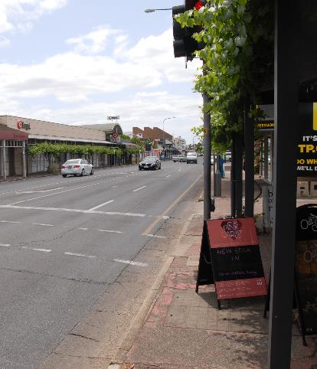
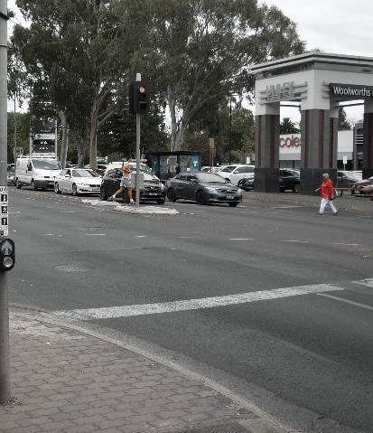
The current system
Press enter to continue
Access needs often secondary to motorised modes
Specific needs not well-considered
Intersections are good example of poor integration
Source: Centre for Automotive Safety Research
Source: Centre for Automotive Safety Research
Source: Centre for Automotive Safety Research
Notes:
Currently, our road networks generally do not cater well for vulnerable road users. In urban areas, space is often at a premium, meaning within the carriageway there is competition between the use of space for different modes. Our consideration of the road network function largely follows a motor vehicle-oriented perspective. While walking and cycling can be well catered for where space and a well-conceptualised demand exits, the needs for these modes are generally underserviced in order to cater for the larger demand for motor vehicle access.
In the context of a road transportation system, pedestrians and cyclists are viewed as another mode of transportation alongside motorised forms. This has produced a legacy whereby pedestrians and cyclists are required to fit the system laid out in this context. As a result, pedestrians and cyclists are often required to interact with motorised modes without much consideration for their specific needs. In other words, access to the system is granted without consideration of their extreme vulnerability.
As an example, consider an standard signalised intersection. Pedestrians may have their own phase and cyclists are often required to use the same phase as motor vehicles. However, both are required to intersect with motor vehicle streams, which at these locations operate under speed conditions that do not take into account the extreme vulnerability of the pedestrians and cyclists with which they interact.

Slide 9
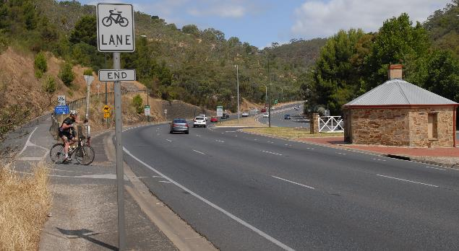
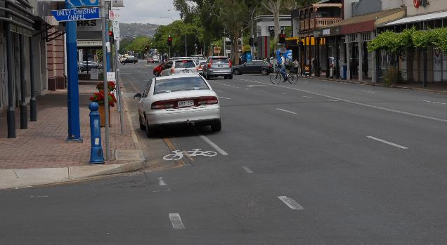
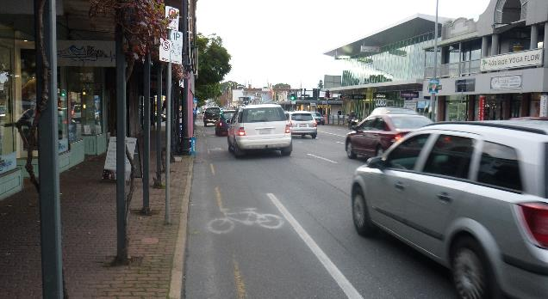
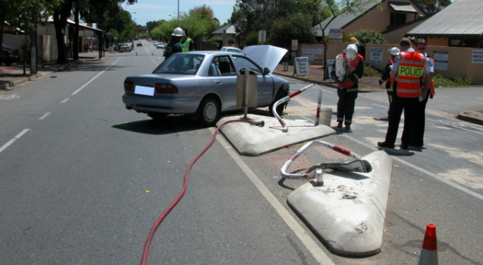
Route level access
Press enter to continue
Source: Centre for Automotive Safety Research
Source: Centre for Automotive Safety Research
Notes:
While cyclists and pedestrians are well-catered for in some discrete sections of the road network, route level access can have many gaps. A common gap is accessibility across heavily-trafficked roads, where priority is given to the larger volumes of motor vehicles and often requires people to judge gaps in traffic in order to cross.
When space becomes a premium, pedestrian and cyclist are often the first to lose accessibility. Examples are bicycle lanes running out before intersections, where additional space is required for turning lanes; and narrow footpaths alongside multi-lane roads.
Pedestrian and cyclist facilities are often required to perform several functions. For instance, bicycle lanes often revert to on-road parking outside of peak traffic times. Footpath space is generally required for multiple functions, such as space for utilities and roadside furniture; and uses common to the adjacent land, such as dining facilities outside of restaurants.
Where space is provided, the comfort and vulnerability to harm of pedestrians and cyclists is often not well-considered. Footpaths can run alongside roads without any perceived or real protection from errant vehicles or those simply accessing adjacent land. Bicycle facilities often reside on the roadway itself, with little room between cyclists and high speed traffic, let alone any form of physical separation able to protect cyclists from vehicles or cyclists straying out of their lanes.

Slide 10
Primary treatments
Notes:
Next, we will take a look at the primary Safe System aligned treatments available to help eliminate harm to pedestrians and cyclists.

Slide 11
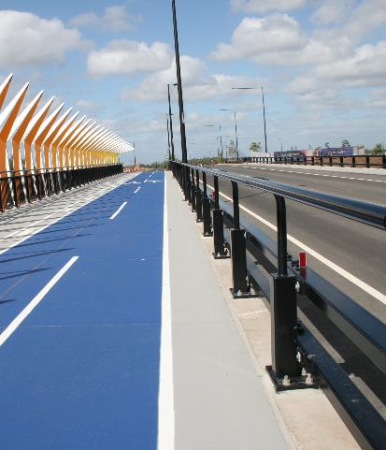
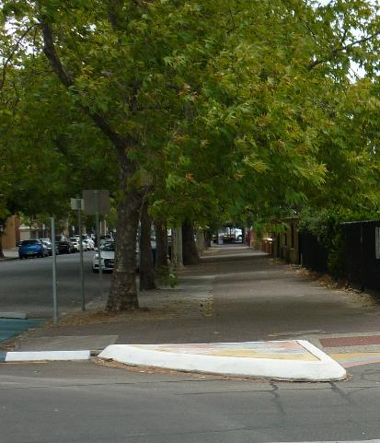
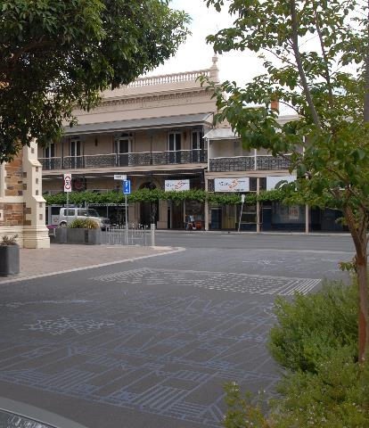
Primary treatments for pedestrians
Press enter to continue
Physical separation where high speeds/risk of errant vehicles exists
Spatial separation where traffic speeds are moderate
Minimal separation at safe interaction speeds
Source: Safe System Solutions
Source: Centre for Automotive Safety Research
Source: Centre for Automotive Safety Research
Notes:
Primary treatments for eliminating harm are essentially similar for both pedestrians and cyclists. They must be separated from motorised traffic or traffic speeds must be managed to safe interaction speeds. For pedestrians, this means providing separation between footpaths and roads where traffic speeds are above the safe interaction speed.
In some locations, physical separation may not be desirable from an amenable or aesthetic perspective. At moderate urban speeds, spatial separation such as through the use of vegetation strips may be considered as adequate, though this in itself may not always guarantee a safe outcome.
Where motorised vehicle speeds can be managed to acceptable levels, there can be minimal separation between them and vulnerable road users. With careful design, mixing these road users modes can itself help to manage motor vehicle speeds as the road environment becomes ambiguous and motor vehicle priority is no longer perceived.

Slide 12
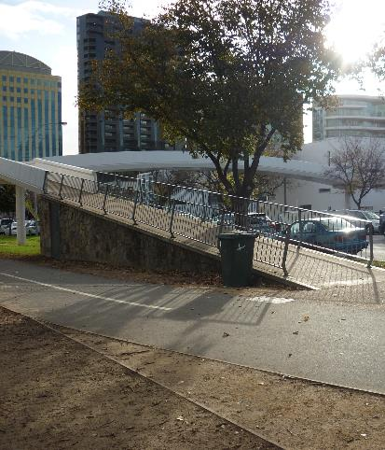
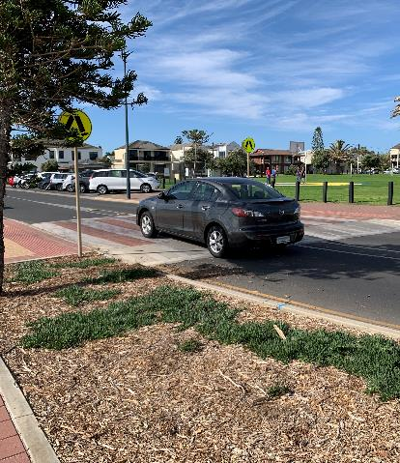
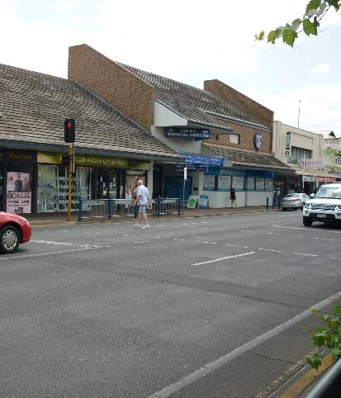
Primary treatments for pedestrians
Press enter to continue
Physical separation where safe interaction speeds cannot be managed
Speed managed crossings
Arterial road crossings a considerable challenge
Source: Centre for Automotive Safety Research
Source: Centre for Automotive Safety Research
Source: Centre for Automotive Safety Research
Notes:
Where pedestrians cross roads, they must be separated from motorised traffic when safe interaction speeds cannot be maintained. This is a particular challenge in the urban environment, as spatial constraints and amenity issues mean that grade separated crossings are often undesirable or not feasible.
For most urban locations, speeds will need to be managed in order to maintain safe interactions where pedestrians cross traffic streams. Physical treatments such as raised platforms at intersections and vertical deflection at pedestrian crossings may be sufficient to achieve safe interaction speeds.
Pedestrian access across arterial urban roads are a considerable challenge and will require a complete rethink about how we prioritise traffic along these roads.

Slide 13
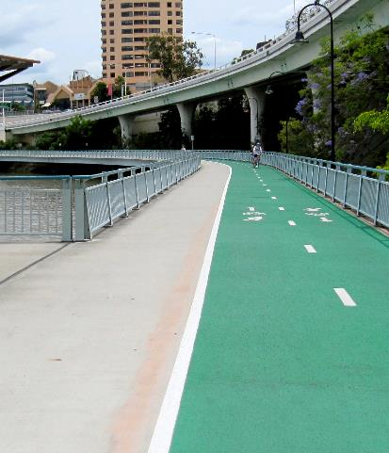
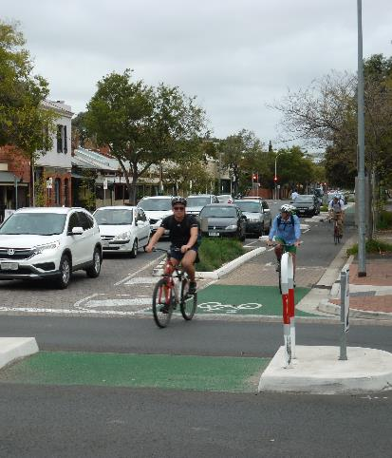
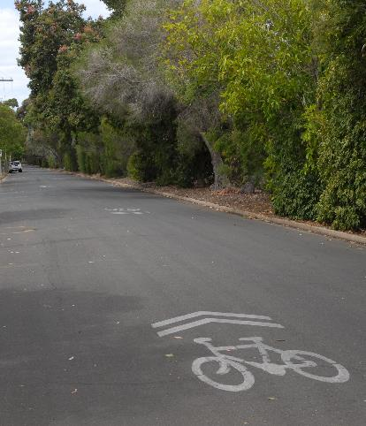
Primary treatments for cyclists
Press enter to continue
Off-road bikeways and shared-use pathways
Physically separated on-road bicycle lanes
Mixing with motorised traffic where safe interaction speeds are maintained
Source: Safe System Solutions
Source: Centre for Automotive Safety Research
Source: Centre for Automotive Safety Research
Notes:
Facilities well-aligned to Safe System outcomes are already available for cyclists in many locations around Australia. There exists a growing network of dedicated bikeways and shared-use pathways that link with the greater road network. Along these paths, interactions with motorised traffic needs only to be managed where they join or cross the road network.
Along roads with moderate speeds and vehicle traffic volumes, separated bicycle lanes are necessary. Physical separation can be achieved through the use of barriers, non-mountable curbs or in combination with on road parking facilities, where parked vehicles provide a level of physical protection between cyclists and vehicles.
Where safe interaction speeds can be managed, mixing of bicycle and vehicle traffic can be encouraged. For our current network, this is generally limited to local roads with little vehicle traffic. As perceptions of appropriate speeds broaden, managed interactions may become possible over other parts of the network. Where heavy vehicles are present, mixing is likely to be unmanageable, irrespective of speed.

Slide 14
Supporting treatments
Notes:
Now, let’s look at some supporting treatments that can help to reduce harm to pedestrians and cyclists.

Slide 15
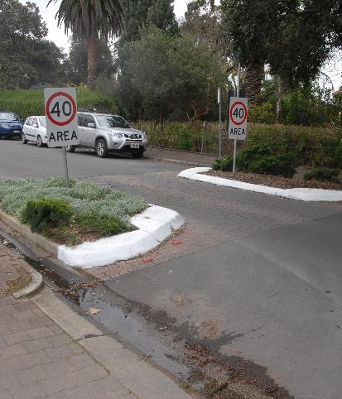
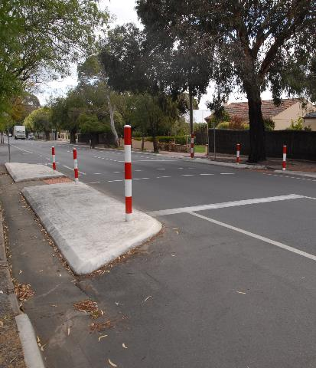
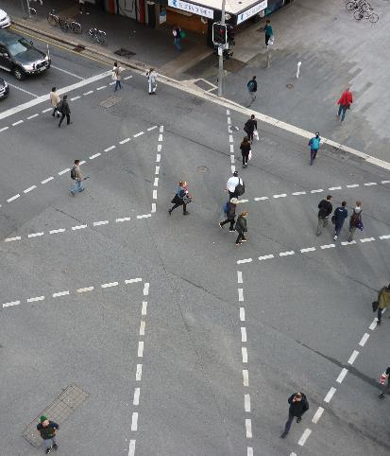
Supporting treatments for pedestrians
Press enter to continue
Reduced speeds
Reduced traffic volumes
Midblock crossings (refuge islands, signalised crossings)
Intersection crossings (separate signal phasing)
Source: Centre for Automotive Safety Research
Source: Centre for Automotive Safety Research
Source: Centre for Automotive Safety Research
Notes:
While speeds above a safe interaction speed may be undesirable from a safety perspective, they are often considered as beneficial from a mobility perspective. For the time being, this tension is unlikely to be solved and so speeds will likely remain higher than is desirable. In such circumstances, lowering speeds by any amount may not fully eliminate harm, but it will be helpful in reducing harm. Such outcomes are already being seen across wide areas of the local road network, with many local governments opting for 40 km/h speed limits along their road networks, and backing these speed limits with physical measures to manage speed.
Reducing motorised traffic volumes will undoubtedly benefit vulnerable road user safety. Although any motorised traffic still poses a threat of harm, reduced volumes reduce exposure to possibly harmful events. Where motorised traffic capacity is considered as strategically important, reducing exposure to motorised traffic could also be achieved by moving key pedestrian routes away from these high volume roads.
Along midblock locations, both formal signalised and non signalised crossings, and informal pedestrian crossings such as pedestrian refuge islands, can be used to guide pedestrians to cross at safer locations along the roadway. Ideally, safe crossing at these locations would be reinforced by speed management to lower interaction speeds.
At intersections, signalised crossings can be used to provide priority to pedestrians crossing the road. Uncontrolled vehicle movements across pedestrian crossings, such as filter right turning movements, should be avoided. Especially at high pedestrian volume locations, separate pedestrian phases can be used to stop all motor vehicle movements when pedestrians are crossing.

Slide 16

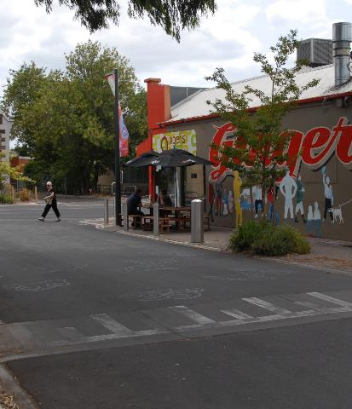
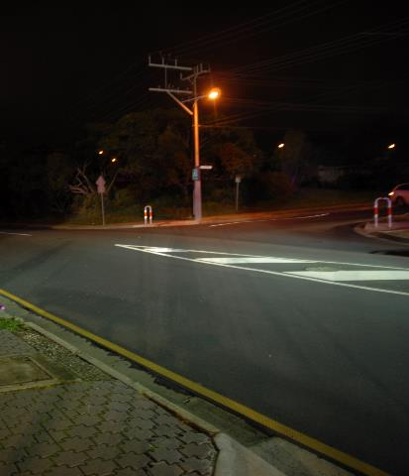
Drunk pedestrian issue
Press enter to continue
Intoxication involved in half of all pedestrian fatalities
Calm traffic and prioritise pedestrian movements
Rest-on-red signal phasing
Improve pedestrian conspicuity (e.g. upgrade lighting)
Source: iStock.com (Starflamedia)
Source: Centre for Automotive Safety Research
Source: Centre for Automotive Safety Research
Notes:
A substantial proportion of fatal pedestrian crashes involve pedestrian intoxication. Intoxication is especially problematic around night entertainment areas. Especially in such locations, pedestrian safety measures need to be formulated with consideration of the intoxicated pedestrian issue.
Intoxication brings an increased likelihood that pedestrians will fail to see and give way to motorised vehicles. It is therefore even more important at these locations that treatments deal with the consequences of crashes. Traffic calming and treatments that prioritise pedestrian movements should be prioritised. Variable speed limits are a relatively new concept that can be used to calm traffic during high pedestrian volume hours, while still conceding to motor vehicle mobility demands during other times.
Rest on red signal phasing is an especially promising treatment for high pedestrian volume and intoxicated pedestrian areas. At signalised intersections, all approaches default to a red signal and the ability to traverse the intersection is only allowed once a vehicle stops at the intersection control line, thereby activating the green signal.
Other more general improvements can be made that will benefit the intoxicated pedestrian issue. Increased pedestrian conspicuity can be used to reduce the likelihood that drivers will fail to see a pedestrian on the road. Increasing night-time conspicuity is especially important for pedestrians as they carry no lights or other forms of illumination that can be used by others to detect their presence.

Slide 17
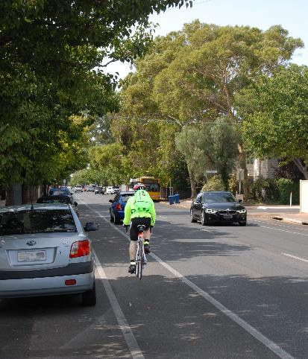
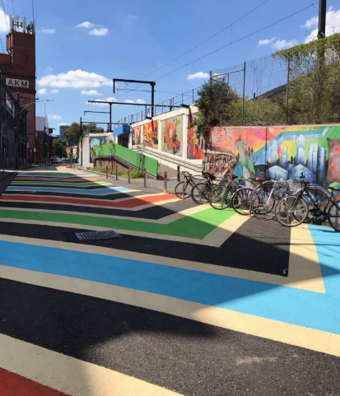
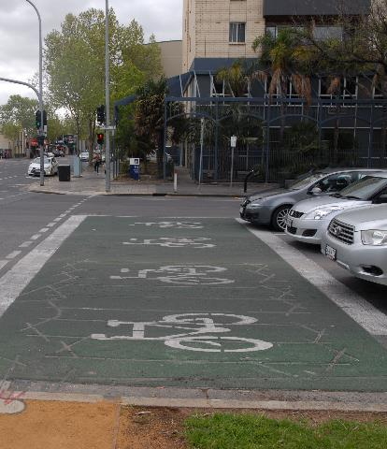
Supporting treatments for cyclists
Press enter to continue
Bicycle lanes on non-arterial roads
Reduce traffic volumes
Prioritisation at signalised intersections
Source: Centre for Automotive Safety Research
Source: Safe System Solutions
Source: Centre for Automotive Safety Research
Notes:
Like for pedestrians, eliminating harm for cyclists means either separating them from motorised traffic, or reducing speeds to those survivable in the event of a crash. While these measures may not be feasible across the broader network now, there are measures that can be taken to reduce the harm occurring to cyclists. Most forms of separation can be beneficial cyclists, including commonly provided bicycle lanes.
As with pedestrians, either reducing motorised vehicle volumes or re-routing cyclists along lower motorised vehicle volume routes will be beneficial. This can be achieve by providing bicycle lanes and other facilities away from arterial and other heavily trafficked route, and by filling gaps and removing blockage points along bicycle routes that utilise the local and distributor road networks.
While encouraging cyclist use of the local and distributor road network is beneficial from the perspective of reducing exposure to high motor vehicle volumes, it is often necessary to access some part of the arterial road network. Providing prioritisation to cyclists, such as through separate cyclist phases at signalised intersections, can help to calm motorised traffic at locations where cyclists are present.

Slide 18
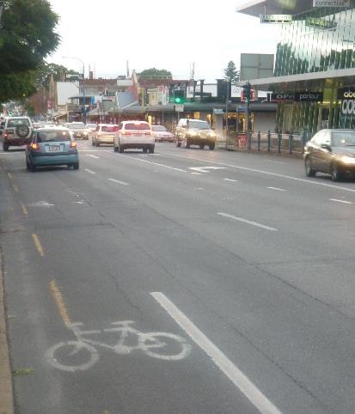
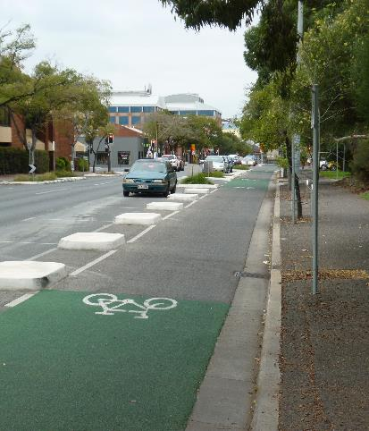
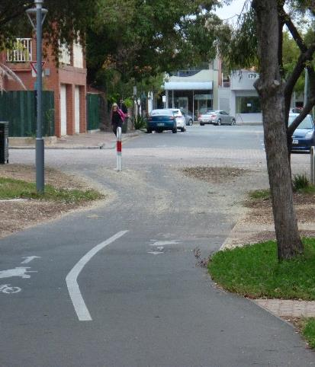
Bicycle route planning
Press enter to continue
Historically using arterial roads
Recent movement to using non-arterial roads
Prioritising cycling movements away from motorised vehicle-critical roads
Bicycles on arterial road
Source: Centre for Automotive Safety Research
Source: Centre for Automotive Safety Research
Notes:
Historically, cyclists have been catered for by providing facilities along arterial roads. While this may benefit dedicated commuter cyclists desiring the most direct links to travel upon, it has come at the detriment to safety by increasing crash consequences through higher speeds and increasing exposure through higher motorised traffic volumes. This approach is also an issue from an amenity perspective and is arguably one of the barriers preventing more people from pursuing cycling as a viable alternative travel mode.
More recently, the thinking behind catering for cyclists has shifted. Safety and amenity have come to the fore and this has informed the way cycling routes are now being planned. Local and distributor roads are now becoming the primary locations for strategic bicycle routes, moving cyclists away from highly competitive space and onto roads where other functions are less highly prioritised.
The key benefits of this movement is it allows cyclist to use the space with little competition from other travel modes and provides a safer, more amenable space for cyclists to use. This change is bringing more people to cycling, which will ultimately help to reduce motorised congestion and improve cycling visiblity and priority on parts of the road network where they can not only be catered for, but can be prioritised without detriment to other road users.

