Slide 1

Changing the safety paradigm
Notes:
Welcome to Module 4 of Safe System for Universities. In this final module, we will explore some of the pragmatic barriers between us and zero death and serious injury throughout the road transportation system. Along this journey, we will look at some examples of how to put the safety theory we have previously covered into practice. First though, let’s discuss the history of how road safety got to where it is, and where it now needs to go.

Slide 2
Press enter to continue
1.0
01 Jul 2020

Slide 3
About this snippet
This snippet is made up of a number of sections. Click on the below links to go through each section. To advance a slide, press enter on your keyboard or click the slide.
Start here
Go to
Transforming the paradigm
Go to
Evolution of the system
Go to
Economics of safety
Notes:
This snippet is made up of a number of sections. Click on the below links to go through each section. To advance a slide, press enter on your keyboard or click the slide. If you miss anything that has been said, you can replay the narration to each slide. A printed version of the narrative is also provided in the curriculum guideline.

Slide 4
Evolution of the system
Notes:
To understand where road safety must head next, we firstly need to know where it has been. So let’s start by taking a quick look at road safety through its generations and where its evolution has come to.

Slide 5

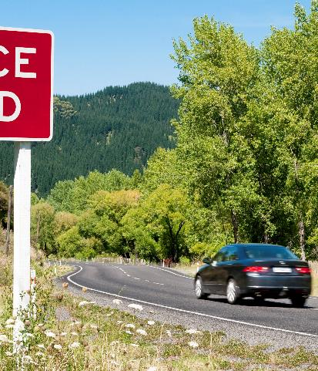
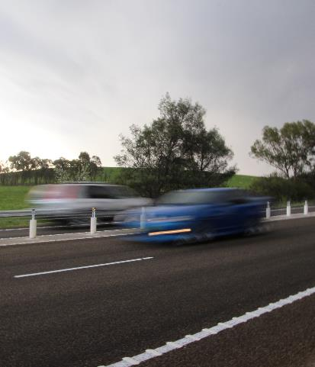
Evolution of safety in road transportation
Press enter to continue
Early idea of chance and accident proneness
Later based on economic outcomes
Current tendency to maximise economic benefits
Other methods are becoming more popular
Environment
Community
Multi-criteria
analysis
Mobility
Health
Safety
Amenity
Source: iStock.com (drz100)
Source: iStock.com (georgeclerk)
Source: Safe System Solutions
Notes:
Early perceptions of road safety tended to treat crashes as a chance phenomenon and placed the cause of crashes on accident proneness – the idea that some people are more prone to having accidents and that crashes are therefore a result of certain personality traits. The perception that crashes happen by chance takes away a notion of responsibility and therefore the idea that anything can be done to stop them from occurring.
Later, the economic costs of crashes became a key driver for road safety. Ideas such as benefit-cost analysis were used to balance the economic burden of road safety initiatives against the economic gains made through fewer crashes. The shift to economic rationalisation of road safety comes from a desire to find a tangible way to deal with the issue. The benefit of this approach is the ability to consider road safety with respect to other important factors, rather than the earlier tendency to ignore road safety as we had no tangible way to comprehend it.
In essence, road safety became an economic issue instead of a human suffering issue. And this approach lingers on today. It can be seen in the way most road investments are prioritised. Benefit-cost analysis is still a primary tool used to rank investments. By perceiving road safety in such a way, it is inevitable that we aim to maximise the economic benefits of road safety.
Other methods for prioritising investment are entering the industry. A key alternative method that is becoming more widely used is multi-criteria analysis. Multi-criteria analysis provides a qualitative look at investment from the viewpoints of different important factors, such as environmental sustainability, health and safety, amenity and community needs. While a step in the right direction, multi-criteria analysis still allows these factors to be traded against one another, leading to compromised outcomes. Additionally, multi-criteria analysis is a qualitative tool and does not provide the quantitative approach that has been well-understood and favoured by system managers.

Slide 6
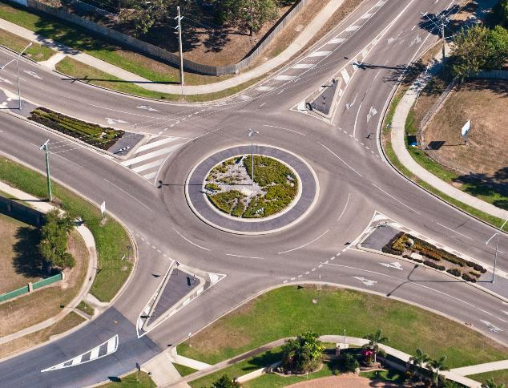
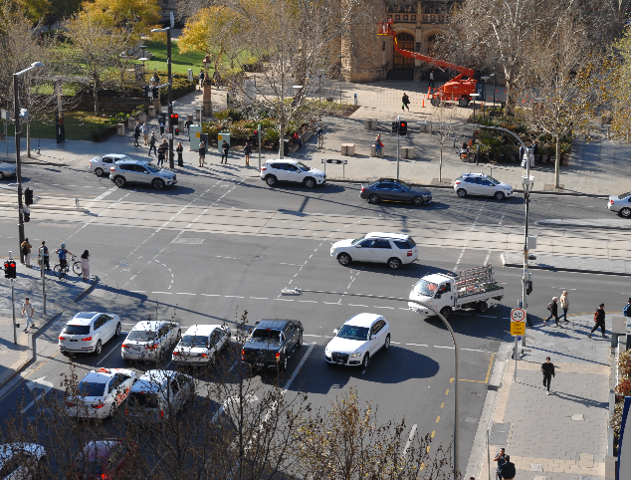
Safety as a function of mobility
Press enter to continue
Safety currently treated as a function of mobility
Currently accept some risk for an economic gain
In conflict with economic maximisation
Source: iStock.com (greenantphoto)
Source: Centre for Automotive Safety Research
Notes:
This is why we have previously discussed safety as being a function of mobility. Mobility is the driver of economic value from the road transportation system. Hence, when we treat all aspects of the road transportation system as an exercise in economic maximisation, they become a function of the economic value of the system, which is mobility. As highlighted by Claes Tingvall and Anders Lie in their 2017 review of the history of Vision Zero, safety investment has become defendable only when the economic value of its benefits are larger than the collective cost that it creates. In other words, only when it has an economic benefit to cost ratio of greater than one.
As a result, we have inadvertently come to accept some level of risk to road users as a trade-off for the economic gain that we can obtain from designing and operating the road transportation system in a certain way. A practical example is the case for roundabouts. Roundabouts are generally not seen along arterial roads in the urban environment. There are two key reasons for this. Firstly, roundabouts are perceived as having reduced capacity compared to conventional signalised intersections. They are perceived to result in reduced mobility. Secondly, they generally require a larger footprint that conventional signalised intersections, which creates an added economic cost. Despite the clear safety benefits of roundabouts, signalisation is often chosen because of the greater net economic benefits. We accept the greater level of risk afforded by signalisation because it provides greater economic benefits.
Hence, the Safe System is generally seen as in conflict with the notion of economic maximisation. Instead of safety being a function of mobility, the Safe System calls for mobility to become a function of safety. In other words, safety is expected to be delivered at no less than a threshold level of acceptance, such as the zero death and serious injury threshold that is currently considered in the Safe System. Mobility is then maximised within this boundary. However, to achieve such an outcome, we need to drive safety through more than just the mechanism of economic justification.

Slide 7
Economics of safety
Notes:
Before we can understand how to move away from economic justification for safety, we must first understand why economic justification has led to a situation where safety is compromised. Next, let’s go through an example that shows how the economics of safety work.

Slide 8
Economics of safety
Press enter to continue
Productivity
Net economic benefit
Economic benefit
Mobility
Crashes
Notes:
Mobility is the primary function of the road transportation system. Its role is to transport people and goods. The world’s economy is dependent on our ability to stay mobile. Without mobility, our systems of trade, food and other vital services would cease to operate in the way to which we have become accustomed. It is therefore understandable that we have historically looked at our road transport system from an economical standpoint. We have historically balanced mobility on the economic benefit that we receive. Fundamentally, you can think of mobility as a combination of volume and speed. In other words, how much we can transport and how quickly we can transport it.
The primary benefit we receive from the road transportation system is economic productivity. This means the ability to trade goods, source commodities, transport people to work and provide vital services that prop up our communities. Logically thinking, an increase in mobility will come with an increase in economic benefit. Eventually, the demand placed on the system will reduce efficiency and the economic gain will become less pronounced. Similar to the volume-density relationship in traffic theory, there will be a point at which a peak economic benefit is reached.
But our road transportation system also comes with economic costs. One of these is the economic burden of crashes and injuries that occur on our roads. Even by assuming a linear relationship between mobility and crashes, we can see that economic costs result from an increase in mobility. The greater we increase mobility, the greater the number of crashes that will occur. From solely an exposure standpoint, this relationship is logical, as greater mobility equals greater exposure and greater exposure increases the risk that crashes will occur. But increased mobility has historically come with increased speed and energy on the road network. When not properly managed, these can translate to increased death and serious injuries as outcomes of the crashes that occur.
By taking into account the economic benefit of productivity with the economic cost of crashes, we can plot the net economic benefit of increasing mobility. At first, increasing mobility will come with an economic gain. However, there will come a point where the economic burden of crashes and injuries outweighs the benefits of productivity. At this point, the greatest net economic benefit of mobility is achieved. By balancing safety against mobility, we have maximised the economic benefit. However, as a result we have also created a system where some risk of harm is accepted.

Slide 9
Economics of safety
Press enter to continue
Economic benefit is maximised
Economic benefit maximised as a function of safety
Net economic benefit
Economic benefit
Mobility
Crashes
Level of risk with death and serious injury a possible consequence
Level of risk where death and serious injury is not a possible outcome
Notes:
As you can appreciate, this is a simplification of the real system. Other economic contributions, such as environmental costs, will affect the economic outcome. However, this model demonstrates the reasons why safety is often traded for economic gain.
At the point where economic maximisation occurs, there is some level of safety risk to road users. Often this level of risk is such that death and serious injury are a regular consequence of crashes. Think about our earlier example of signalised intersections. Signalisation often makes the most sense on economic grounds. Many projects employ signalisation as it is a well-understood and well-proven way to manage large volumes of intersecting vehicles. Unfortunately, signalisation does not deal well with the consequences of crashes when they do occur, which is why a large proportion of urban fatal and serious injury crashes can be seen at signalised intersections.
Under the Safe System, risk is managed in such a way that death and serious injury are no longer an acceptable outcome of system use. Crashes will still occur and while undesirable, low severity crashes are tolerated. In this situation, safety is not traded off against mobility. Instead, mobility and economic gain are maximised within the boundary of harm elimination.

Slide 10
Transforming the paradigm
Notes:
Finally, let’s take a look at the road safety paradigm through the lens of William Haddon Junior, a pioneer medical ecologist and road safety advocate who started the journey to scientifically-based road safety theory.

Slide 11
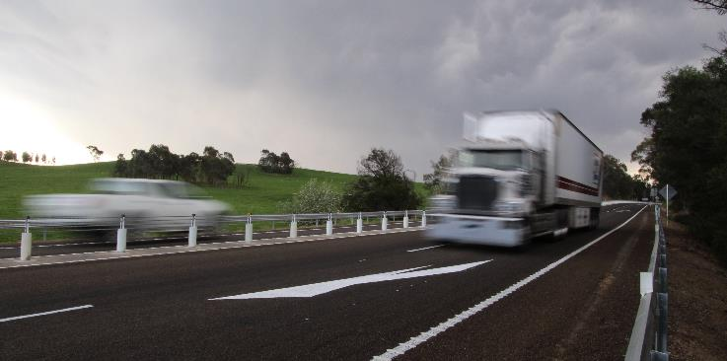
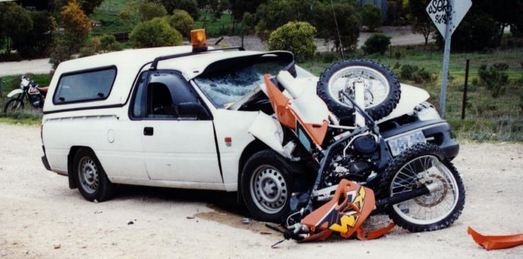
On the escape of tigers
Press enter to continue
Managing kinetic energy
Priority order of energy control
Reduce exposure, likelihood and consequences of energy release
Source: Safe System Solutions
Source: Centre for Automotive Safety Research
Notes:
In 1970, Doctor William Haddon Junior, a medical ecologist and then president of the United States Insurance Institute for Highway Safety, published a paper in the Journal of Public Health. Entitled “on the escape of tigers: an ecologic note”, this paper and its author have been attributed with founding a scientific basis for road safety. In this paper, Haddon outlined kinetic energy, and the need to manage it, as a fundamental social concern. While his examples vary over a wide range of systems, his work has become the basis for the modern scientific study of road safety.
Haddon, in his paper, describes ten strategies to control the losses that stem from kinetic energy. These strategies are presented in a hierarchical order, from most to least preferential. In this way, they are similar to more recently adopted tools that are being frequently used in industry, such as the hierarchy of hazard control, which we covered in module one, and the Safe System treatment hierarchy, which we covered in module three.
The first two strategies that Haddon outlines call for the control of energy production, either through outright prevention or through reduction in the amount of energy that is produced. Road transport examples of these strategies are the elimination or reduction of vehicular traffic, or the reduction of vehicle speed. The third strategy is to prevent the release of energy, which is akin to preventing crashes from happening and is something that we have become particularly used to practicing in the road design sphere. The fourth, fifth, sixth, seventh and eighth strategies are about something that we are not yet as used to doing in the road industry, which is shielding the human from the release of energy. In the Safe System, we talk about this in terms of reducing the consequences of crashes. Importantly, while Haddon placed likelihood affecting measures above those that affected consequence, in the Safe System this order is reversed. This has been done in acknowledgement that no matter what we do, we are unlikely to ever completely prevent all crashes from occurring, and so the only way to reach zero harm is by prioritising the reduction in crash consequence.

Slide 12
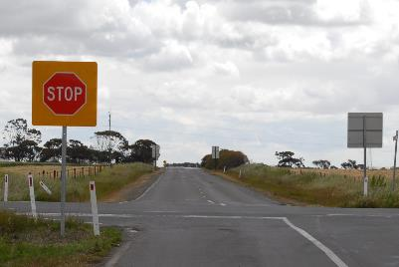
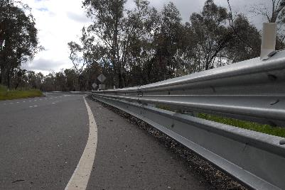
Haddon’s lessons
Press enter to continue
Economics
Energy
Economy
People
(survivability)
Active
Passive
Source: Centre for Automotive Safety Research
Notes:
So, what has Haddon to do with the safety paradigm and how it can be changed? Haddon teaches us two fundamental lessons. The first is the importance of energy. A focus on the economics of safety brings focus to the economic importance of the road transportation system. While important, this focus when concerned with safety brings us away from the fundamental reason for having a road transportation system – to benefit people.
Haddon’s focus on energy makes us look at safety from the perspective of its direct effect on people. Safety, or a lack of it, causes harm to people. Road safety is primarily concerned with the release of energy. Therefore, energy, or a lack of its control, causes harm to people.
Haddon’s second lesson was coined in his 1962 paper “an analysis of highway safety strategies”. In a way quite different to how we define active and passive, Haddon distinguished these as to whether human intervention was or was not required. Active strategies, such as seatbelts and stop signs, require correct road user behaviour for them to work. The vehicle occupant must engage the seatbelt and the driver must stop the car and check for other traffic before proceeding. Passive strategies, on the other hand, are always working regardless of road user behaviour. Road safety barriers, for example, protect from collisions with more hazardous objects in a crash, no matter what the road user is doing.

Slide 13

A paradigm change
Press enter to continue
Economic benefit maximised as a function of safety
Economic benefit
Level of risk where death and serious injury is not a possible outcome
Source: iStock.com (aluxum)
Notes:
Where these two lessons relate to a paradigm change is in their ability to guide the way we value safety and in the way we implement it. Haddon’s first lesson, on the importance of energy, guides us to look at the value of safety from a different perspective. To achieve the elimination of death and serious injury, we need to value safety in terms of the effect it has on people. In other words, we need to prioritise road investment through the lens of an ability to reduce the cause of harm. Currently, we maximise economic benefit as a primary goal. We settle for the safety benefits that can be achieved within this paradigm. We must change this paradigm to maximise safety. Safety becomes the primary objective which cannot be neglected or compromised. Mobility and economy can then be maximised within the paradigm of safety.
Haddon’s second lesson highlights the importance of human error, and the need to use strategies that do not place a reliance on people giving one hundred percent performance, one hundred percent of the time. As we will explain in the next two snippets, we are entering a phase where we will need to transition from piecemeal safety actions and an overarching reliance on compliant road users, to a strategic transformation of the road transport system, where safe road use is guaranteed by passive strategies that will work regardless of whether or not people make mistakes.

