Slide 1

Achieving widespread implementation
Notes:
Welcome to Module 4, Snippet 2 of Safe System for Universities. In this snippet, we will look at some of the key enablers that need to be realised before we can hope to achieve widespread implementation of the Safe System.

Slide 2
Press enter to continue
1.0
01 Jul 2020

Slide 3
About this snippet
This snippet is made up of a number of sections. Click on the below links to go through each section. To advance a slide, press enter on your keyboard or click the slide.
Start here
Go to
When we think about safety
Go to
From safer to safe
Go to
Safe System first
Go to
A transformative approach
Notes:
This snippet is made up of a number of sections. Click on the below links to go through each section. To advance a slide, press enter on your keyboard or click the slide. If you miss anything that has been said, you can replay the narration to each slide. A printed version of the narrative is also provided in the curriculum guideline.

Slide 4
From safer to safe
Notes:
Firstly, we will discuss the philosophy of the Safe System in the context of moving from safer to safe – from coping with the road trauma problem to fixing it once and for all.

Slide 5
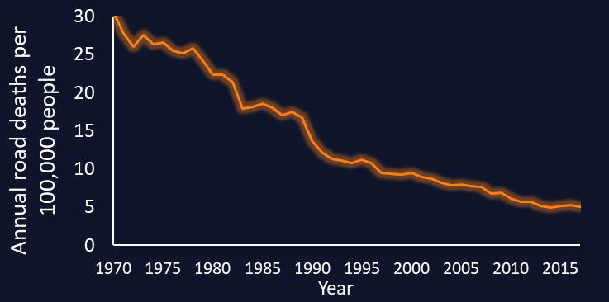
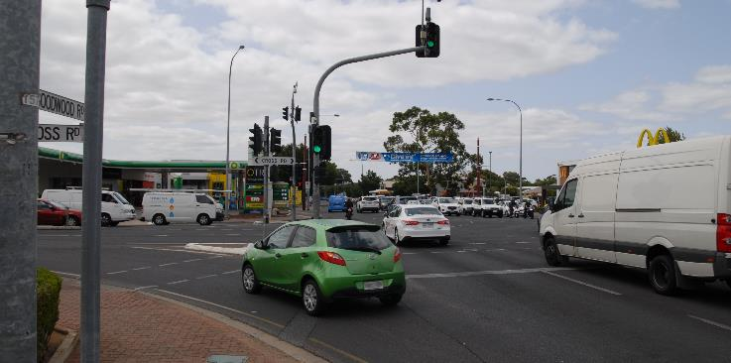
From safer…
Press enter to continue
Road safety has greatly improved…
…but this improvement has slowed
We are good at making roads safer
Source: based on ATSB and BITRE data
Source: Centre for Automotive Safety Research
Notes:
The people that manage the road transportation system are concerned with the safety of the people using it. It is unfair to say that safety has not been their concern. Much effort has been made to ensure roads become safer and harm becomes less likely. Since the dawn of the motor age, roads have come to the point where crashes are exceedingly unlikely on a personal level. For example, the number of annual deaths on our roads has fallen from a peak of thirty per one hundred thousand people in 1970, to about five per one hundred thousand people today. We have come to a point where most people will experience no more than a handful of crashes in their lives, and many will never be personally involved in a serious crash.
The level of safety that we currently enjoy is thanks to the advancements that have been made in road design, vehicle design and the education and enforcement of safe behaviours. However, we can also see that the fall in the annual death rate has been steadily reducing to a point near equilibrium. Serious injuries are even worse, having started to increase in both rate and overall number in the past few years. This begs the question; if we have become so good at reducing harm on our roads, why has our progress slowed down so much?
Over the previous few decades, we have become very good at guiding road users to do the safe thing. However, we have not explicitly realised that road users do not always follow this guidance. Crashes can occur when road users intentionally disobey guidance. But most of the time, crashes occur because road users have simply made mistakes – they have unintentionally used the road in a way that was not intended by the road designer. A great example is that of signalised intersections. Signalisation is a great way to guide road users through an intersection – it dramatically reduces the likelihood that crashes will occur between intersecting vehicles. However, drivers sometimes run red lights. Sometimes this is intentional, and sometimes it is not. Signalisation falls down in a Safe System because it does nothing to help the situation if a driver fails to obey the signal.

Slide 6
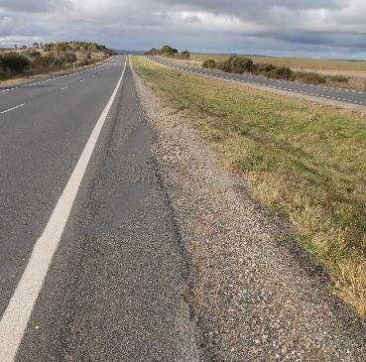
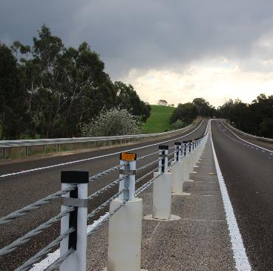
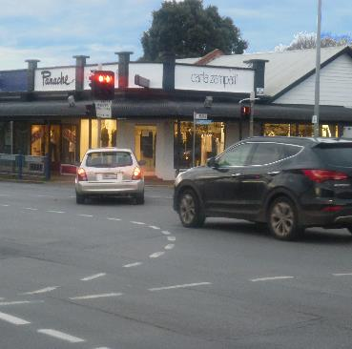
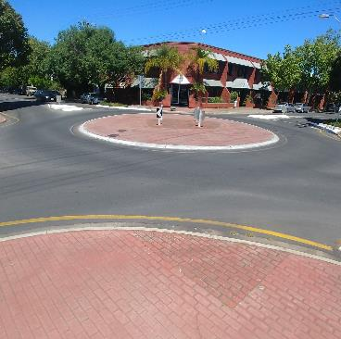
…to safe
Press enter to continue
Safer
SAFE
Making a distinction between safer and safe
Safe ensures survivability
Safe pursued first
Source: Centre for Automotive Safety Research (left) Safe System Solutions (right)
Safer
SAFE
Source: Centre for Automotive Safety Research
Notes:
Like many other aspects of road design, signalisation is great at making roads safer. However, it does not make them safe. This is where we have fallen down. Much effort is put into advancements that make roads safer than they have been. And this has been our folly. When a new project is undertaken, or a section of roadway is upgraded, often at great expense, we are satisfied by the notion that the road has been made safer for those using it. But we often don’t ask the question; has the road been made safe?
The distinction between safer and safe is subtle but important. When we make a road safer, we reduce the likelihood that crashes and harmful outcomes will occur. But crashes and harmful outcomes can still occur, they are just less likely. When we make a road safe, we are ensuring the survivability of crashes. Crashes will continue to occur along a safe road, but harmful outcomes will not. By continuing to pursue safer outcomes, rather than safe outcomes, we are missing opportunities to realise the goal of zero harm.
Common examples can be found in large road projects that are undertaken every year, at substantial cost to tax payers who ultimately use and become harmed through use of these roads. Road design and operation for these projects often falls back to long used techniques that make the road safer, but not safe. We rarely make the distinction between safer and safe, and therefore rarely ask the question of whether a safe alternative can be utilised. A prime example are many kilometres of new freeways and motorways built each year that depend on design and operation poorly aligned with the Safe System. Where we could pursue safe by utilising solutions such as flexible barriers to control road departures and roundabouts where these roads intersect with the wider network, we all too often revert back to safer by using standard clear zone and signalisation based designs.

Slide 7
Safe System first
Notes:
Moving from safer to safe will require a change in the way we manage the road transportation system. This is where the Safe System comes into play. Now, we will look at how the Safe System provides mechanisms for achieving safe outcomes.

Slide 8
Prioritising the Safe System
Press enter to continue
Safe
System
Prioritising safe solutions
Tools to inform decision making
Safer
Safe
Primary
Supporting – step towards
Supporting
Notes:
Pursuing safe rather than safer outcomes will require a change in mindset in the way we pursue safety. This is where the Safe System comes in. The Safe System provides a new philosophical approach to road safety. In doing so, it provides an ethical argument for why we need to change our perspective on road safety, as well as a theoretical approach to achieve this. However, actually achieving a safe road transportation system will require operationalising the theory provided by the Safe System. To do this, we first need to prioritise methods and solutions that give the greatest promise of harm elimination.
The Safe System provides a method for categorising Safe System-aligned treatments from those that do no ensure survivability. It is impractical to expect road designers and operators to understand all the fundamental theory and research regarding the suitability of all options. As the front line of road safety, these practitioners require easy ways to make informed decisions. Within the Safe System, treatments are categorised as either primary, step-toward or supporting treatments. By categorising treatments according to their alignment with Safe System philosophy, practitioners can make informed decisions about which options to pursue first. Pursuing a safe transportation system means prioritising primary treatments, and only pursuing non-primary solutions when the application of primary treatments is unfeasible.

Slide 9
Placing safety at the core
Press enter to continue
Most road investments don’t focus on safety
Safety as a core component
Ultimate goal is no need for safety specific investment
Safety
Road investment
Safe road investment
(safe mobility)
Safety
investment
Notes:
A significant barrier to prioritising the Safe System is how safety is treated within road investments. Generally speaking, road investments can be pursued because of road safety goals or because of other goals. Those falling outside of road safety goals may be pursued to increase mobility and efficiency, provide for certain interests such as freight, or to serve broader changes such as new residential developments. While these projects will include some consideration to safety, this is often one of many factors influencing the final outcome. On the other hand, road safety specific investments account for a small proportion of all road investments and are pursued to improve safety, such as through road safety barrier installation or intersection upgrades.
Our transition to a Safe System means a need to encompass all road investments in the bounds of safety. This means safety is no longer one of many factors that are traded-off against one another to fit the investment objectives. Instead, safety forms a bounding limit to the outcomes of investment. In other words, safety outcomes become a non-negotiable and all other factors are optimised within this limit.
The ultimate goal of the Safe System however is to make redundant the need for any road safety specific investments. Instead, safe road investments will be made that ensure every time a section of the network is upgraded, survivability is build into the design and operation of that part of the network. This is the idea of safe mobility that we explored in the previous module. Safe mobility means that use of the road transportation system allows for mobility within the confines of survivable operation.

Slide 10
When we think about safety
Notes:
Transitioning from our current system to one of safe mobility comes with some barriers that need to be broken. One of these is they way we implant safety into projects. Now, we will discuss the changes that need to be made in the project pathway in order to achieve harm elimination outcomes.

Slide 11
The project pathway
Press enter to continue
Concept
development
Funding
Design
Build
Operate
Project pathway
Start
Finish
Notes:
Most road projects, whether they are for new greenfield or existing brownfield roads, for design or operational changes, are developed through a standard project pathway. The changes that can be made to different aspects of the project depend on where it lies along this pathway. This concept is very important as it has repercussions as to how much the design and operation of a road can be informed by the Safe System.
A standard project pathway looks something like this. In the initial stages, the project is conceptualised, usually as a solution to some identified problem or desired improvement. At this stage of the project, detail is low and different solutions can be explored.
Once a concept is settled upon, funding is sought. Because funding is closely tied to the concept that is proposed, it is difficult to change the fundamental concept once funding is secured. Details fixed at this stage may be the basic geometry and geometric design, the location and the amount of land that will be used or that needs to be acquired.
Once funding is secured, a detailed design can be developed. This stage will include design such as the detailed earthworks, line marking and signage, roadside furniture and services, and detailed geometry. Changing any fundamental aspects of the design, such as opting for roundabout control over intersection signalisation, is all but impossible at this stage of a project.
Once a detailed design is settled upon, physical works can commence. Through this stage, small corrections to the design can be made as unforeseen issues arise. Once built, operation commences. During the operational life of a project, minor physical amendments and operational changes can be made to suit changing operational conditions and new values, such as an increased awareness of road safety issues.

Slide 12
Where does safety come in?
Press enter to continue
Safety
Safety
Safety
Safety
Safety
When do we think about safety?
Concept
development
Funding
Design
Build
Operate
Notes:
Safety is a core element of any project. Thinking about the safety of road users needs to come in at every step along the pathway. But when is safety currently considered, and when does it need to be considered to have maximum impact?
Currently, safety is mostly thought about in the latter stages of a project, after a concept has been devised and funding has been secured. While consideration of safety is of course important at the detailed design, build and operation stages, there is only so much that can be influenced and changed. A common forum for highlighting safety issues at these stages is the road safety audit, which is useful for identifying issues in the details of a project, not in its fundamental concept.
Where safety is really required is at the conceptualisation and funding stages of a project. At the conceptualisation stage, the fundamental design of a road can be altered to suit safety objectives. At this stage, fundamental questions can be explored, like why not implement a safe solution, such as a roundabout, instead of a less safe solution, such as a signalised intersection? At the funding stage, procedures can be written into the funding that ensure safety is maintained at an acceptable level, instead of writing safety out as a side consideration.
With safety being considered at all stages of a project, we can ensure safe solutions are pursued first, while ensuring that the integrity of safety is continued from conceptualisation all the way to construction and operation. While this concept may seem simple, realising it is not. Realisation will require a fundamental change in the way we perceive safety, which is what the Safe System is all about. Next, we will take a look at one possible way to solidify the philosophical concepts of the Safe System into reality, so that fundamental issues such as ‘when safety is considered’ can be brought into practice.

Slide 13
A transformative approach
Notes:
All that we have discussed so far are logical ways to operationalise the Safe System, but they do not provide the practical approach required to achieve transformation. Next, we will introduce the concept of a transformative approach through the example of the zero twenty-fifty framework.

Slide 14
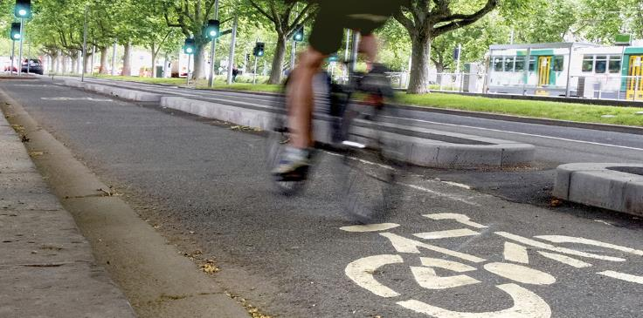
What is a transformative approach?
Press enter to continue
Operationalising the Safe System
Changes the status quo
Visualising a future & how to get there
SAFE SYSTEM
APPROVED
Future
Present
Notes:
A transformative approach is about operationalising the Safe System. While Safe System philosophy and rhetoric has been discussed in strategic plans and other high level circles, we have failed to practically implement the solutions that will lead to zero harm on a widespread basis. Operationalising the Safe System will create the mechanisms required to achieve practical implementation.
In order to operationalise the Safe System, we will need to change the status quo. Historical thinking and historical practice has been well aligned to balancing safety with other objectives, which in practice often means that safety is compromised in order to achieve other desires. Changing the status quo means changing this mindset to one where safety is the primary consideration, where we set non-negotiable objectives around safety, then set about achieving other desires within these bounds. In other words, it means making roads safe, rather than just making them safer.
Transformation is also about visualising the future that we want, and how we are going to get there. Everyone needs a map to find a previously unexplored place. A zero harm future is no different. We need a map to show us what a zero harm road could look like and that work our way back until we can see a pathway between where we are now, and where we want to be. A key part of a transformative approach is providing this map and providing the directions on how we need to change in order to achieve the future that we want.

Slide 15
Zero 2050
Press enter to continue
A transformation framework
Sets a goal of zero harm by 2050
Provides the tools for transformation
Quantifies the magnitude of effort
$
Harm
2050
Future
Present
Notes:
Zero twenty-fifty is a form of transformation, as perceived by the state of Victoria. Zero twenty-fifty is the way in which Victoria is defining the vision of their future and mapping the pathway to get there. It is important to remember that zero twenty-fifty is a framework; it does not tell us what the solution is, but it allows us to define possible solutions and see whether they can get us to where we want to go.
Zero twenty-fifty transforms the way we look at safety, from the traditional road safety strategy approach of defining intermediate targets with no clear end objective in sight, to a Safe System-aligned approach that defines the future time when we expect to achieve zero harm. Zero twenty-fifty changes the mentality from one where we are content to reduce harm but have no vision of how to eliminate it, to one where we have a clear goal and clearly defined timelines for when it will be achieved.
But zero twenty-fifty is more than just a vision. It provides the tools necessary to transform the way in which we approach safety. These tools come in the form of predictive analyses to define what a zero harm road system looks like; models to map the path from our current system to one in-line with Safe System principles; and indicators to let us know how we are performing and whether we are remaining on-schedule to meet our milestones.
Importantly, zero twenty-fifty helps to quantify the magnitude of effort and investment that needs to be made in order to achieve a zero harm future. By doing so, we can put forward arguments to re-align the magnitude of funding that goes into our road transportation system, and the ways in which it is utilised. Importantly, doing so will help to solidify the argument that current levels of investment will not allow us to achieve a goal of zero harm.

