Slide 1

Transformation: part 1
Notes:
Welcome to Module 4, Snippet 3 of Safe System for Universities. In Snippet 2, we concluded with the discussion of Victoria’s zero twenty-fifty transformation framework. In this snippet, we will detail what the zero twenty-fifty framework is and how it is being used to operationalise the Safe System objective of harm elimination.

Slide 2
Press enter to continue
1.0
01 Jul 2020

Slide 3
About this snippet
This snippet is made up of a number of sections. Click on the below links to go through each section. To advance a slide, press enter on your keyboard or click the slide.
Start here
Go to
Mapping the current state
Go to
Zero 2050
Go to
Defining the future
Notes:
This snippet is made up of a number of sections. Click on the below links to go through each section. To advance a slide, press enter on your keyboard or click the slide. If you miss anything that has been said, you can replay the narration to each slide. A printed version of the narrative is also provided in the curriculum guideline.

Slide 4
Zero 2050
Notes:
Transformative approaches are going to be required if we are to achieve a safe road system. Zero twenty-fifty is the state of Victoria’s transformative approach to achieve harm elimination by the year 2050. Now, we will take a look into what zero twenty-fifty comprises and why it is being prioritised over more traditional road safety strategies.

Slide 5


Zero 2050
Press enter to continue
What do I do today to achieve this vision?
Vision of
what I want
Future
Present
Notes:
Zero twenty-fifty starts with a goal. Like traditional strategic frameworks, zero twenty-fifty is defined around a goal-setting agenda. However, this is where the similarities tend to end. Traditional frameworks rely on agendas that call for short-term reductions in harm over short-term timeframes, which call for road safety improvements but ultimately fall short at setting a path to harm elimination. Zero twenty-fifty is set to the agenda of harm elimination. Like its name suggests, zero twenty-fifty sets a date of 2050 for complete elimination of harm on the Victorian state road network. This is a long-term goal set over a long-term timeframe.
Achieving a safe road transportation system is a huge undertaking. Such an undertaking can be divided into more manageable sized steps. Like traditional strategic frameworks, this could be in the form of piecemeal improvements. Unlike traditional strategies, these improvements are tied to the overall goal of achieving harm elimination. Doing so allows milestones to be placed into perspective with the overarching objectives, which has commonly been absent from previous strategy. In the remainder of this snippet, we will discuss the steps by which the objective of harm elimination can be visualised and operationalised.

Slide 6
Defining the future
Notes:
The first step to transformation is to define the future road transportation system that we wish to achieve.

Slide 7
Defining the future
Press enter to continue
Vision of
what I want
Future
Present
Notes:
The first step to transformation is to visualise what a future of zero harm may look like. This could be achieved in many ways, and the ways in which we visualise this now may change as we move into the future. Because of this, it is important that the steps we develop, as well as the transformation framework itself, be agile enough to contend with future developments that may change the trajectory along which we chose to move.

Slide 8
Defining the future
Press enter to continue
Safe road transportation system
Safe Vehicles
Safe Roads
Safe Users
Minimum 2025
5-Star rated vehicles

What do roads
need to look like
to achieve zero harm
in 2050?
No extreme violations
Notes:
If we plot out a safe transportation system to the founding structure of the Safe System, we can define the future road transportation system as a function of three separate elements. These signify a future road transportation system based upon safe vehicles, safe roads and safe road users. Speed is not in itself a separate element, as it becomes a function of the three other elements within the framework. In other words, a safe speed is defined as a function of the level of safety guaranteed by the road, the vehicles travelling along the road and road users using the road.
It is important to remember that each element does not in itself guarantee a safe road transportation system. Instead, each element sets the boundaries under which a safe road transportation system can operate. Such a setup allows for adaptability. For example, safe road users are defined as those who do not undertake extreme violations. However, if such behaviour is unable to be guaranteed, then the other elements can be managed to maintain a safe system, such as by introducing vehicle equipment to more stringently manage access control to those unable to maintain appropriate behaviour. Alcohol interlock systems are an example of such an already available access control technology.
For those managing the road network, the question becomes one of “what do roads need to look like to achieve zero”? This is the question that will be tackled by the next steps through the transformative approach.

Slide 9
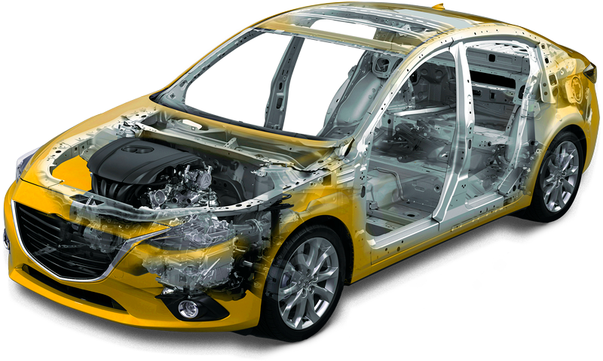
A 2025 vehicle
Press enter to continue
Vehicle to vehicle and infrastructure (V2X) communications
Autonomous emergency steering
Driver monitoring
Enhanced crash protection
Autonomous and access control functions
Enhanced cycle and pedestrian protection
Autonomous emergency braking
Notes:
However, before we get to the roads themselves, let’s take a look at what a safe vehicle may look like in the year 2025. Most technological improvements will focus on automating the driving task. Full autonomy is unlikely to be widespread by the year 2050. Instead, autonomy will focus on taking control of the vehicle in dangerous situations, such as when an imminent collision is detected. Other advancements will provide greater assistance to drivers in normal operation and may help to regulate access to those unfit to drive, such as those who are excessively fatigued or intoxicated.

Slide 10
Why a 2025 vehicle?
Press enter to continue
100%
Fitment of ESC
in new cars
Proportion of vehicle mileage with a minimum of 2025 technology
Proportion of vehicle mileage with ESC
Start of 2025 vehicle sales
0%
2000
2010
2020
2030
2040
2050
Notes:
You may have noticed that we define a safe vehicle in the year 2050 as a vehicle from 2025. But why not just use a vehicle from 2050? As this graph demonstrates, it takes time for improvements to infiltrate the wider car automobile market. A technology available today may not be standard fitment in all new vehicles for a number of years. This is also dependent on whether a technology is regulated. Electronic stability control is a good example, as its fast infiltration into the new car market has been due to its regulated inclusion into all new passenger vehicles.
The other reason for choosing a 2025 vehicle as the minimum standard in the year 2050 is the time it takes for new vehicles to infiltrate the fleet. In Australia, the average vehicle age is about ten years. The time taken for the vast majority of vehicles in the fleet to renew is much longer. Choosing as a minimum standard a 2025 vehicle provides gives twenty five years for the majority of the vehicle fleet to turn over. In other words, by the year 2050, the vast majority of vehicles on the road will have been built on or after the year 2025.

Slide 11
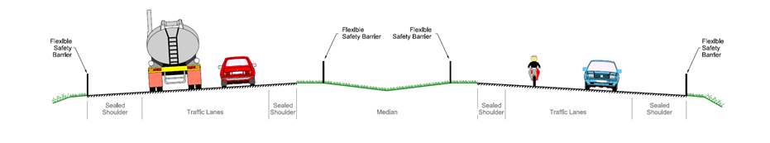
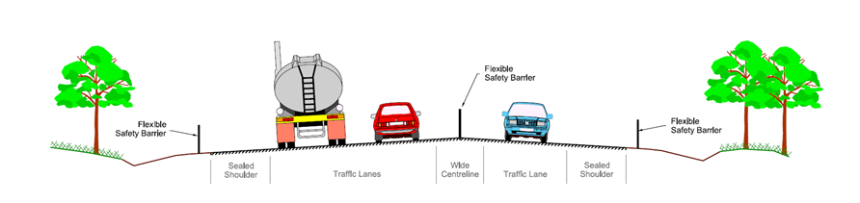
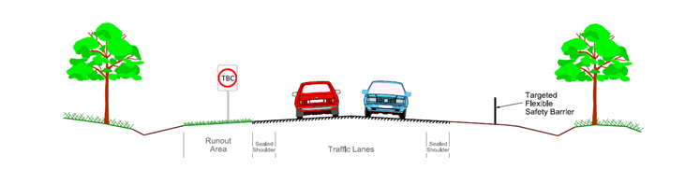
2050 road hierarchy
Press enter to continue
Divided freeways (highest standard roads)
Undivided highways (major rural roads)
Undivided rural roads (all other rural roads)
Source: Regional Roads Victoria
Notes:
The main challenge for those managing the road transportation network is to consider what a safe road may look like in the year 2050, within the bounding definitions of a safe vehicle and safe road user. For zero twenty-fifty, rural roads have been defined into three categories based on their cross-sections. Roads of adequate quality will be allowed to operate at higher speeds. For those where the level of quality cannot be maintained, speed limits and speed management will be corrected to ensure survivability.
This is not the only way in which a safe road can be defined. However, any way in which a safe road is defined should be predicated on Safe System theories of survivability. In other words, energy needs to be managed so that any crashes that do occur are survivable.

Slide 12
Mapping the current state
Notes:
Once the future has been defined, we need to know where we are in order to determine what needs to be done. Next, we will look at how we can map the current state of the road network.

Slide 13
Mapping the current state
Press enter to continue
What do I do today to achieve this vision?
Vision of
what I want
Future
Present
Notes:
Mapping the current state of the road transportation network is an essential part of the transportation process, as it gives insight into the quantum of effort that is required to achieve a safe road transportation system. It also allows us to direct discussion towards Safe System speak. By mapping the current network our in Safe System language, we can more easily understand the changes that are required, and more easily disseminate this information to decision makers and the wider community.

Slide 14
Mapping the current state
Press enter to continue
Map the road network and usage
Map the extent of safe roads
Utilise tools such as road assessment programs
Notes:
The first step along this journey is to map the road network. While this may seem a trivial task, it is often not that easy. Not all roads are controlled by the same entity. Some roads are federally controlled, some controlled by the state government and some are controlled by local entities, such as with local government roads. In most states around Australia, state and local government roads constitute the majority of road kilometres. In Victoria, forestry roads also constitute a substantial proportion of the network. This can make sourcing basic data, such as traffic volumes and basic asset data, a challenge.
Once the road network has been mapped, the level of safety that each road affords can also be mapped. One way to achieve this is to contextualise each road against Safe System theories of survivability. For example, this could mean mapping out the extent of primary Safe System treatments such as road safety barriers and roundabouts. Such direct measures can be hard to ascertain in detail, but are good for giving a direct comparison as to the level of investment that is needed in order to achieve harm elimination.
Another way to map the current state of the network is through the use of network risk assessment tools, such as the Australian Road Assessment Program. Such information is likely to already exist for state and federal roads and so can make a good way to start contextualising the current network. However, such data is less likely to be obtainable for local government roads, where the cost of data collection is prohibitively expensive. Another consideration, it is also important to remember that network risk assessments may not be as well aligned to Safe System principles as is desired.

Slide 15
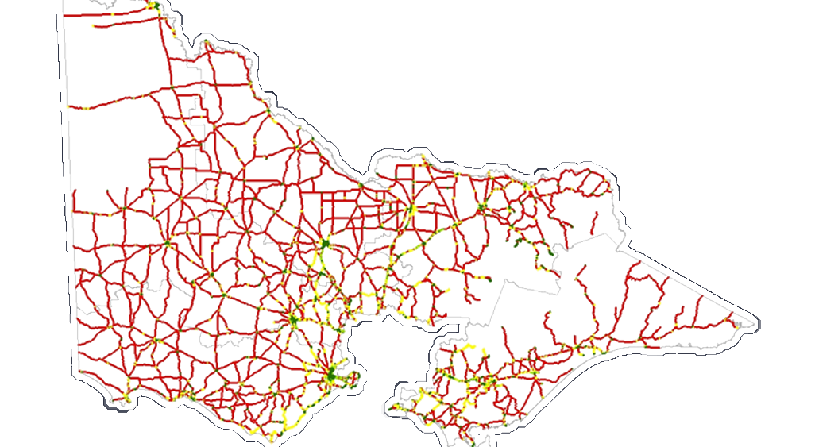
Victoria’s current road network
Press enter to continue
Well-aligned to the Safe System
Somewhat-aligned to the Safe System
Poorly-aligned to the Safe System
Source: Regional Roads Victoria
Notes:
Mapping the current state of the road network gives good insight into the general state of affairs. As this map shows for state controlled roads throughout the state of Victoria, most roads are poorly aligned to Safe System principles. This does not mean that these roads are sub-standard in the context of road design standards and guidelines, but instead highlights the inconsistencies between current design standards and what level of design actually ensures crash survivability.

Slide 16
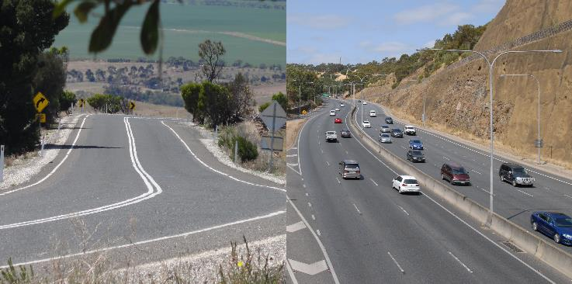
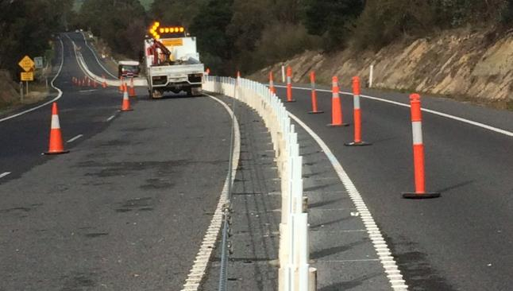
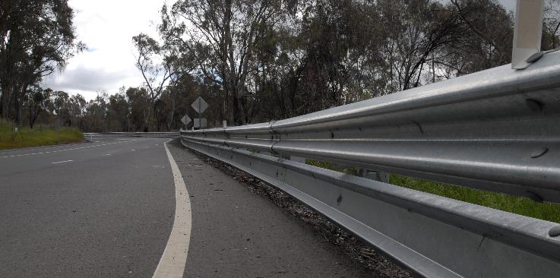
Mapping the current state
Press enter to continue
How is the network utilised?
What have we done and where?
Data collection is not always simple
Source: Centre for Automotive Safety Research
Source: Transport Accident Commission of Victoria
Source: Centre for Automotive Safety Research
Notes:
A key step in the process is to understand the ways in which the network is utilised, and how this utilisation is likely to change into the future. Such information is vitally important when it comes time to decide how investments will be distributed. Some roads may be little utilised and so will attract little future funding, relying more heavily on speed limit corrections. At the other end, some roads will form key strategic parts of the road network. These may be for reasons of mobility, such as with freeways, or they may be important for economic reasons, such as the roads that support substantial freight movements. Knowing what roads serve which functions will help to inform the quantum of investment that needs to be made.
Another task is to assess what has been done so far to improve the road network. While this may seem like a trivial matter, even understanding the locations of major infrastructure assets can be a challenging task. As previously discussed, different parts of the road network are controlled by different levels of government and even different organisations within government, making the task of data collection a challenging process.
Controlling entities also have varying and often relatively poor knowledge of what is contained on their network. For example, the locations of recently installed road safety barriers may be well documented, but knowledge of older barriers is often missing or lost in outdated databases. Compounding this issue is that of maintenance records, as even the safest infrastructure is no good if it is not maintained to operable levels. Again, new infrastructure may be well documented but older parts of the network are likely to be under-documented.

